Slide 1
Infection dynamics of two different FAdV strains and evaluation of the innate intestinal immune response using a chicken primary epithelial cell culture model INPOMED 2022
Katharina Strebinger, PhD candidate
Clinic for Poultry and Fish Medicine

Slide 2
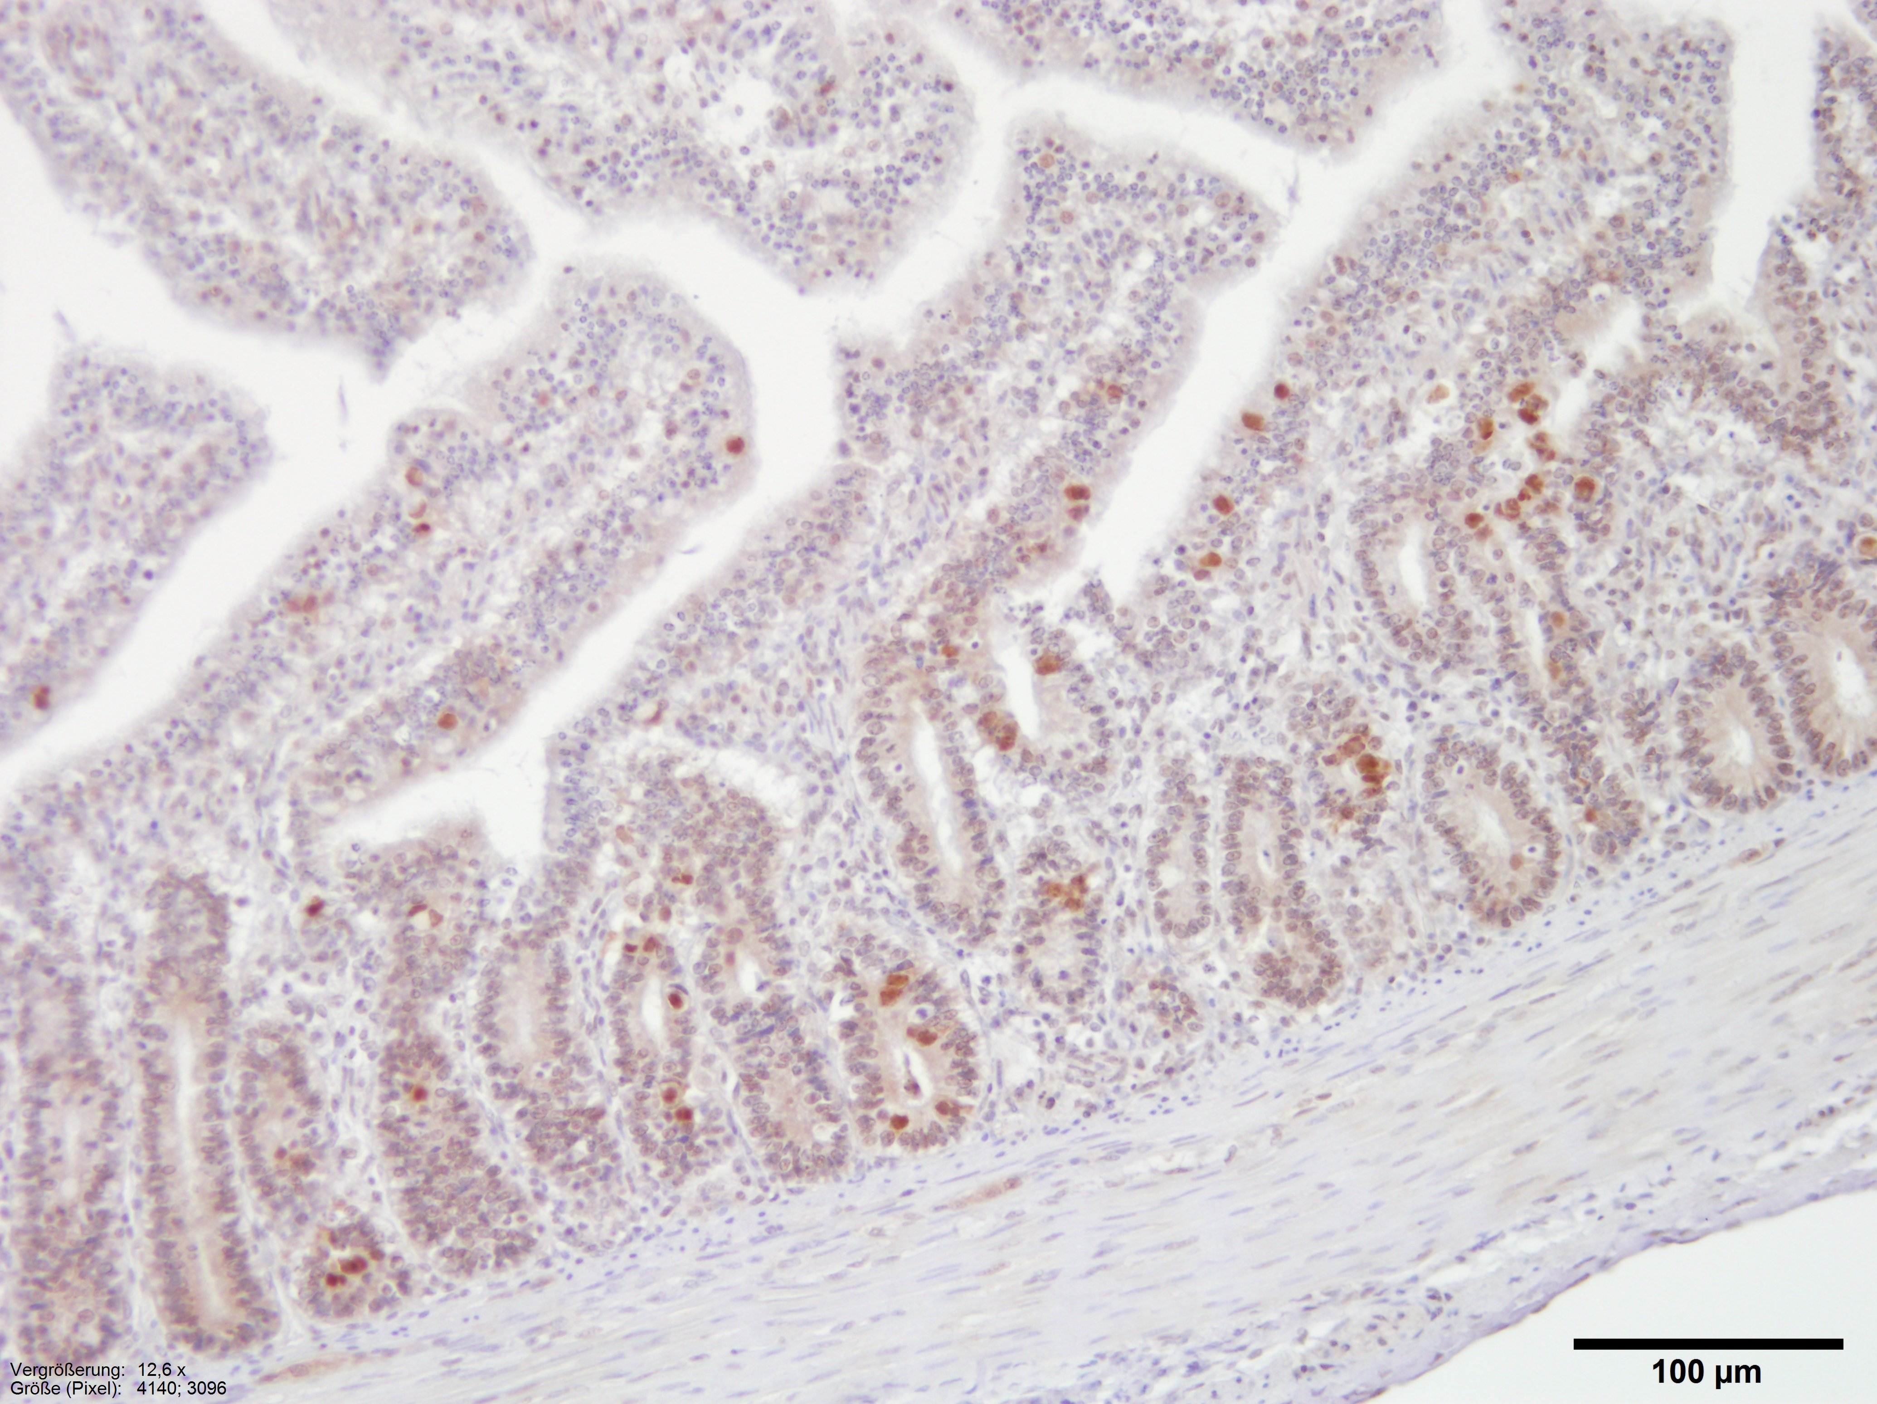
Introduction
intestine (particularly the epithelium)
is a major entry site for pathogenic microorganisms
little is known about the enteric innate immune response in chicken
mainly adapted immune system
intracellular (Th1) - vs. extracellular (Th2) immune response (Mosmann et al., 1986)
innate epithelium-pathogen interaction
crucial for immune defence
development of effective vaccines and therapies
in vitro
highly standardized system
less influencing factors
for example, FAdV (fowl aviadenovirus) detectable in intestine 12 hours after infection (Saifuddin and Wilks, 1991)
no studies in vitro
FAdV-D (fowl aviadenovirus-D) in chicken intestine

Slide 3
Hypotheses and objectives
hypotheses
The infection of intestinal epithelial cells with different virulent FAdV-C strains can be investigated using an in vitro model.
The innate immune response of intestinal epithelial against the FAdV strains cells can be demonstrated by the expression or Toll-like receptors (TLRs) and cytokines and is related to the virulence of the strains.
objectives
Establishment of a stable chicken intestinal tissue culture system that features extended passage conditions for in vitro infection studies.
Investigation of epithelial toll-like receptor regulation and cytokine expression in the in vitro system after infection with the model organism FAdV.
Notes:
We hypothesize, that with respect to the GI immune response in chicken there is a difference in local cytokine induction and epithelial cell events between an infection with extracellular or intracellular GI pathogens.
In order confirm our hypothesis, we will investigate the interaction between pathogens (intracellular and extracellular) and host epithelial cells, by means of live-cell-imaging-microscopy. Furthermore, determination of cytokine expression and immune cell regulation by utilization of different techniques, such as immunohistochemistry, in-situ hybridization, flow cytometry and gene expression profiling (RNA extraction and qRT-PCR) will be conducted. Additionally, the interaction of pathogens with the protective GI mucus and, consequently, with the epithelial cells, will be investigated

Slide 4
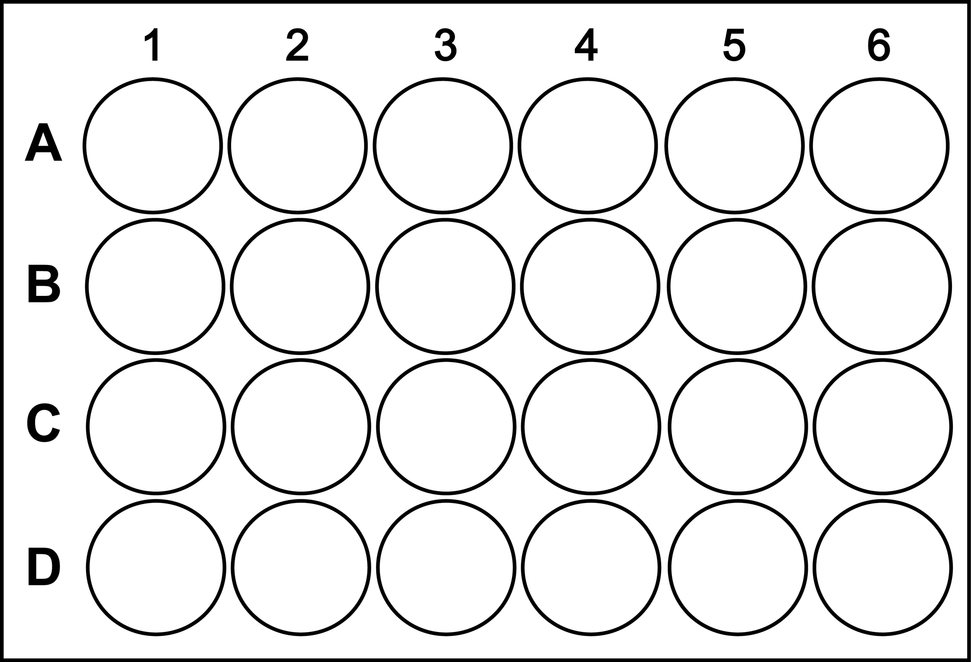
Setup of the experiment - Investigation of the epithelial innate immune response in vitro using a statistical relevant sample size
120 chicken embryos per trial
triplicate
epithelial cell culture
24 hours post seeding infection
KR5 (attenuated)
AG234 (virulent)
cell fixation
immunofluorescence
TUNEL assay
sample collection
RT-qPCR
proteomics
mass spectrometry
quantification of infected epithelial cells
expression analysis
TLRs
cytokines
RT-qPCR
IF + TUNEL assay
RT-qPCR
example for plate layout
“timepoint 4 hpi, infected with KR5”

Slide 5
I. Material and Methods Ia. Preparation of primary intestinal epithelial cell culture of chicken embryos
embryonated chicken eggs day 14
isolation of intestine
rinsing of organs until medium remained clear
digestion
collagenase II (50 minutes) at 37°C
washing steps
2% sorbitol
filtered
gauze
40 µm mesh width
modifications
media supplements
FBS-concentrations
digestion medium | washing medium | growth medium | maintenance medium
DMEM/F12 medium | DMEM/F12 medium | DMEM/F12 medium | DMEM/F12 medium
0,2 mg/ml collagenase II | sorbitol | 5 % FBS | 2,5 % FBS
penicillin |  | penicillin | penicillin
streptomycin |  | streptomycin | streptomycin
 |  | insulin | heparin sodium salt
 |  | human epidermal growth factor | HEPES
 |  | fibronectin
 |  | transferrin
 |  | heparin sodium salt
 |  | HEPES
protocol according to Byrne et al. 2017, Borrmann et al. 2007, Kaiser et al., 2017
Yuan et al., 2015
sample collection after 4h, 12h, 24h, 48h

Slide 6
Ib. Infection protocol with FAdV-C
primary intestinal cells
100 µl of virus suspension 10^{7,1}_{ID50} /ml
incubation 4 hours
sample collection 4h,12h, 24h and 48h methanol fixation paraformaldehyde fixation Trizol reagent
FAdV-C (serotype 4)
attenuated strain
KR5
virulent strain
AG234

Slide 7
Ic. Detection of infected and/or apoptotic cells
primary intestinal epithelial cells
immunofluorescence | apoptotic cells - TUNEL assay
1st antibodies anti-E-Cadherin 1:4,5 (monoclonal, mouse) anti-KR5 1:500 (polyclonal, rabbit) | detection of DNA fragments labelling 3′- hydroxyl termini in double-strand DNA breaks
2nd antibodies goat anti-mouse IgG Alexa Fluor 488 (1:500) goat anti-rabbit IgG Alexa Fluor 568 (1:100) | fluorescein labeled
DAPI 1:1000 | simple two-step kit according to manufacturers protocol

Slide 8
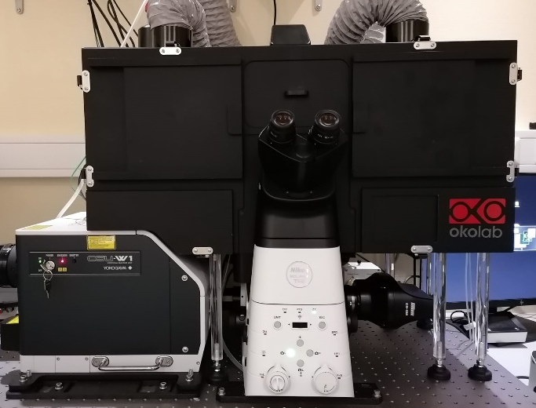
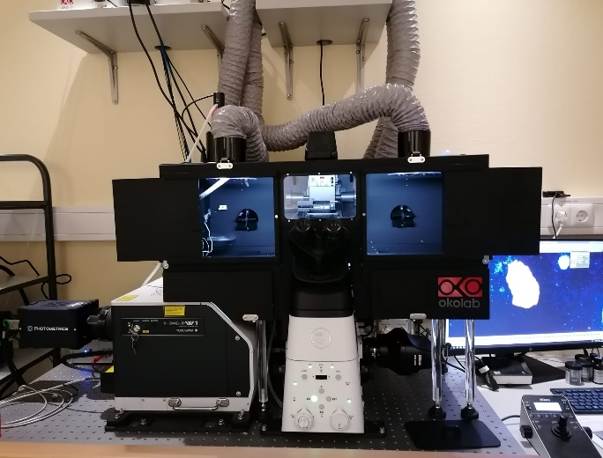
Id. Determination of total infected and/or apoptotic epithelial cell number
Nikon Eclipse Ti2-E/Yokogawa CSU-W1 Spinning Disk
inverted confocal spinning-disk microscope
live cell imaging
high-speed multidimensional imaging
dual camera system
fast capture of images
script edition “Fiji – ImageJ”
detection of epithelial surface area
ROI region of interest
analysis according to virus signal intensity

Slide 9
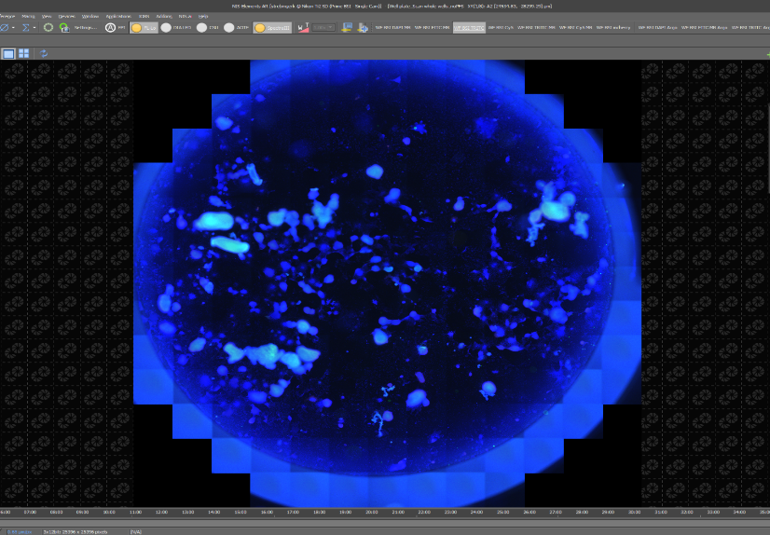
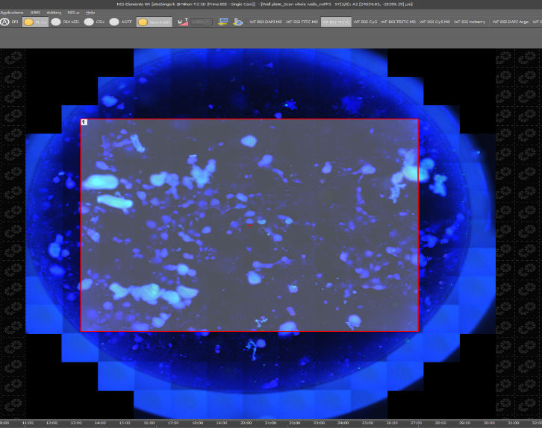
Quantification of infected epithelial cells
quantification of epithelial and/or infected cells
Nikon Eclipse Ti2-E/Yokogawa CSU-W1 Spinning Disk
overview of well plate
selection of well
determination region of interest (ROI)

Slide 10
Quantification of infected epithelial cells
selection of ROI (epithelial cells)
threshold setting (virus particles)

Slide 11
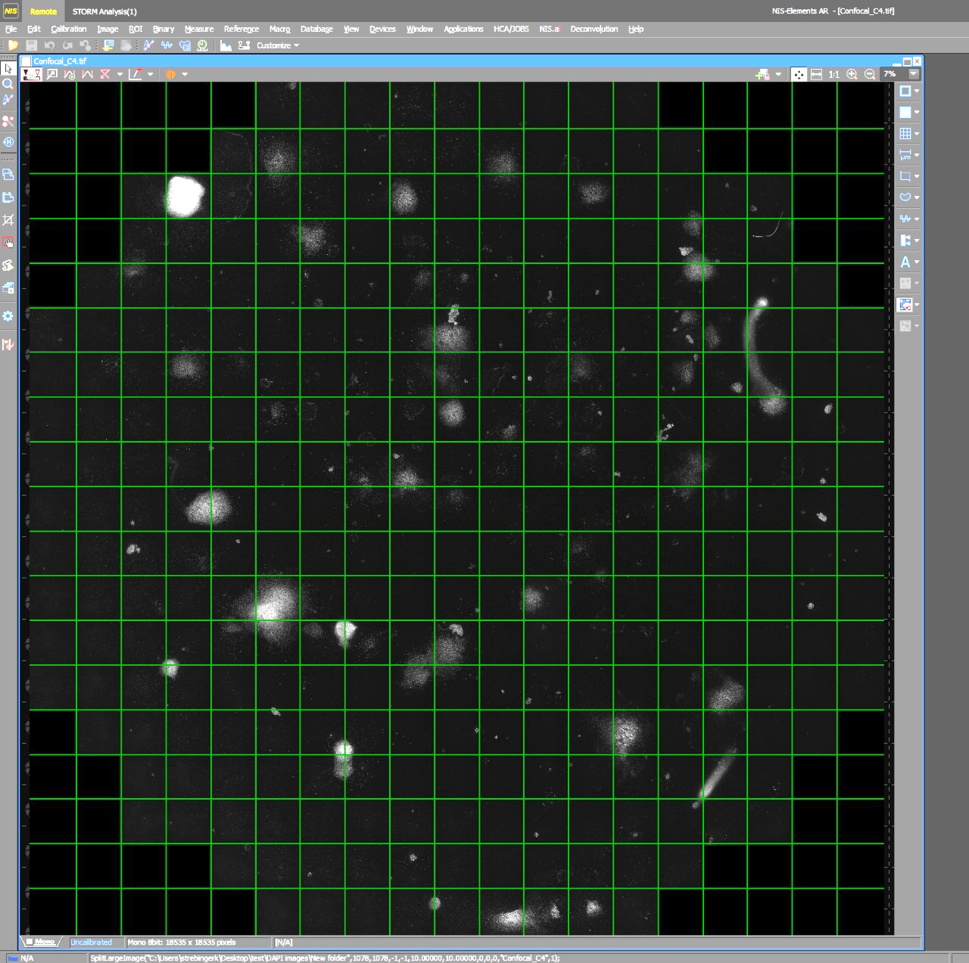
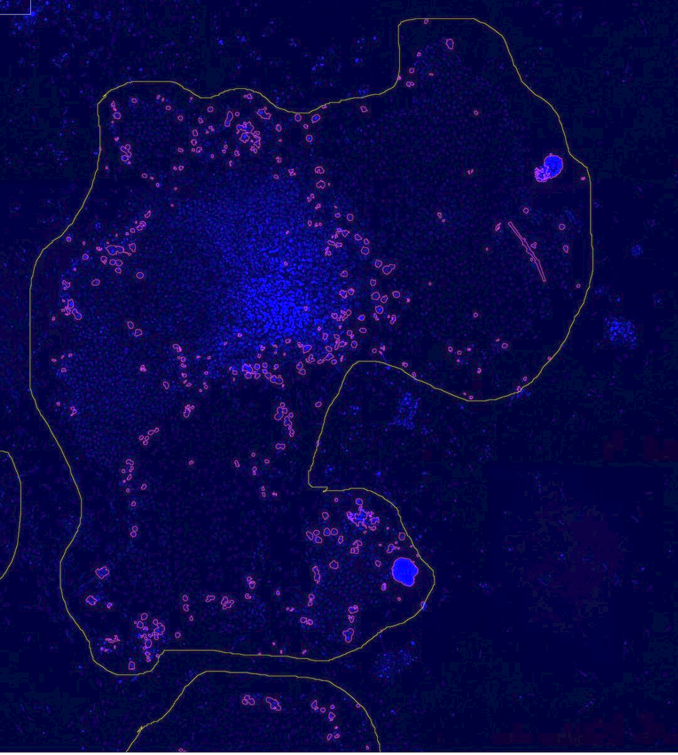
Quantification of infected epithelial cells
Splitting and stitching
overlay ROI, DAPI and virus particels

Slide 12
Quantification of infected epithelial cells
epithelial area and detection of virus signal

Slide 13
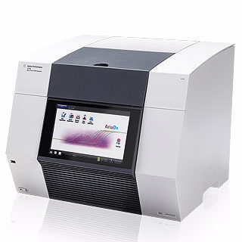
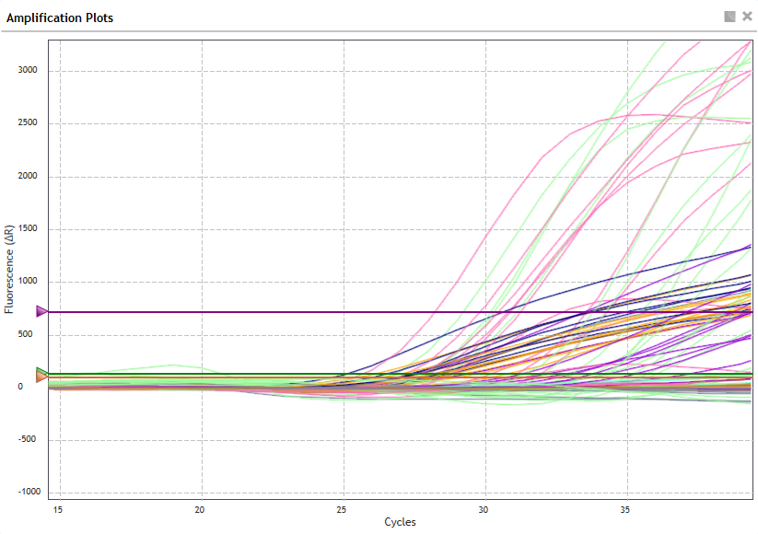
Ie. Gene expression analysis of TLRs, cytokines and protein extraction
RNA concentration
Nanodrop®
Qubit®
RNA quality assessment
Bioanalyzer ®
innate immune response markers
protein extraction
https://www.agilent.com/en/product/real-time-pcr-(qpcr)/real-time-pcr-(qpcr)-instruments/ariamx-real-time-pcr-system-software-pc/ariamx-real-time-pcr-system-232711
RT-qPCR AriaMx®
TLRs | proinflammatory cytokines | reference genes
TLR 1A TLR 2B TLR 1B TLR3 TLR4 TLR5 TLR6 TLR7 TLR13 TLR21 | IL-1β IL-6 INF-ɣ IL-13 | TBP RPL13
graphical display of gene expression

Slide 14
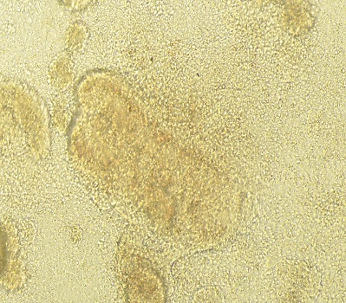
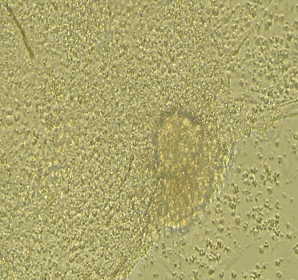
II. Results IIa. Primary intestinal epithelial cell culture from embryos
proof for epithelial origin → E-Cadherin marker !
0 hours
24 hours
48 hours
20x
20x
20x

Slide 15
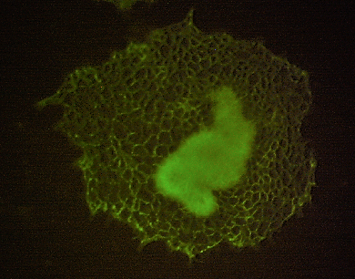
IIb. E-Cadherin staining and virus marker
10x
AG234
E-Cadherin
E-Cadherin
monoclonal antibody E-Cadherin
marker for epithelial cells
polyclonal antibody KR5
marker for FAdV strains KR5 and AG234
10x

Slide 16
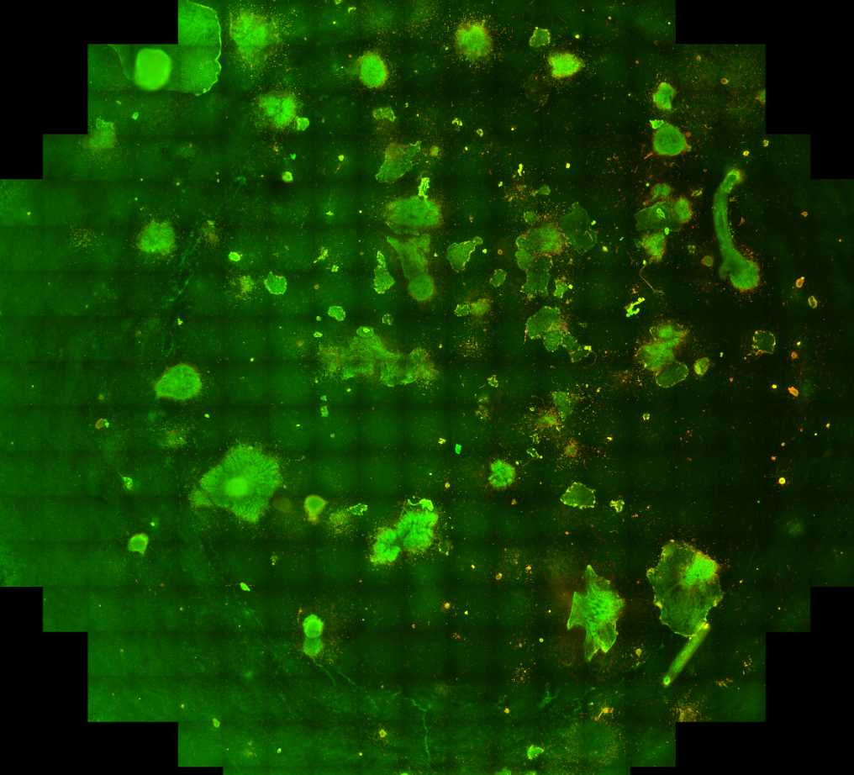
IIc. Overview of selected well
intestinal crypt containing stemcells
outgrowing epithelial cells
E-Cadherin
epithelial cells 24 hps

Slide 17
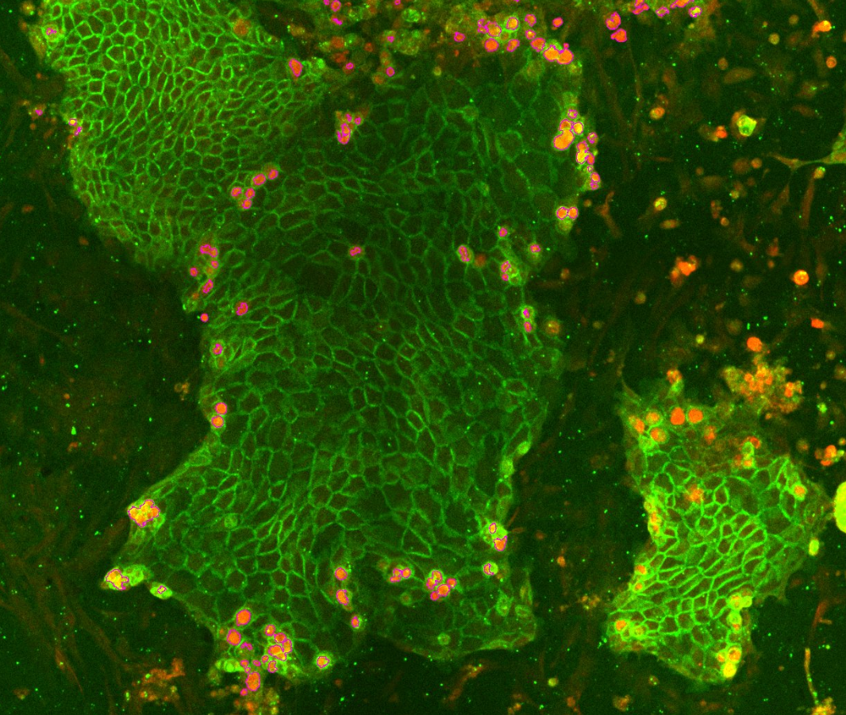
Quantification of epithelial and/or infected cells

Slide 18
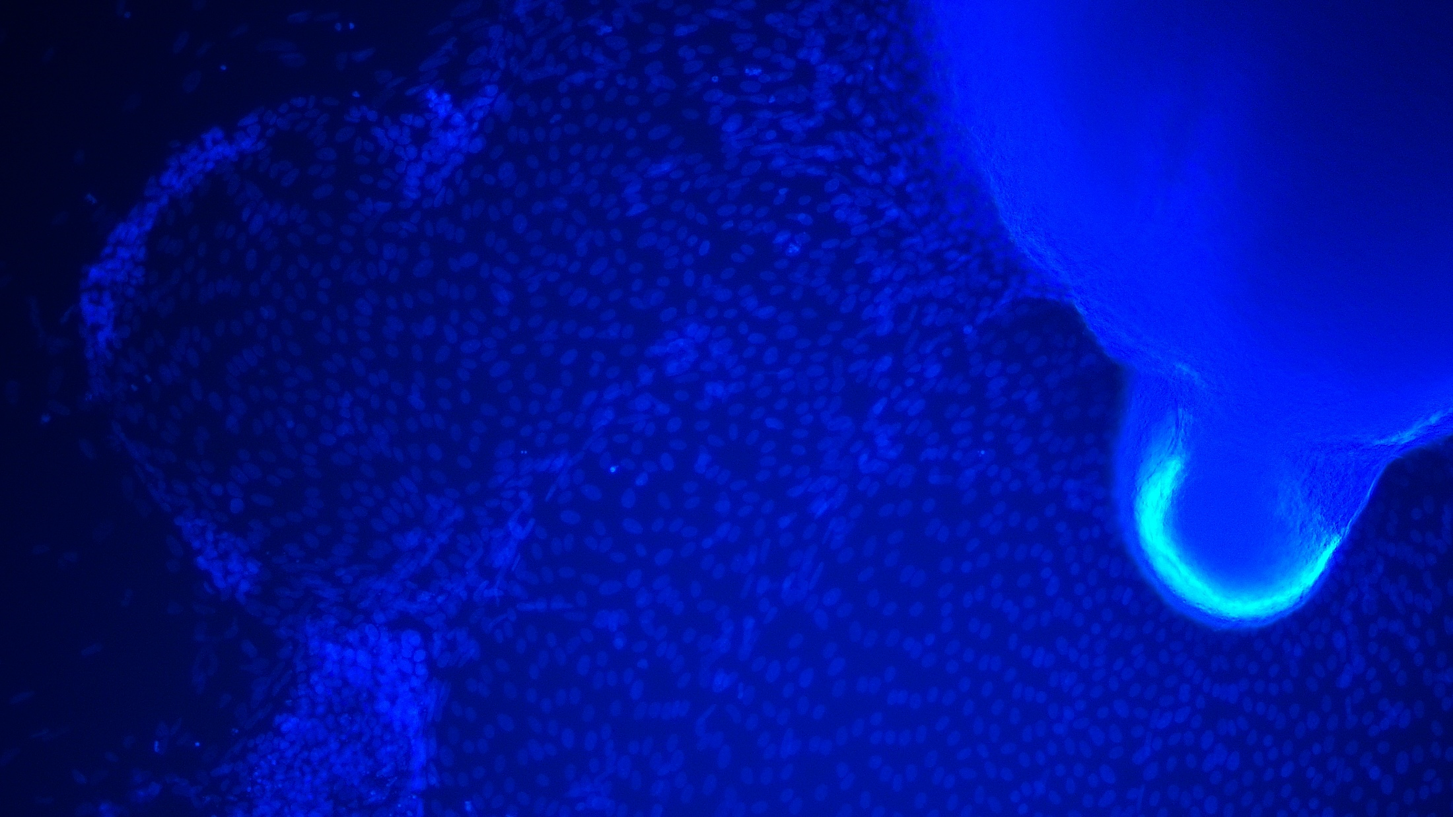
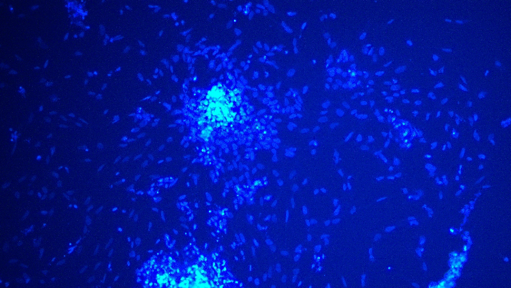
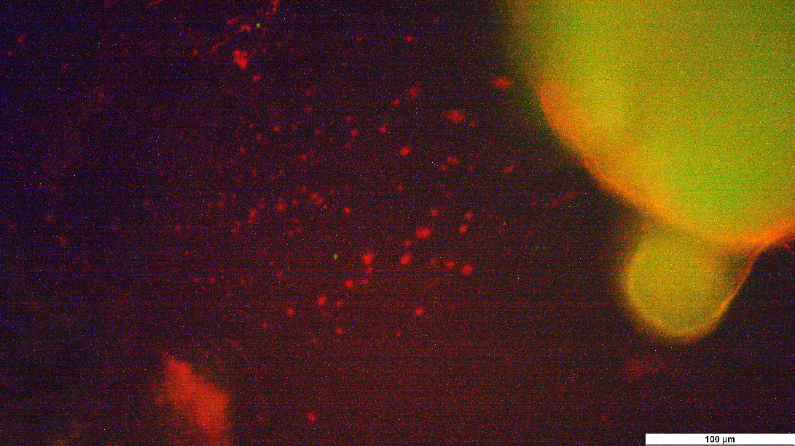
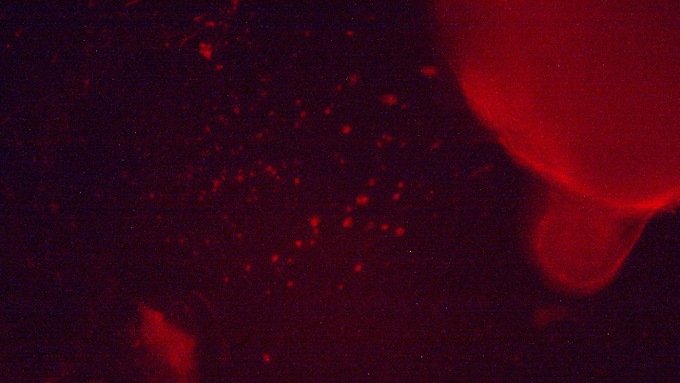
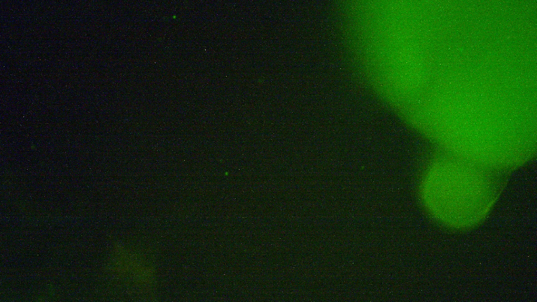
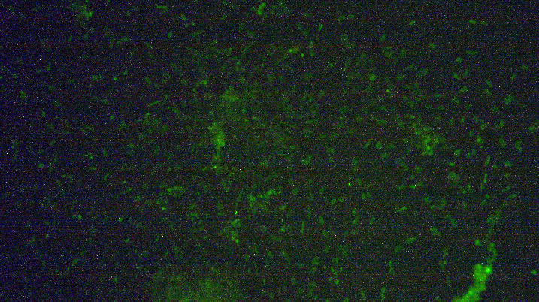
TUNEL assay – apoptosis detection
AG234 infected
positive control
DAPI
DAPI
AG234
AG234
merged
TUNEL
TUNEL

Slide 19
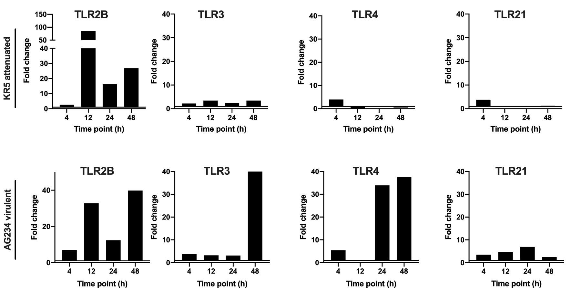
IIe. Detection of TLRs and cytokines
preliminary data
KR5: 33% analyzed
AG234: 66% analyzed

Slide 20
IIe. Detection of TLRs and cytokines
preliminary data
KR5: 33% analyzed
AG234: 66% analyzed

Slide 21
Summary/conclusion/outlook
summary
modification of
in vitro system of chicken embryos
primary intestinal cell culture
model pathogens to survey in vitro system
FAdV: KR5 (attenuated) and AG234 (virulent) strain
visualization of infection and cell death
immunofluorescence and TUNEL assay
preliminary quantification of TLR- and cytokine expression
↑ TLR2B after 12 hpi in both viruses
↑ TLR3 after 48 hpi for AG234
↑ TLR4 after 24hpi for AG234
cytkoine expression after 48 hpi for AG234 more increased than for KR5
conclusion
preliminary data indicates time dependant propagation of virus in epithelial cells
increased TLR and cytokine expression induced by the virulent strain were apparently stronger than those observed in cells infected with attenuated strain
outlook
remaining analysis
quantification of infected epithelial cells
protein extraction for further proteomic experiments

Slide 22
Acknowledgements
Clinic for Poultry and Fish Medicine
Dieter Liebhart
Michael Hess
Taniya Mitra
Beatrice Grafl
Patricia Wernsdorfer
Veterinary Research Institute Brno
Ivan Rychlik
Vetcore Vetmeuni Vienna
Ursula Reichart
Reinhard Ertl

