Slide 1
Differences in the innate immune response of a macrophage cell line against the extracellular parasite Histomonas meleagridis and intracellular fowl adenovirus
Taniya Mitra¹, Anna Weidinger¹, Sarah Heidl¹, Mozhgan Rezaee Sharokhyan²,
Tamas Hatfaludi², Anna Schachner², Michael Hess^{1,2}, Dieter Liebhart¹
¹Clinic for Poultry and Fish Medicine, Department for Farm Animals and Veterinary Public Health, University of Veterinary Medicine, Vienna, Austria
²Christian Doppler Laboratory for Innovative Poultry Vaccines (IPOV), University of Veterinary Medicine, Vienna, Austria

Slide 2
Introduction
pathogen associated innate immune response
PAMP of extracellular pathogen
TLR
TLR
APC
macrophage
TLR
TLR
PAMP of intracellular pathogen
? key TLRs involved
? interaction time
? up-regulation vs down-regulation

Slide 3
Toll-like receptors
part of innate immune response
key role in immune homeostasis
defense against infections
interplay between cells of innate and adaptive immunity
avian pathogen | involved TLRs | reference
bacteria | 2, 4, 5, 15 | Yilmaz et al., 2005
fungus | 2a, 2b | Higgs et al., 2006
virus | 1b, 3, 7 | Iqbal et al., 2005; Roach et al., 2005; Higgs et al., 2006; Philbin et al., 2005
intracellular parasite | 3, 15 | Summers et al., 2011; Zhang et al., 2013; Zhou et al., 2014
extracellular parasite | 1a, 2b, 4, 21 | Mitra et al., 2021
aim
to compare TLR response against the extracellular parasite Histomonas meleagridis and the intracellular Fowl adenovirus by using an in vitro model

Slide 4
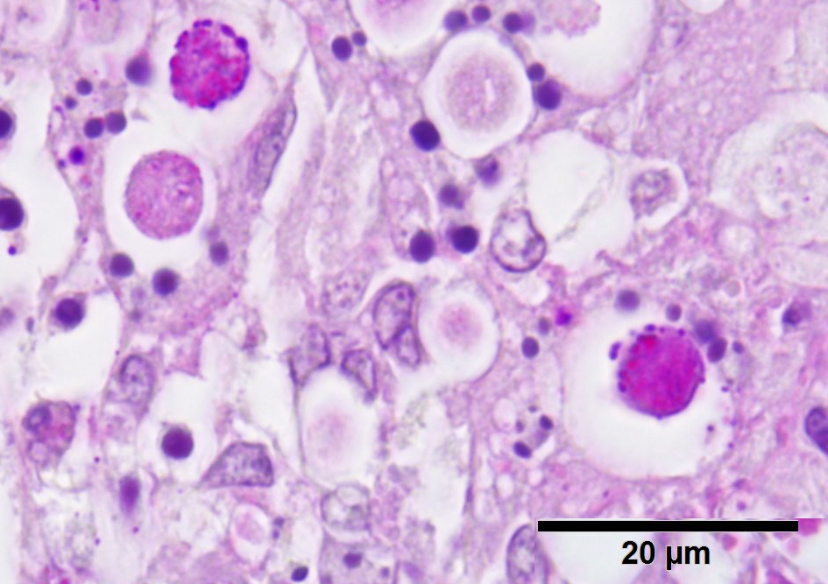
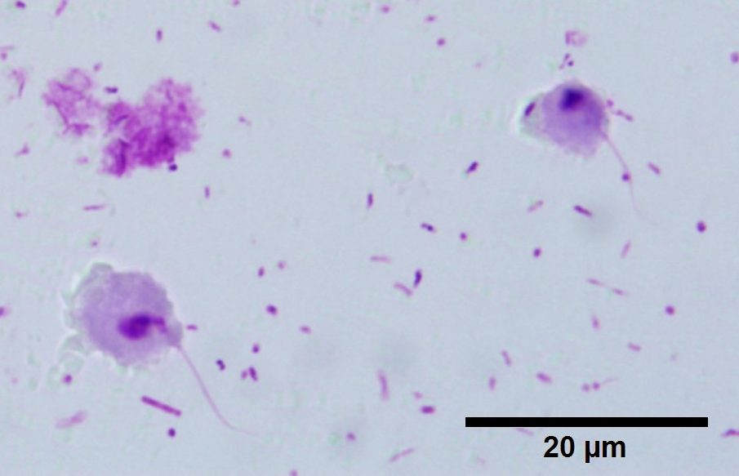
Histomonas meleagridis
extracellular protozoan parasite
flagellated trophozoites (6-20µm), invasive form
causes severe losses in poultry flocks
caeca and liver are most affected organs
in chickens mainly decrease in weight gain / drop in egg production economic losses
limited knowledge on innate immune response
H. meleagridis in the tissue (liver of a chicken, PAS stain)
smears of H. meleagridis from culture (Giemsa stain)

Slide 5
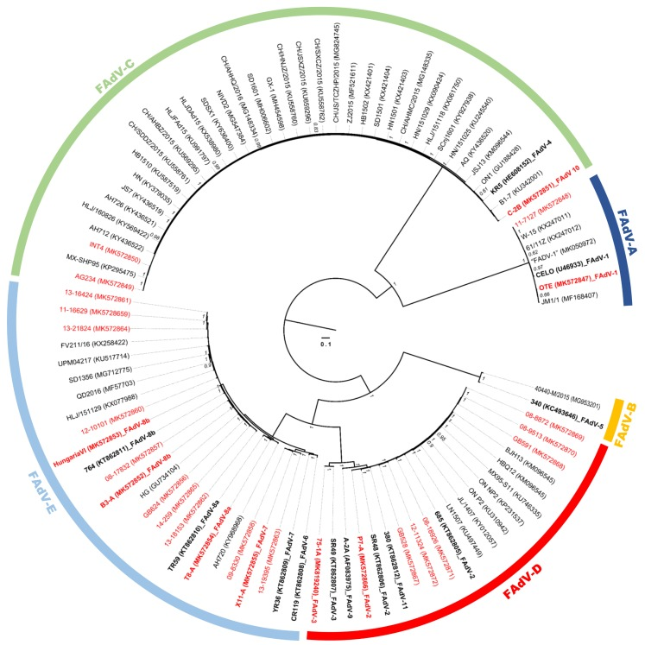
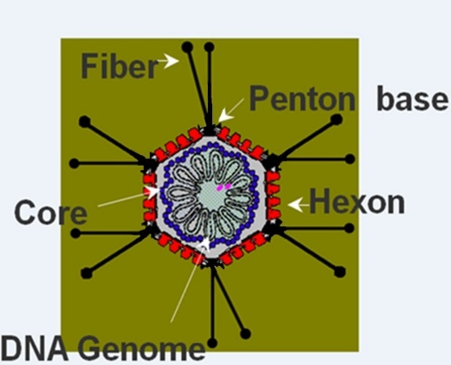
Fowl aviadenovirus
intracellular virus
double-stranded DNA
genome size:~45 kb
particle: non-enveloped, 70-90 nm
severe losses in poultry industry worldwide
metabolic disease
disease affects gastro- intestinal tract and internal organs (e.g. liver, bursa of Fabricius)
selected strain CR119
apathogenic FAdV-6 strain
selected reference strain
Schachner et al., 2019

Slide 6
Experimental layout
HD11
(chicken macrophage)
H. meleagridis with E. coli
only E. coli
positive control: LPS
negative control: only media
extracellular
intracellular
FAdV-6
positive control: LPS
negative control: only media

Slide 7
Experimental layout
comparing different TLRs expression
interaction
sampling
nucleic acid isolation
design primers and probes
establishment of RT-qPCR
calculation of fold change
statistical test
TLR1A
TLR1B
TLR2A
TLR2B
TLR3
TLR4
TLR5
TLR7
TLR21
singleplex
2^{-∆∆CT}
corrected to E. coli expression influence
and
t-test
96h
2h
4h
microscopic analysis
hpi¹
RNA
72h
6h
48h
24h
12h
multiplex
¹hpi: hours post infection

Slide 8
HD11+histomonads: TLR gene expression
*
*
*
*
*
*
*
*
*
*
*
*
*
*
*
*
*
*
*
*
*
*
*
*
*
expressed in non-infected cells but not expressed in infected cells
not expressed in non-infected and infected cells
no expression of TLR2a in HD11 cells
absence of signal after infection with histomonads for TLR3, 5 and 7
down-regulation of TLR1a and 2b until 4 hpi before significant up-regulation
up-regulation of TLR1b, TLR4 and TLR21 significantly increases at several time points

Slide 9
HD11+FAdV-6: TLR gene expression
*
*
*
*
*
*
*
expressed in non-infected cells but not expressed in infected cells
not expressed in non-infected and infected cells
no expression of TLR2a in HD11 cells
absence of signal after infection with FAdV-6 for TLR1a, 4 and 5
down-regulation of TLR2b and 7 at all measured time points
TLR1b down-regulated up to 12hpi and up-regulated until 72hpi with partly significant up-regulation, afterwards again down-regulated
TLR3 and 21 were down-regulated up to 12hpi before a continuous and partly significant up-regulation

Slide 10
Summary
extracellular pathogen H. meleagridis
intracellular pathogen FAdV-6
key TLRs
TLR1a, 2b, 4 and 21
TLR1b, 3 and 21
time
early innate: 2hpi
late innate: 24hpi
TLR3, 5 and 7
no expression after infection
TLR1a, 4 and 5

Slide 11
conclusion
extracellular pathogen
intracellular pathogen
ligand: exosomal
time requirement: faster host cell response
ligand: endosomal mainly
time requirement: longer interaction needed
The current cell culture model can be used to observe the innate TLR response for other virus or parasite
future research
functionality of TLRs
cell pathogen interaction: infection vs. phagocytosis
monoclonal antibody
development of monoclonal antibodies for TLRs
flow cytometry
measurement of TLRs at protein level

Slide 12
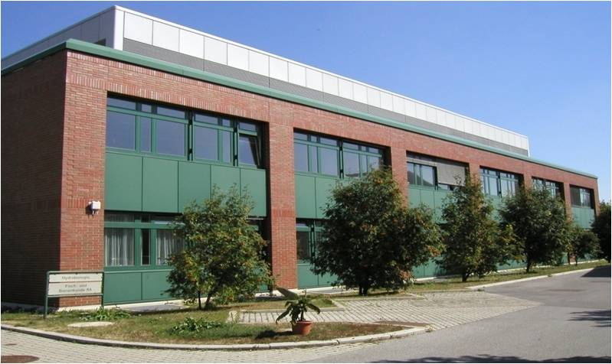
Thank you for your attention!
Team of Clinical Unit of Poultry Medicine
Clinic for Poultry and Fish Medicine
Department for Farm Animals and
Veterinary Public Health

