Slide 1
Establishment of tools to determine the immune response of poultry against intestinal pathogens as part of the INPOMED project
Dieter Liebhart
Clinic for Poultry and Fish Medicine, University of Veterinary Medicine, Vienna, Austria

Slide 2
Introduction INPOMED - „Innovations in Poultry Medicine”
Implementation of a cross-boarder project with Czech Republic and Austria to enhance poultry medicine
project number: ATCZ194
duration: 06/2019-05/2022 programme Interreg V-A AT-CZ 2014-2020

Slide 3
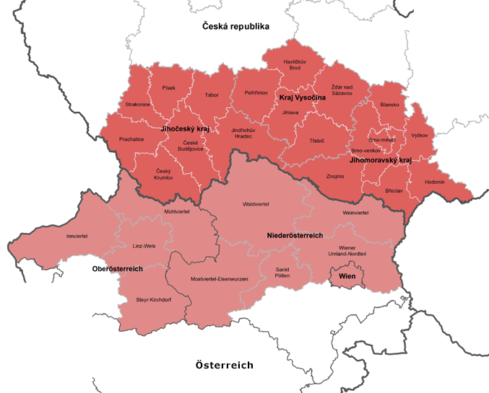
Cross-boarder area
Czech Republic
Jihočeský kraj
Kraj Vysočina
Jihomoravský kraj
Austria
Wien
Oberösterreich (partly)
Niederösterreich (partly)
Notes:
south bohemia, vysocina region, south moravian region

Slide 4
Aim and organization of INPOMED
main aim
use cross-border communication and synergies of both project partners to support veterinarians in the region to improve poultry health
organization
lead partner
Veterinary Research Institute (represented by Ivan Rychlik)
focus: gut health, microbiota
project partner
University of Veterinary Medicine
Department for Farm Animals and Veterinary Public Health
Clinic for Poultry and Fish Medicine (represented by Dieter Liebhart)
focus: poultry immunology
Working Packages (WP) of the project
preparation – management – communication – implementation
strategy – enhance research and development
pilot project: intestinal health of poultry
transfer of knowledge

Slide 5
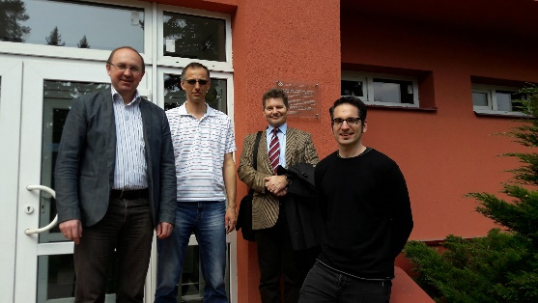
Preparation
1st meeting: 3rd of Apr., 2017 in Brno
planning of the project
decision on lead partner (Veterinary Research Institute)
2nd meeting: 16th of Oct., 2017 in Vienna
discussion on scientific aspects
participation Interreg information event: 30th of Nov., 2017 in St. Pölten, Austria (D. Liebhart)
visits at the Joint Technical Secretary: 26th of Jun., 2017 and 19th of Nov. 2018 in Vienna, Austria

Slide 6
Management
Activity | Detail output | Specification | Quantity
M1.1 | Meetings of the Strategic Advisory Board (SAB with Alois Cizek, Jiri Bures, Harald Schliessnig, Michael Hess) | Once a year on the occasion of the annual meetings (including kick-off and final meeting). Discussion / review of the past period, preparation of proposals / recommendations for the next period. | 3 (once per year, including kick off and final meeting)
M2.1 | Meetings of the Management Board (MB) | In half-year intervals (including kick-off and final meeting) held personal meetings of the Management Board, including preparation of a meeting minutes. | 6 (half a year) attached to meeting of the SAB
M2.2 | Preparation of the scientific and financial reports | Preparation of interim and final reports | 6 (half a year)

Slide 7
Communication
Activity | Detail output | Specification | Quantity
C1.1 | PR-texts/(short) papers | On the occasion of large-scale public project events, paid articles with content determined by us are published in regional newspapers or journals. | 8 (in regional newspapers or professional journals)
C2.1 | Installation of social media | Creation of information pages on Twitter, Facebook and similar media. | 3 (Twitter, Facebook, etc.)
C3.1 | Scientific publications | Publications in German, Czech or English are created and published. | 2

Slide 8
Implementation
Working Package T1
strategy – enhance research and development
main output: Cross-border training and intercultural activities
Activity | Detail output | Specification | Quantity
T1.1.1 | Preparation (to define agenda, location, etc.) | The general agenda is related to the preparation of seminars, such as selection of a conference venue, selection and invitation of speakers and addressing potential participants. | 2
T1.1.2 | Workshops | Holding of events, implementation of programs | 2
T.1.1.3 | Catalogue (summary of the events showing the most prominent problems in poultry farms) | From the seminars, a collection of abstracts will be published, to which the final summary of the organizers of the meeting will be added, focusing in particular on identifying the most urgent problems in poultry farms in relation to animal health. | 1

Slide 9
T1 continued
Activity | Task | Specification | Quantity
T.1.2.1 | Meeting 1 in Brno | At this meeting, VUW partners will be presented with the VRI's current workplace introducing options for infrastructure and know-how exchange. | 1
T.1.2.2 | Meeting 2 in Vienna | At this meeting, VRI partners will be presented with the current VUW location, listing options for infrastructure and know-how exchange. | 1
T.1.2.3 | Project cooperation-plan (use zoning plan) | Following seminars in the T1.1 activity and previous visits (activities T1.2.1 and T1.2.2), a project cooperation plan will be established, the theme of which will be set during the T1.1 activity seminars. The result will be the clear identification of the topic for the pilot research project in follow-up activity T1.3. | 1
T1.3.1 | Structuring processes | To strengthen R&D in the practices and to better integrate with research at VRI/VUW, taking into account the outcomes of T1.1 and T1.2 | 1
T1.3.2 | Establishing a working program | Elaboration of a possible joint work program to investigate important current issues in poultry medicine | 1
T1.4.1 | Symposia | Symposia with strategic partners from the poultry sector back to back with T1.1.2 (Workshops) regional veterinarian companies are invited to contact the project partners with problems concerning poultry health. The partners use their expertise and research results to work out a possible solution. | 2

Slide 10
Implementation
Working Package T2
pilot project: Intestinal health of poultry
main output: Research to increase the R&I of poultry veterinarians in the field of poultry health, in particular poultry immunology and the
Activity | Task | Specification | Quantity
T2.1.1 | Research in immune reaction against pathogens | The immune response against various infectious agents is being investigated in order to develop new approaches for prophylaxis and therapy. For this purpose, scientific experiments are carried out and evaluated. | 1
T2.1.2 | Tech transfer (ISH) | In situ hybridization is used to study probiotic cultures. VRI staff will be trained in this technique during a visit to VUW. Then, during a reciprocal visit to Brno, the trained personnel under the supervision of the VUW will begin the investigations. | 1
T2.2.1 | Research microbiota | New findings on the composition of the intestinal microbiome of poultry. For this purpose, scientific experiments are carried out and evaluated. | 1
T2.2.2 | Manipulation of microbiota | The positive manipulation of the gut microbiota of the poultry is intended to promote the R & D of the poultry vets and to improve the treatment of poultry. In this output, the scientific findings from T2.2.1 are actively put into practice. | 1
T2.3.1 | Survey with Vets/SME | Evaluation sheets among veterinarians | 1

Slide 11
Implementation
Working Package T3
transfer of knowledge
main output: Exchange of scientific know-how
Activity | Task | Specification | Quantity
T3.1.1 | Exchange of experts CZ-AT | Visits of researchers are held to conduct joint experiments, collect samples and transfer of know-how from one job to another. These visits also include visits to farms to discuss real problems with poultry farming. | 3
T3.1.2 | Exchange of experts AT-CZ | As written above. | 3
T3.2.1 | Conference | There are regular meetings of researchers, poultry farmers and veterinarians at organized conferences. These meetings involve an intensive transfer of information, not only from research into practice, but also from practice to research. | 3
T3.3.1 | Teaching scripts in powerpoint to University and Vets/SME | Presentation in PPT format summarizes the ongoing and outstanding project results. The presentation will be stored in the internal central storage systems for teaching materials of the two institutions and sent to the target group of the poultry veterinarians. | 6

Slide 12
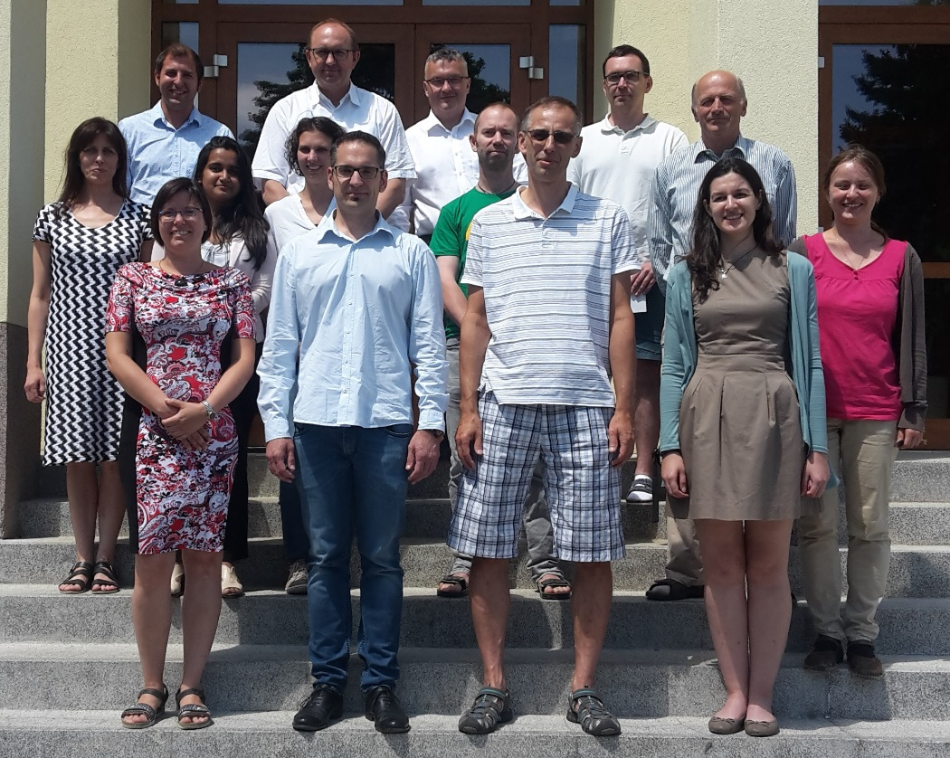
Kick-off meeting
Brno, 3rd of July 2019
initiation of the project

Slide 13
Research topics
Tools to investigate host responses/gut health against infectious diseases including model organisms
Virus – fowl adenovirus (FAdV)
Parasite – Histomonas meleagridis
Bacterium – Escherichia coli

Slide 14
Establishing a primary intestinal epithelial cell culture model to investigate FAdV infection
intestines of birds or chicken embryos
isolation of duodenum
rinsing of organs until medium remained clear
digestion
collagenase and dispase II (2 hours) at 37°C
washing steps
2% sorbitol
filtration
different mesh width (40µm – 900µm)
modifications
media supplements
hEGF, insulin, transferrin, fibronectin
culture conditions
37°C vs. 41°C
FBS-concentrations
5%, 10%, 20%, 30%
Growth medium | Maintenance medium
DMEM/F12 medium | DMEM/F12 medium
50 µg gentaimcin | 10µg/ml insulin
100 (U/ml) penicillin | 2.5% FBS
100µg/ml streptomycin | -
2.5% FBS | -
10µg/ml insulin | -
1,4µg/ml hydrocortisone | -
1µg/ml fibronectin | -
5µg/ml transferrin | -
protocol according to Kaiser et al., 2017

Slide 15
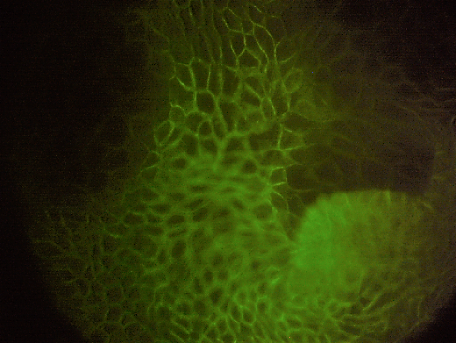
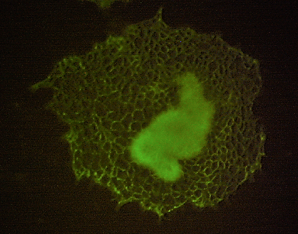
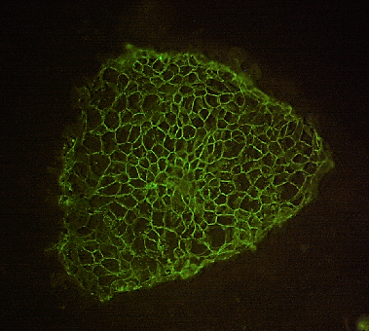
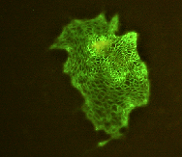
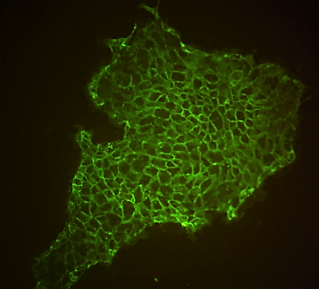
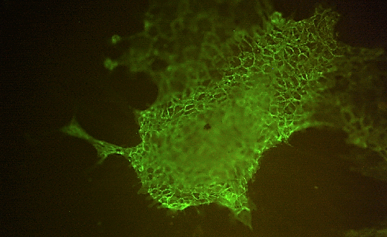
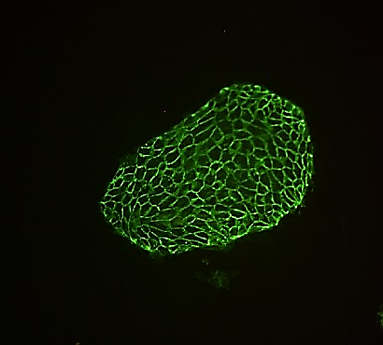
Intestinal epithelial cells in a primary cell culture
0 hours
24 hours
48 hours
72 hours
E-Cadherin
10x
E-Cadherin
40x
E-Cadherin
10x
E-Cadherin
10x
Day 4
Day 5
Day 6
Day 7
E-Cadherin
10x
E-Cadherin
10x
E-Cadherin
10x
E-Cadherin
10x
epithelial character up to 7 days

Slide 16
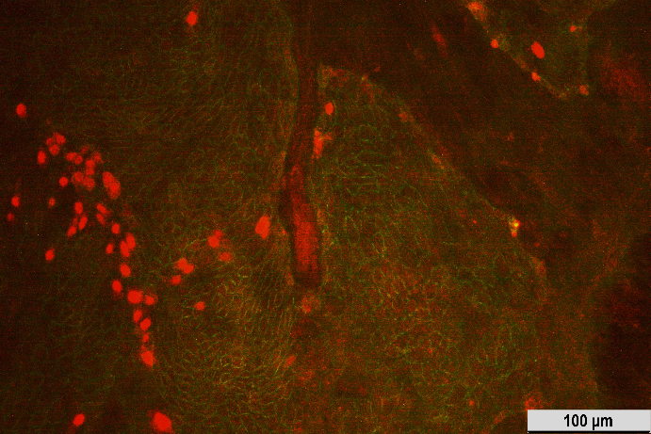
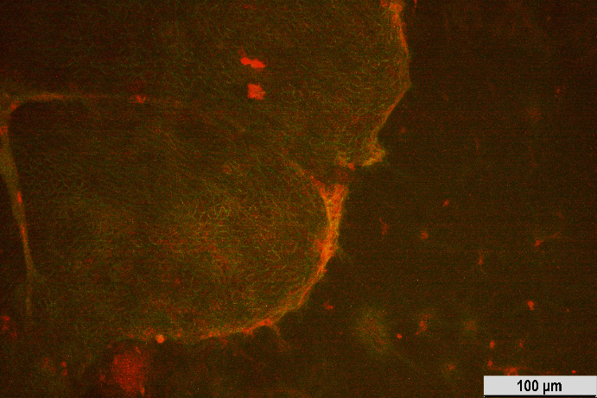
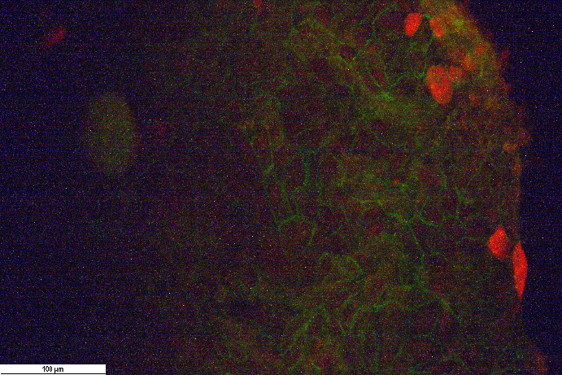
Infection with FAdV-D
SR48
E-Cadherin
SR48
E-Cadherin
SR48
E-Cadherin
SR48
E-Cadherin
SR48
E-Cadherin
SR48
E-Cadherin

Slide 17
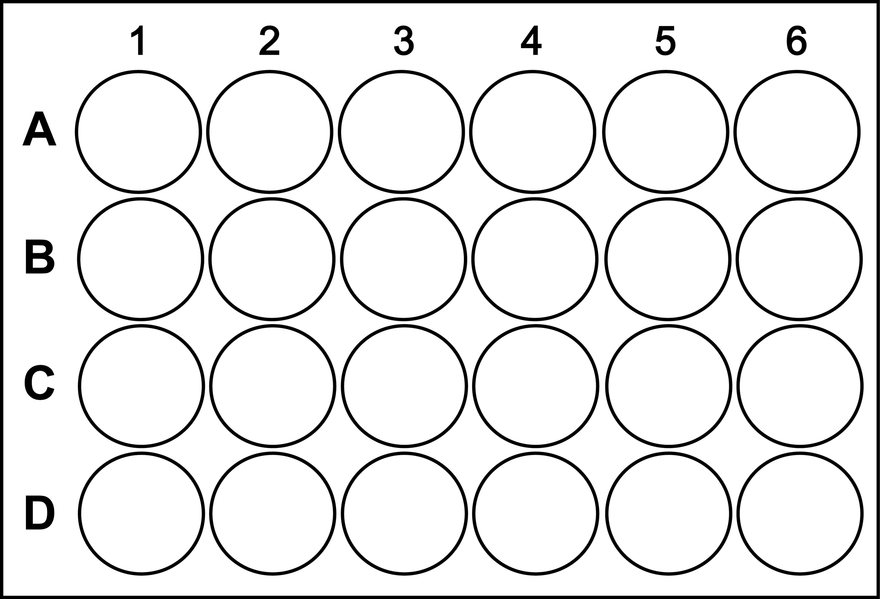
Experimental application of the cell culture tool
120 chicken embryos per trial
triplicate
epithelial cell culture
24 hours post seeding infection
KR5 (attenuated)
AG234 (virulent)
cell fixation
immunofluorescence
TUNEL assay
sample collection
RT-qPCR
proteomics
mass spectrometry
quantification of infected epithelial cells
expression analysis
Toll-like receptors (TLRs)
cytokines
RT-qPCR
IF + TUNEL assay
RT-qPCR
example for plate layout
“timepoint 4 hpi, infected with KR5”

Slide 18
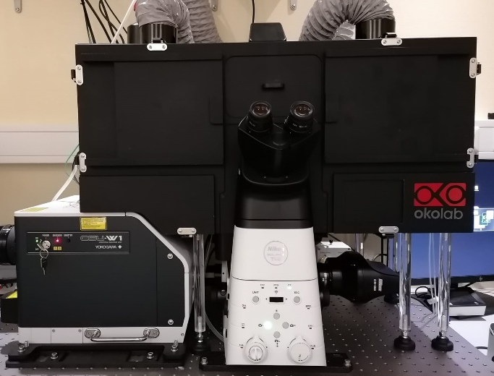
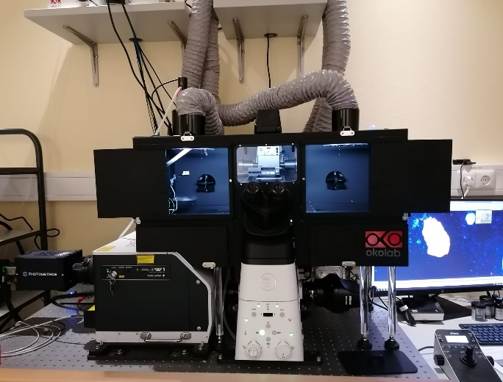
Image analyses of the infected cell culture
Nikon Eclipse Ti2-E/Yokogawa CSU-W1 Spinning Disk
inverted confocal spinning-disk microscope
live cell imaging
high-speed multidimensional imaging
dual camera system
fast capture of images
script edition “Fiji – ImageJ”
detection of epithelial surface area
ROI region of interest
analysis according to virus signal intensity

Slide 19
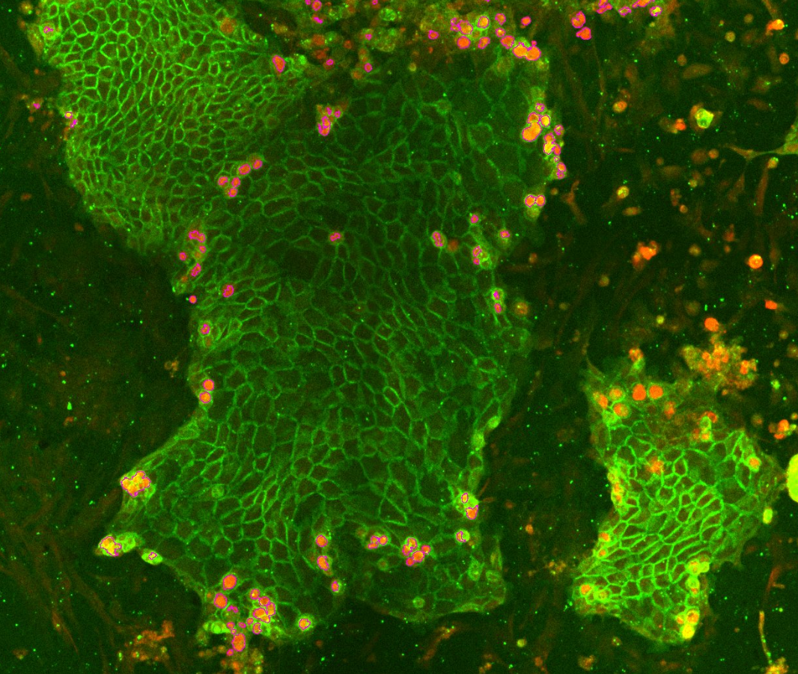
Quantification of epithelial and/or infected cells

Slide 20
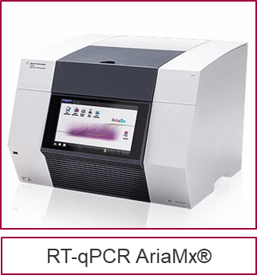
Gene expression analysis of cytokines
preliminary data
KR5: 33% analyzed
AG234: 66% analyzed

Slide 21
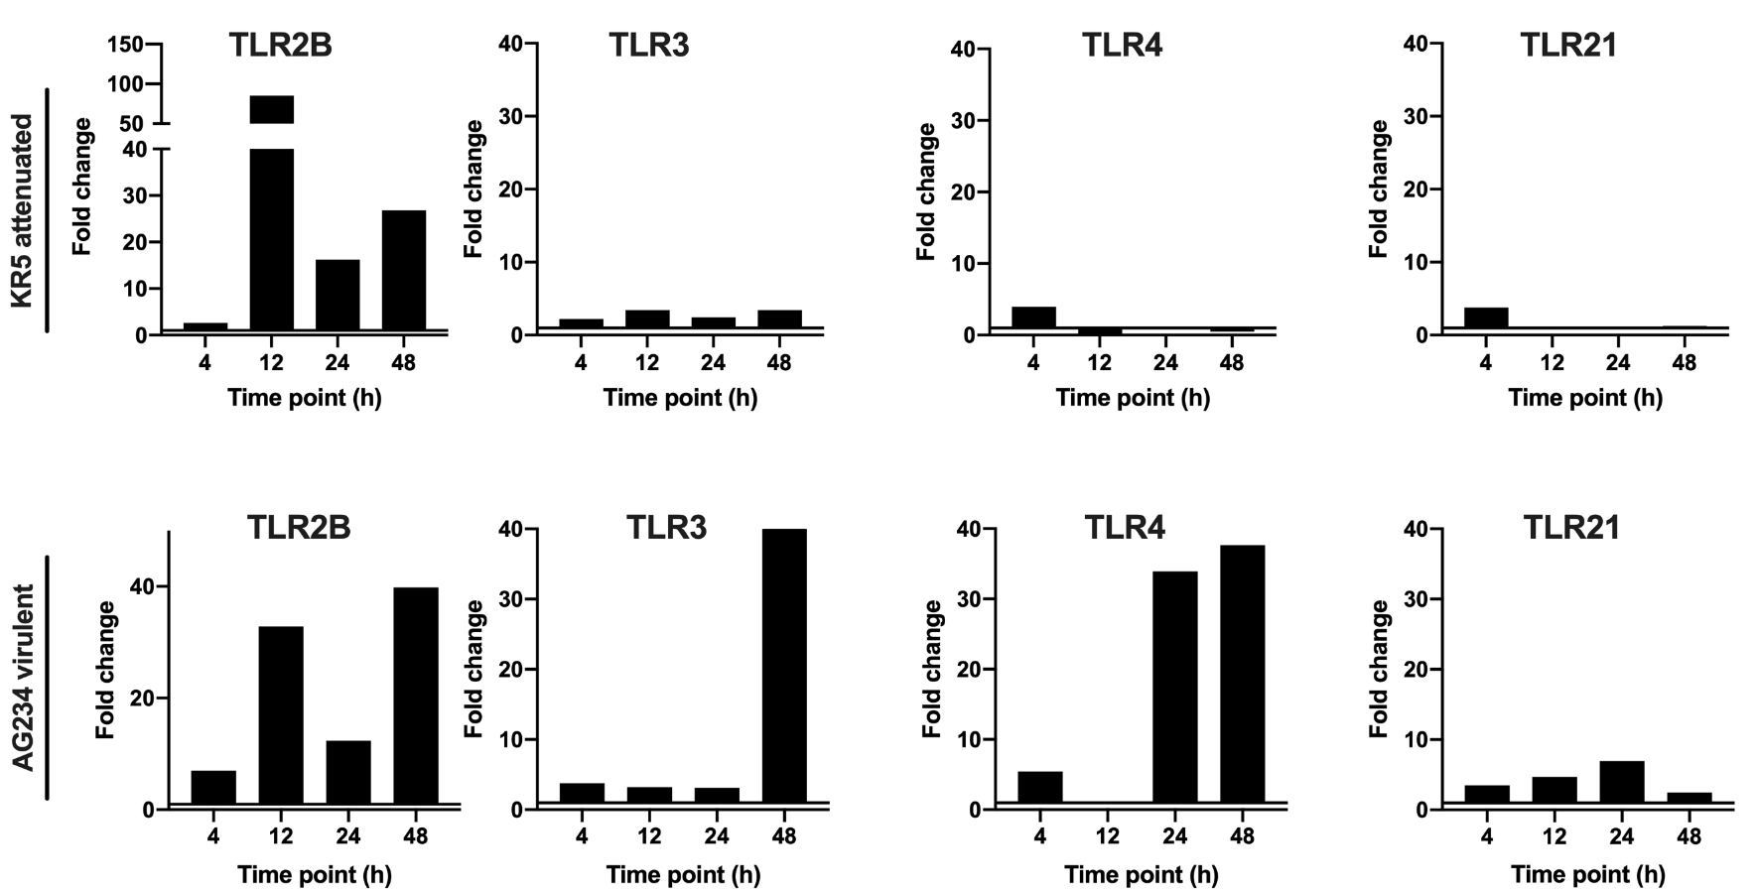
Gene expression analysis of Toll-like receptors
preliminary data
KR5: 33% analyzed
AG234: 66% analyzed

Slide 22
Research topics
Tools to investigate host responses/gut health against infectious diseases including model organisms
Virus – fowl adenovirus (FAdV)
Parasite – Histomonas meleagridis
Bacterium – Escherichia coli

Slide 23
Investigating the innate immune response against the intestinal parasite Histomonas meleagridis
no data on the role of avian Toll-Like Receptors (TLRs) against extracellular protozoan parasites
part of innate immune response
key role in immune homeostasis and defense against infections
TLR activation leads to the interplay between cells of innate and adaptive immunity
avian pathogen | involved TLRs
bacteria | 2, 4, 5, 15
virus | 3, 7, 8
intracellular parasite | 3, 15
extracellular parasite | ?
to analyze toll-like receptor pattern in caecum and spleen of vaccinated and/or infected turkeys and chickens (TLR1A, TLR1B, TLR2A, TLR2B, TLR3, TLR4, TLR5, TLR6, TLR7, TLR13, TLR21) by RT-qPCR

Slide 24
Experimental design
inoculum: clone H.m./Turkey/Austria/2922-C6/04
infection: passage 21 – 2x10⁴ virulent histomonads
vaccination: passage 295 – 2x10⁴ attenuated histomonads
1 day of life
28 days
32 days
35 days
38 days
42 days
49 days
*
infected turkeys/chickens
vaccinated turkeys/chickens
infected turkeys/chickens
vaccinated turkeys/cickens
control turkeys/chickens
4 dpi
7 dpi
10 dpi
14 dpi
21 dpi
killing of 3 inoculated birds per group and collecting blood, spleen, liver and caecum
* all turkeys died until 14 days post inoculation (dpi)

Slide 25
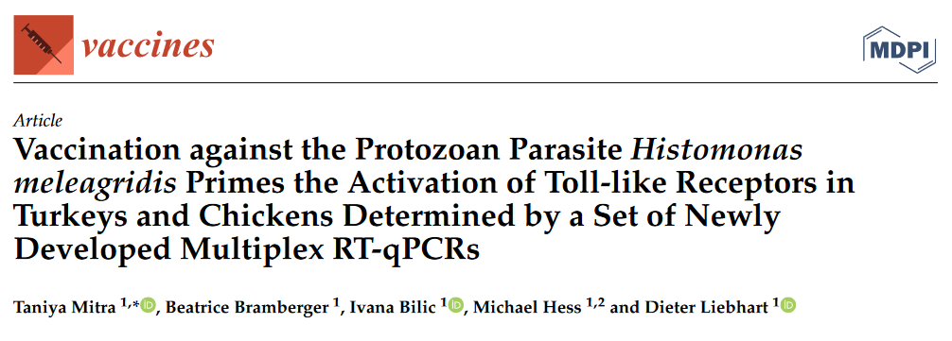
Toll-like receptor expressions measured by RT-qPCR
Genes | Species | Vaccinated |  | Vaccinated and Infected |  | Infected
 |  | Caecum | Spleen | Caecum | Spleen | Caecum |  | Spleen
TLR1A | turkey
 | chicken |  |  |  |  | 21*
TLR1B | turkey | 4 |  | 10 |  | 4, 10
 | Chicken |  |  | 4 |  | 10
TLR2A | Turkey
 | Chicken
TLR2B | Turkey |  |  | 4 |  | 4,10
 | Chicken |  |  | 4 |  | 10
TLR3 | Turkey |  | 10 |  |  | 10 |  | 10
 | Chicken |  |  |  |  | 4 | 10
TLR4 | Turkey |  |  | 10, 21 |  | 4, 10
 | chicken | 10 |  | 10 |  | 4
TLR5 | turkey |  | 10 |  |  |  |  | 10
 | chicken | 10,21 |  | 21 |  | 21
TLR6 | turkey |  | 4 | 21
 | chicken | NA #
TLR7 | turkey | 10 |  | 10 |  | 10
 | chicken
TLR13 | turkey
 | chicken | NA
TLR21 | turkey | NA
 | chicken |  |  | 4 |  | 4
* day post inoculation with significant TLR expression; # not available;
TLR 1B, 2B and 4 showed a continuous up-regulation in the caecum of both species during infection or vaccination followed by challenge with virulent parasites.

Slide 26
Expression patterns of TLRs and cytokines in permanent cell lines against H. meleagridis
LMH
(leghorn male hepatoma)
H. meleagridis with E. coli
only E. coli
positive control
only media
+
microscopic analysis
30min, 2h, 4h, 6h, 12h, 24h
RNA
HD11
(chicken macrophage)
TLRs
1A, 1B, 2A, 2B, 3, 4, 5, 7, 21
RT-qPCR
pro-inflammatory cytokine
IL-1β (Powell et al., 2009)
adaptive stage cytokine
IFN-γ (Powell et al., 2009)

Slide 27
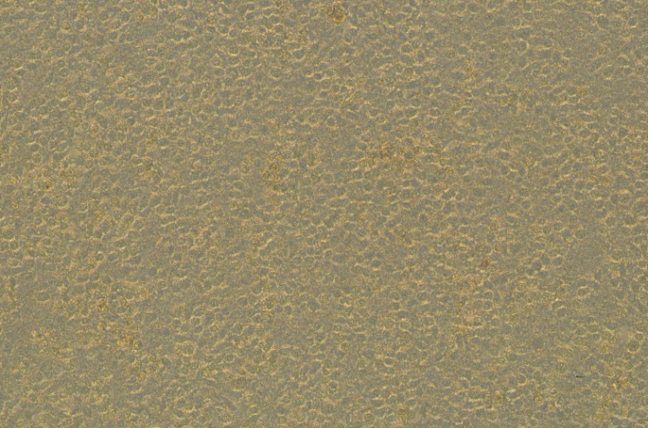
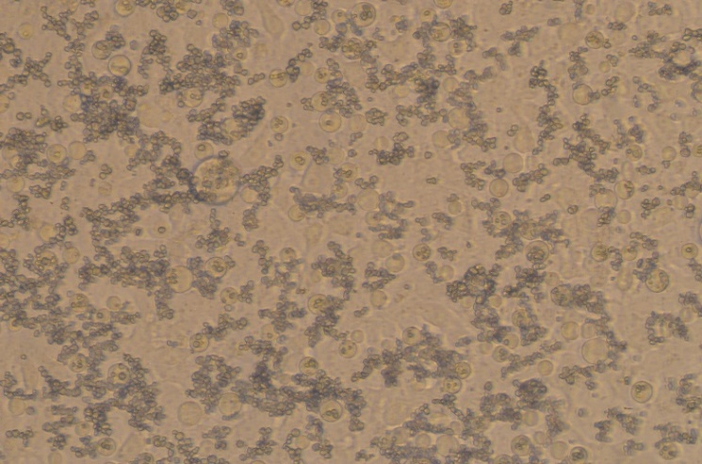
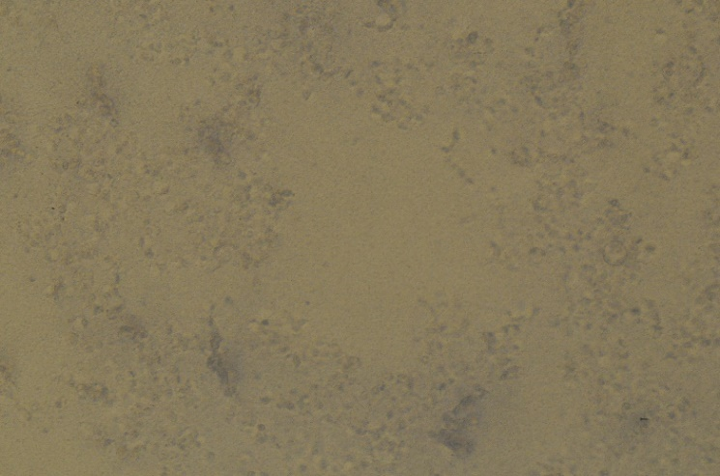
Microscopic analysis
Only HD11
HD11+histomonads
Only LMH
LMH+histomonads

Slide 28
TLR gene expression
HD11+histomonads
*
*
*
*
*
*
*
*
*
*
*
*
*
*
*
*
absence of signal after infection with histomonads for TLR 2A, 3, 5 and 7 indicate down-regulations
expression of TLR 1A and 2B was down-regulated until 4 hours post infection (hpi) and up-regulated significantly from 6 hpi
TLR 1B up-regulated throughout the time, at 12 and 24 hpi significantly
continuous significant up-regulation for TLR 4 from 2 hpi
TLR 21 was firstly down-regulated and from 2 hpi up-regulated (from 4 hpi significantly)
no significant differences compared to non-infected cells
LMH+histomonads

Slide 29
Cytokine gene expression in cell cultures
HD11+histomonads
IL-1β significantly up-regulated from 4 hpi up to 12 hpi
IFN-γ significantly up-regulated from 12 hpi
LMH+histomonads
no signal for IL-1β and IFN-γ

Slide 30
Research topics
Tools to investigate host responses/gut health against infectious diseases including model organisms
Virus – fowl adenovirus (FAdV)
Parasite – Histomonas meleagridis
Bacterium – Escherichia coli

Slide 31
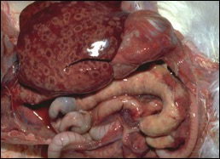
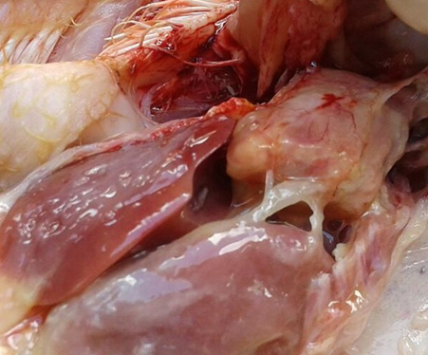
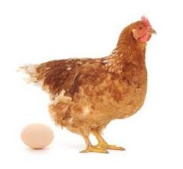
Interaction of E. coli with H. meleagridis
H. meleagridis
E. coli
microbial dysbiosis
Enhanced penetration of E.coli throughout the caecal tissue

Slide 32
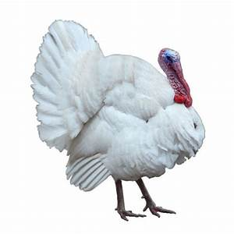
Experimental design
inoculation with
necropsy & sampling
attenuated histomonads ( ) and /or virulent histomonads ( )
Caecum, liver and spleen
Day of life
1 28 35 42 49
negative control (n= 9)
3
3
3
vaccinated (n= 9)
3
3
3
infected (n= 6)
3
3
x
vaccinated + infected (n= 9)
2
3
3
H. meleagridis
clone: virulent and attenuated monoxenic clonal culture of H. meleagridis/Turkey/Austria/2922-C6/04 with E. coli DH5α
routes: through oral and cloacal routes

Slide 33
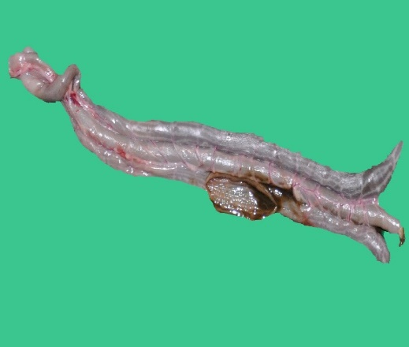
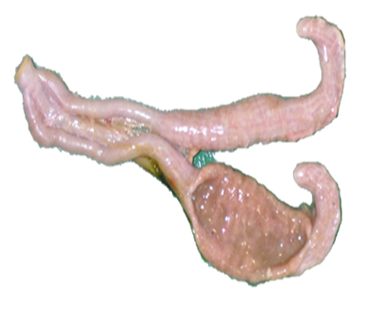
Macroscopic lesion in caeca
LS 0
LS 1
LS 3
LS 4
treatment | groups based on the severity of macroscopic lesions
 | negative control (n= 9) | no lesion (n= 11) | mild lesion (n= 6) | severe lesion (n= 6)
negative control | 9 | - | - | -
vaccinated | - | 9 | - | -
Infected | - | 0 | 3 | 3
vaccinated + infected | - | 2 | 3 | 3
33

Slide 34
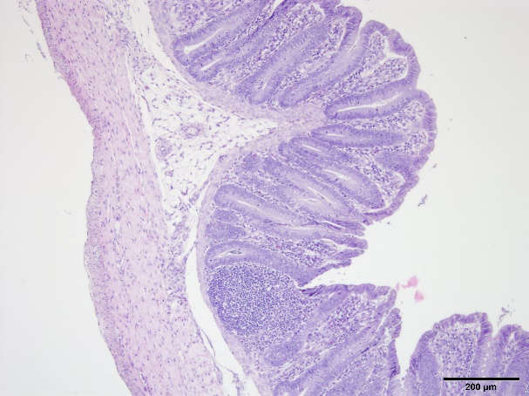
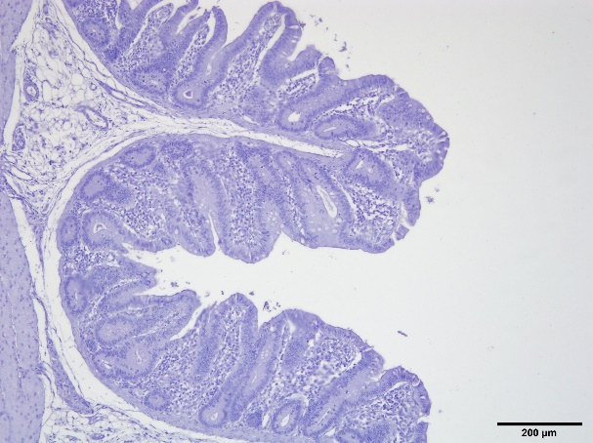
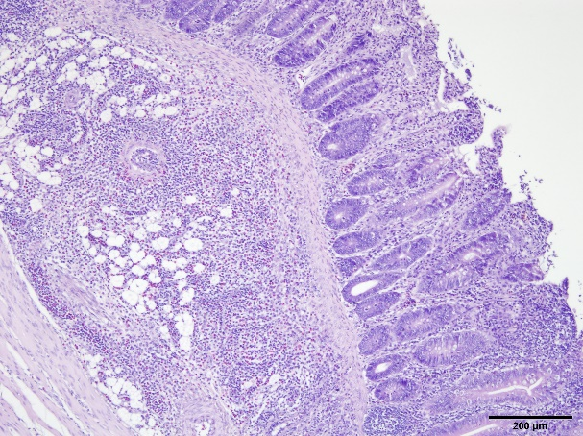
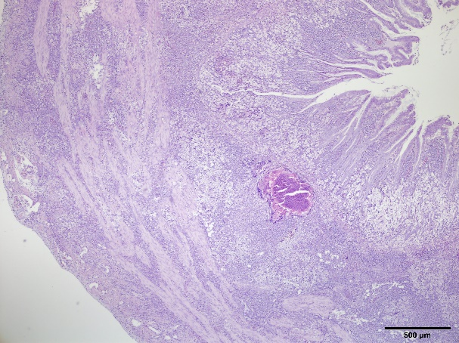
Microscopic lesions
negative control group
no lesion group
mild lesion group
severe lesion group
34

Slide 35
CFU count in caecum and systemic organs
9.22ª
9.33ª
8.99ª
r = 0.11
caecal lesion is positively correlated with the bacterial load of E. coli in the caeca
group | liver | spleen
negative control | - | 1.56 log cfu/g
no lesion | 3.1 log cfu/g | 3 log cfu/g
mild lesion | - | -
severe lesion | - | -

Slide 36
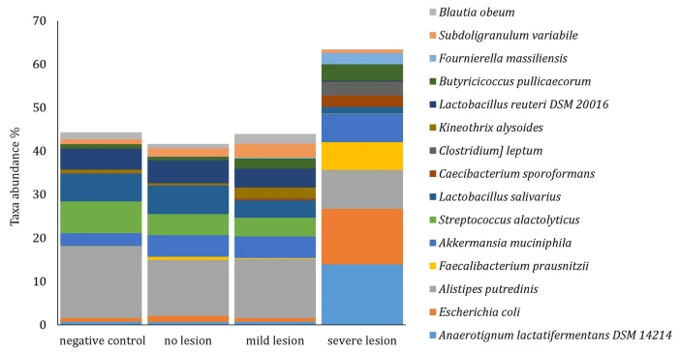
Microbial diversity in the caecum

Slide 37
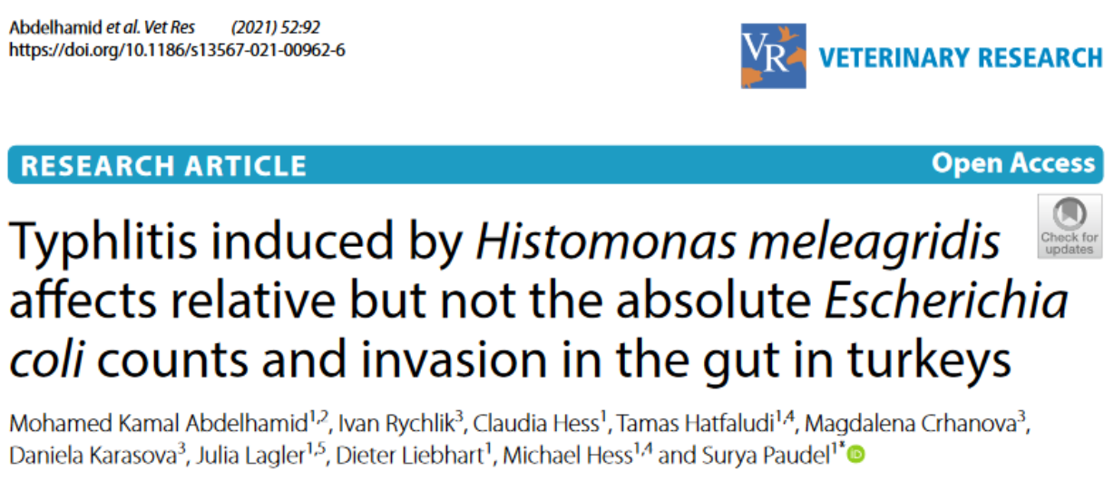
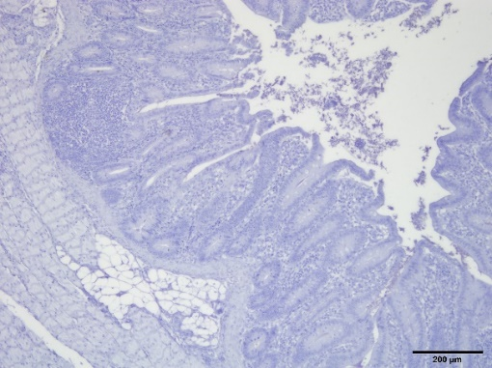
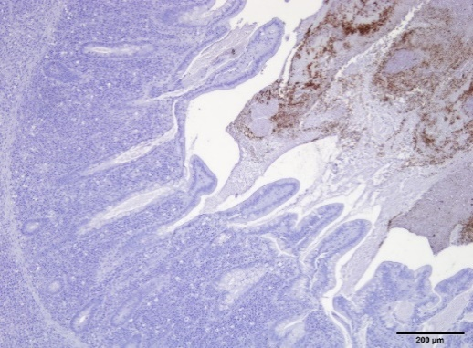
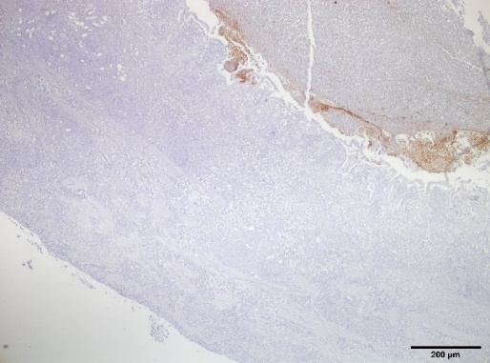
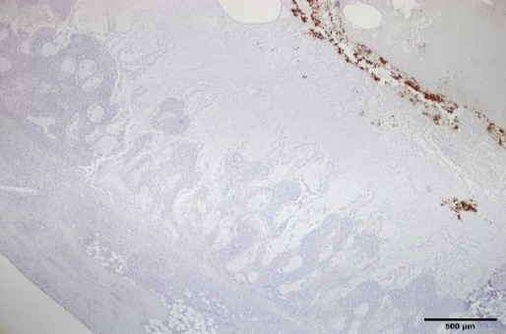
Immunohistochemistry
negative control
severe lesion
sample type | caecal lumen (content) | caecal wall
monoxenic H. meleagridis (actual trial)
mild lesion (n=6) | 1 | -
severe lesion (n=6) | 3 | -
monoxenic H. meleagridis (Lagler et al., 2021)
LS 3 (n=3) | 2 | -
LS 4 (n=4) | 1 | -
xenic H. meleagridis (Kidane et al., 2018)
LS 3 (n=1) | 1 | -
LS 4 (n=5) | 3 | -
field cases
n= 2 | 2 | -
monoxenic
xenic
field case

Slide 38
Summary
The interreg project INPOMED focused on research on intestinal health of poultry.
research on microbiota
research in immune reaction against pathogens
Establishing a chicken primary epithelial cell culture model to investigate the innate immune response against fowl adenovirus.
Investigating the intestinal innate immune response against the parasite H. meleagridis in vivo and in vitro.
Identifying microbial dysbiosis and the absence of systemic translocation of E. coli from the gut.

Slide 39
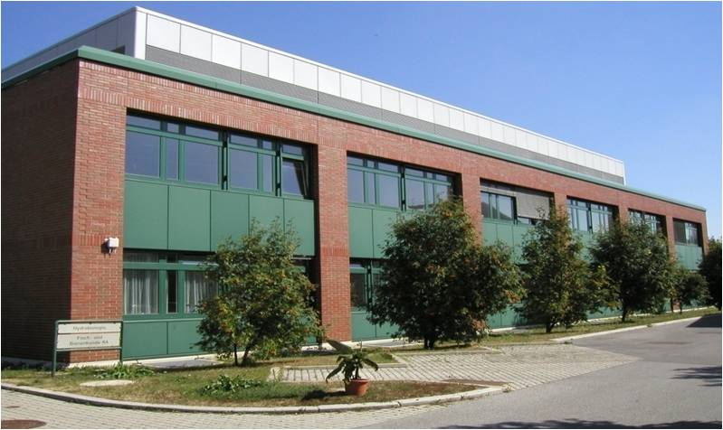
Katharina Strebinger
Taniya Mitra
Ivan Rychlik and his team
SAB
Michael Hess and all colleagues from the Clinic for Poultry and Fish Medicine
Sabine Ecker
Hermann Schobesberger
Clinic for Poultry and Fish Medicine
Department for Farm Animals and
Veterinary Public Health
Notes:
Alois Cizek and Jiri Bures, Harald Schliessnig, Michael Hess

