Slide 1





INTERREG Meeting
ATCZ-86
Krems
WaterMon
04.11.2021

Slide 2
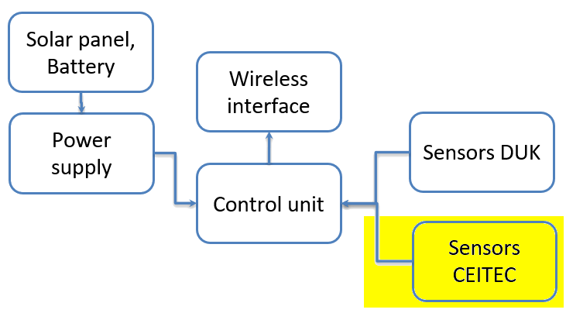
Electrochemical sensing module
Jakub Arm

Slide 3
Agenda
Overview of the sensing module
Potentiostat – parameters
Potentiostat – example of LSV
Sensing module power consumption
Future plans

Slide 4
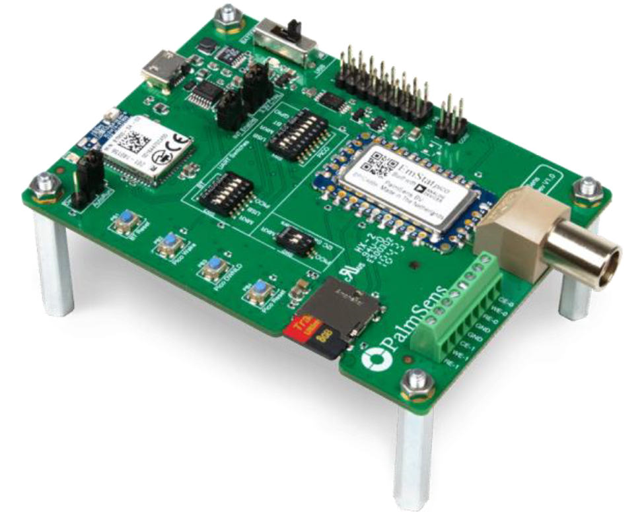
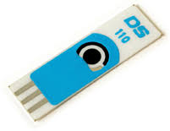
Overview
The module is based on EmStat-pico (potentiostat)
Precise, low-power device
Control unit – Arduino MKR Zero
Programing (measurement) using scripts (tuneable)
Supported techniques: voltammetry, EIS
Electrodes - printed
Preliminary study was promising with both the SPGE and SPCE (half yearly progress report)
Communication with the control unit via UART 3,3 V (RXD, TXD, GND) – defined on the last telco

Slide 5
Potentiostat parameters
Full dc-potential range: -1.7 (-1.2) V to +2 V
EIS frequency range: 0.016 Hz to 200 kHz
Current ranges: 100 nA to 5 mA
Modes:
  Low Speed (up to 1 V/s or up to 100 Hz)
  High Speed (up to 200 kHz)
  Max Range (optimal dynamic dc-potential range)
Source: https://www.palmsens.com/product/oem-emstat-pico-module/

Slide 6
Potentiostat parameters
Voltammetric techniques:
  Linear Sweep Voltammetry
  Cyclic Voltammetry
  Square Wave Voltammetry
  Differential Pulse Voltammetry
  Normal Pulse Voltammetry
Electrochemical Impedance Spectroscopy
Techniques as a function of time:
  Chronoamperometry
  Pulsed Amperometric Detection
  Open Circuit Potentiometry
  MultiStep Amperometry

Slide 7
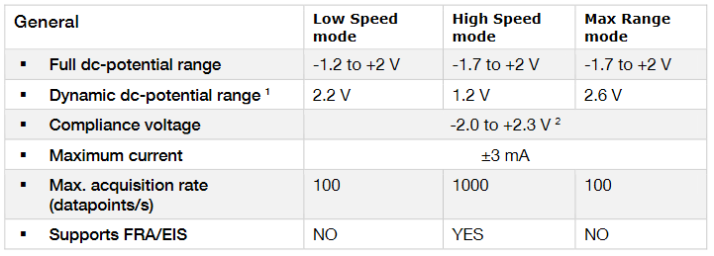
Potentiostat parameters

Slide 8
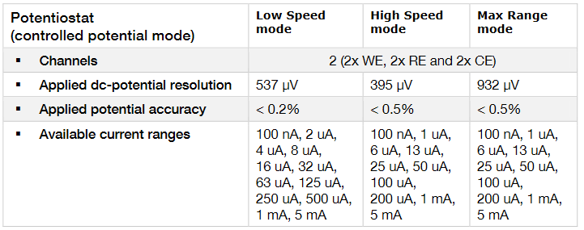
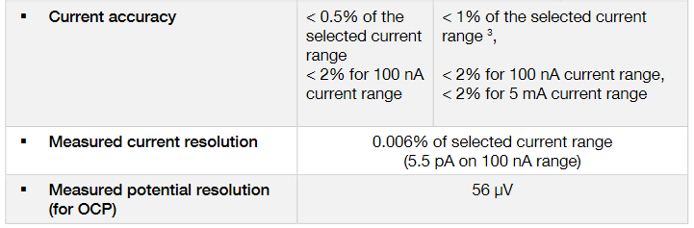
Potentiostat parameters

Slide 9
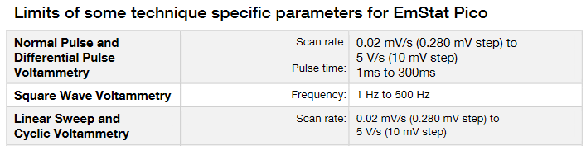
Potentiostat limitations
On-board 1 kΩ and 100 kΩ precision resistors (accuracy: ±0.1%, temperature coefficient: ±25 ppm/°C) for self-calibration

Slide 10
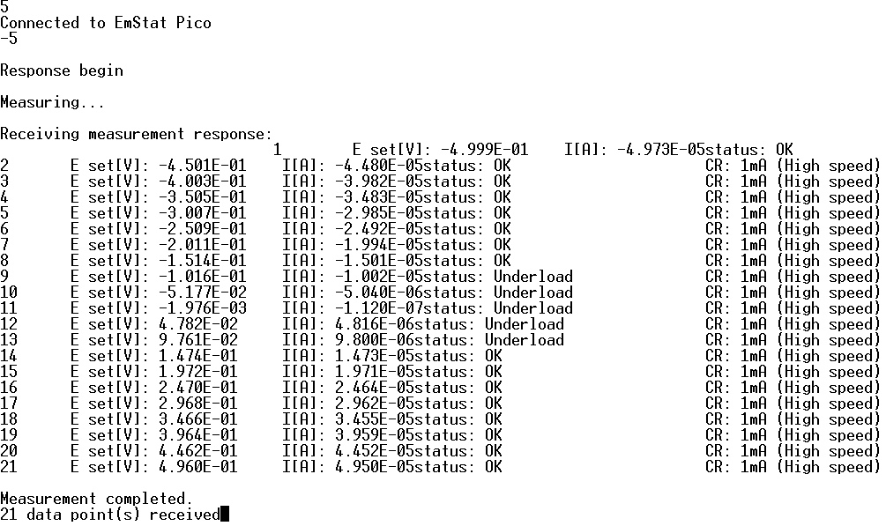
Potentiostat – LSV example
The whole measurement takes approx. 10s

Slide 11
Power consumption - theoretical
EmStat Pico (Normal, High Speed, 1 channel):
30 mA @ 5 VDC
EmStat Pico (Normal, Low Speed, 1 channel):
10 mA @ 5 VDC
EmStat Pico (Hibernate):
10 uA @ 5 VDC
Arduino MKR Zero (maximum rating):
600 mA @ 5 VDC

Slide 12
Power consumption - measured
EmStat Pico (Normal, 1 channel) + Arduino MKR Zero:
40 - 70 mA @ 5 VDC
(Linear Sweep Voltammetry)
Arduino MKR Zero:
20 mA @ 5 VDC
(only CPU and UART)

Slide 13
Power consumption - estimated
Measuring mode
80 mA @ 5 VDC
for approx. 10 s (depends on the measurement script)
Sleep mode:
30 uA @ 5 VDC
for approx. 15 min (depends on the scenario)
Calculated consumption: 0,92 mAh @ 5 VDC

Slide 14
Future plans
Study with the E.coli culture to induce the growth of enzyme by the bacteria itself and obtain the 8-HQ (electroactive species) to be detected electrochemically (half yearly progress report)
Calibration of the E.coli conc. detection to attain the LOD (half yearly progress report)

Slide 15
Future plans
Implement communication protocol (waiting for the description)
Design and implement „business logic“ of the sensing module
Design and implement the measurement scripts (will be defined by MENDELU)
Debugging (connection with potentiostat, script handling)
Reduce power consumption if needed

Slide 16
Thank you for the Attention
Questions ?

