Slide 1





INTERREG Meeting
ATCZ-86
Effects of nutrients and growth parameters to chlorophyll a production in Cyanobacteria
WaterMon
04.11.2021
Mai-Lan Pham

Slide 2
The Aim
Development of a biosensor to detect the cyanobacteria in water
Methodology: Evaluate the influences of growing conditions and nutrients to the growth of cyanobacteria, based on the production of chlorophyll a

Slide 3
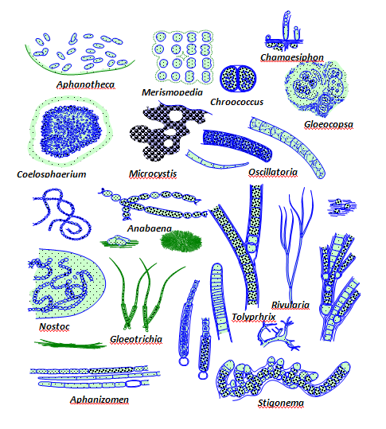
Cyanobacteria
Gram-negative bacteria
in all types of water: fresh, brackish (combined salt and fresh water), and marine water.
Can conduct oxygenic photosynthesis
Can be unicellular (Microsystis, Synechosystis….) or filamentous (Anabaena, Cylindrosperomopsis….)
Primary producer and immense source of secondary metabolites products including bioactive compounds (antioxidants, vitamines, hormones), cyanotoxins…
Issa, A. A., Abd-Alla, M. H., & Ohyama, T. (2014). Nitrogen fixing cyanobacteria: future prospect. Advances in biology and ecology of nitrogen fixation, 2, 24-48.

Slide 4
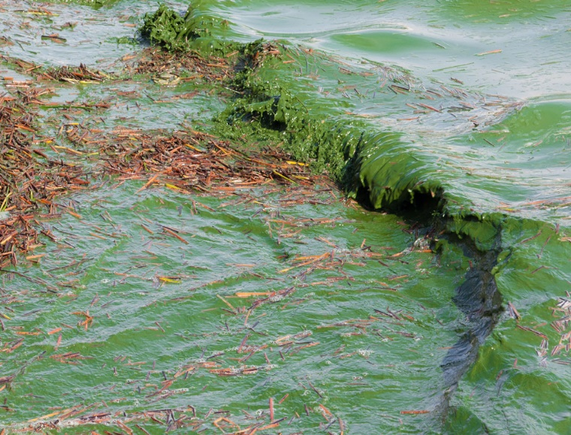
Cyanobacteria in water
Decompose the organic wastes and residues, detoxify heavy metals, pesticides, and other xenobiotics
Catalyze the nutrient cycling, suppress growth of pathogenic microorganisms in soil and water
Harmful bloom formation leading to the increase of biological oxygen demand and anoxia in the water bodies
Causing surface water contamination
Production of cyanotoxins resulting in high risk to aquatic organism as well as domestic animals and human.
Abiotic factors (light intensity, temperature, pH, nutrients…) affect to toxin biosynthesis

Slide 5
Anabaena sp. ULC080
Aphanizomenon sp. ULC602
filamentous cyanobacteria belongs to Nostocales order
Grow as long branched filaments
Harmful blooming formation and produce toxin
One of the most studied cyanobacteria
Nitrogen fixation
Can differentiate into heterocysts (nitrogen fixation) and akinetes forms (spore-like form)
Filamentous cyanobacteria belongs to Nostocales order
Grows as unbranched filaments
Harmful blooming formation and produce toxic
Nitrogen fixation
Can differentiate into heterocysts (nitrogen fixation) and akinetes (spore-like form)

Slide 6
Standard medium for cultivation of cyanobacteria
BG-110 medium : lack of N-sources to preserve the heterocyst differentiation
Component | Final conc (mM)
K₂HPO_{4.}3H₂O | 0,18
MgSO₄.7H₂O | 0,62
CaCl₂.2H₂O | 0,24
EDTA -Mg- Na₂ | 0,0025
Citric acid (monohydrate) | 0,03
Ammonium iron citrate | 0,023
Na₂CO₃ | 0,19
NaHCO₃ | 1,80
Trace elements mix | 1 ml
Trace elements mix
Components | Conc (g/L)
H₃BO₃ | 2,86
MnCl2.4H2O | 1,81
ZnSO4.7H2O | 0,222
Na2MoO4.2H2O | 0,39
CuSO4.5H2O | 0,079
Co(NO3)2.6H2O | 0,049
Anabaena sp was cultivated in 100% BG-110, pH 7 at 18°C, 120 rpm, continuous white light for 30 days.
Aphanizomenon sp was cultivated in 50% BG-110, pH 7 at RT, 120 rpm, continuous white light for 30 days.
Samples were taken regularly for chlorophyll a assay. Cells were harvested after 30 days of cultivation for further analysis.

Slide 7
Chlorophyll a assay
Chlorophyll a is the main photosynthetic pigment in cyanobacteria
Considered as a biomass indicator of cyanobacteria
The most frequently measured biochemical parameter
Chlorophyll a assay:
Collecting cells from 1ml culture
Re-suspend the cell pellets by precooled MetOH 100%, vortexing
Incubated at 4°C, in dark for 20 min
The chlorophyll a is calculated by:
Chla [μg/ml] = 12.9447 (A665 − A720) *
A720: absorbance of MetOH (blank)
A665: absorbance of chl a in the supernatant
Collecting the supernatant by centrigugation
Measuring the absobance of the supernatant at 665 nm
*Ritchie, Raymond J. 2006. Consistent sets of spectrophotometric chlorophyll equations for acetone, methanol. Photosynthesis research, Vol 89 (1): 27-41

Slide 8
44
48,91
44
48,91
25,83
19
Produced chlorophyll a rate in std BG-110 under std growing conditions after 30 days
Produced chlorophyll a rate in std BG-110 and modified BG-110 w/o primary C-cources after 30 days in std growth conditions

Slide 9
Chlorophyll a production rate by Aphanizomenon sp. ULC602 in different BG-110
Chlorophyll a production rate by Anabaena sp. ULC080 in different BG-110
BG-110: standard BG-110 medium
BG-110-M1: BG-110 medium removing primary C-sources from sodium carbonate
BG-110-M2: BG-110 medium removing the iron source from amonium iron (III) citrate
BG-110-M3: BG-110 medium removing primary C-sources and the iron source
BG-110-M4: BG-110 medium removing the iron source from amonium iron (III) citrate and EDTA-disodium
BG-110-M5: BG-110 medium removing the trace elements mix

Slide 10
Effects of media pH to production of chlorophyll a
Aphanizomenon sp. ULC602
Anabaena sp. ULC080

Slide 11
Confocal laser scanning microscopic image of Aphanizomenon sp. Grown in 50% std BG-110 under std conditions, observed with autofluorescent pigment-chlorophylla: a) with autofluorescent pigment. b) Bright field mode. c) overlap two modes. Blue arrow: heterocysts
a
b
c

Slide 12
Confocal laser scanning microscopic image of Anabaena sp. Grown in std BG-110 under std conditions, observed with autofluorescent pigment-chlorophylla: a) with autofluorescent pigment. b) Bright field mode. c) overlap two modes. arrow: heterocysts

Slide 13
On-going work
Growing two bacteria in different modified BG-110, which are changed with the formulation of std BG-110:
organic C-sources supplements, additional of other nitrogen sources from nitrate, urea…
Sources and amount of iron in the media
Different ratio of C:N, N:P
Effects of other elements: Mg, Ca, Zn, Cu, Mn to the growth of cells and production of chlorophyll a
Verification and quantitation of heterocysts and spore-like form (akinetes) of target bacteria by FACS (fluorescence-activated cell sorting) and SEM (scanning electron microscopy).

Slide 14


