Slide 1





INTERREG Meeting
ATCZ-86
Krems
WaterMon
04.11.2021

Slide 2
Spectrophotometric detection of phosphorus
Atripan Mukherjee

Slide 3
Outline
Literature study
Preliminary study for phosphorus detection.
Reagent stability
Temperature stability
Conclusion

Slide 4
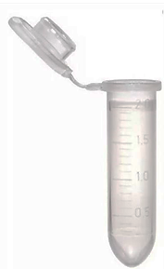

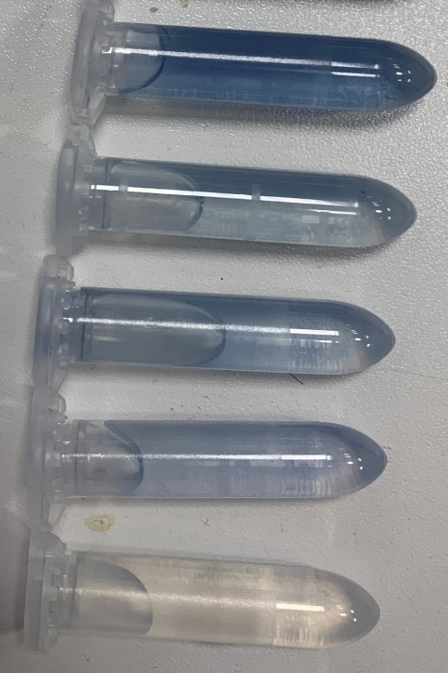
Sample preparation
Solution A: 1.5 g of Antimony potassium tartrate was dissolved in 20 mL milli-Q water containing 2.5 mL of sulphuric acid. And it was diluted to 25 mL.
Reagent: 6.25 mL of solution A was added to 25 sodium molybdate (0.52 M) solution containing 0.2 g ascorbic acid.
Incubation 30 min
Reagent
Solution A
Phosphorus sample
+ reagent
Eisenreich, S.J., Bannerman, R.T. and Armstrong, D.E., 1975. A simplified phosphorus analysis technique. Environmental letters, 9(1), pp.43-53.

Slide 5
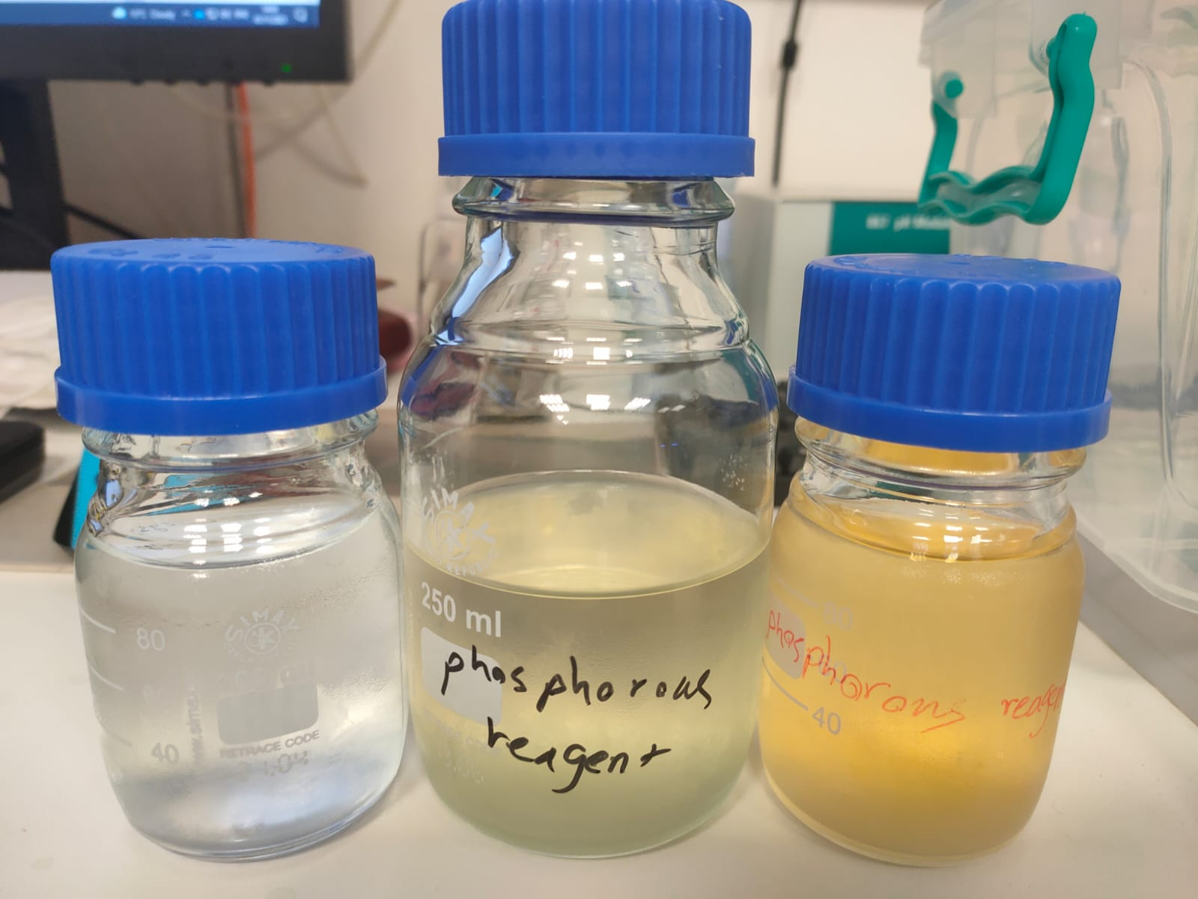
Measurement
The initial absorbance spectra was 880 nm, later recommended to 550-700 nm.
So, protocol was revised by optimising amount of colouring reagent and measured at 650 nm.
The reagent stability study was done at different temperature condition.
30 day
45 day
1 day

Slide 6
Reagent stability
30 day
45 day
1 day

Slide 7
Results and Calibration
Sensitivity remains almost same with decreasing reagent concentration
At 4°C, reagent is found to be more stable.

Slide 8
Conclusion
0.3 mL of reagent were required (min.) for total 2 mL volume.
Reagent is found to be sensitive for a month, following 35 days decolouration of reagent occur from colourless to pale yellow.
The reagent needs to be kept at 4 °C for longer stability and sensitivity.
EU recommended 0.05mg/L in water

Slide 9
Thank you for the Attention
Questions ?

