Slide 1





INTERREG Meeting
ATCZ-86
DOM-SAC Sensor Module
WaterMon
04.11.2021
Thomas Posnicek (DUK)

Slide 2
Overview
What’s the aim
The Measuring principle
Sensor Module
Next steps

Slide 3
The Aim
A compact Sensor Module to measure the following paramters…
        DOM (dissolved organic matter)
        SAC (spectral absorption coefficient)
        COD (chemical oxygen demand)
        BOD5 (biochemical oxygen demand)
…in an optical way.

Slide 4
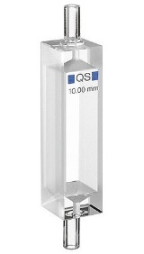
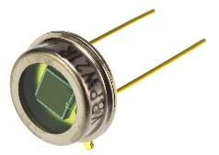
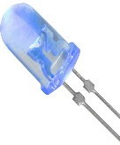
Measuring principle
DOM
(dissolved organic matter )
SAC
(spectral absorption coefficients)
calculated on two
fluorescence indices
calculate
  BIX
  (biological-index)
  FIX
  (fluorescence-index)
  COD and BOD5
(chemical oxygen demand & biochemical oxygen demand)
Ex. 310nm
Em. 380nm
Ex. 370nm
Em. 450nm
254nm
435nm
Em. 430nm
Em. 500nm
550nm
Fluorescence measurement
Absorbance measurement

Slide 5
Sensor Modul for DOM & SAC
BIX and FIX?
are optical indices
significant relationship with molecular formulas
characterize the DOM composition and its origin
BIX indicator of autotrophic production
FIX distinguish DOM derived from terrestrial sources vs. microbial sources

Slide 6
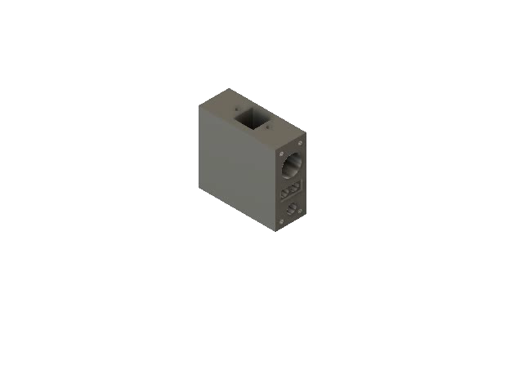
Sensor Modul for DOM & SAC

Slide 7
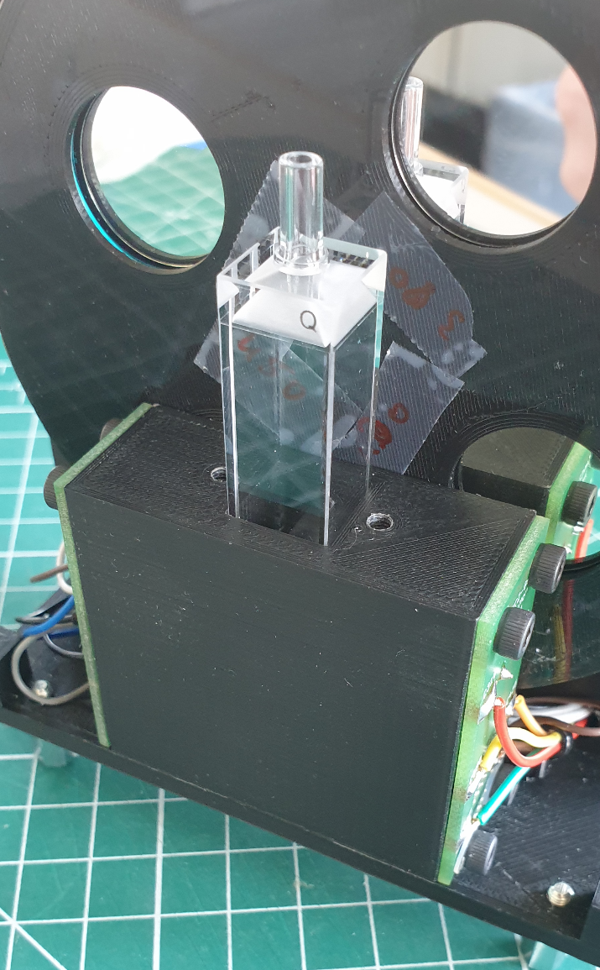
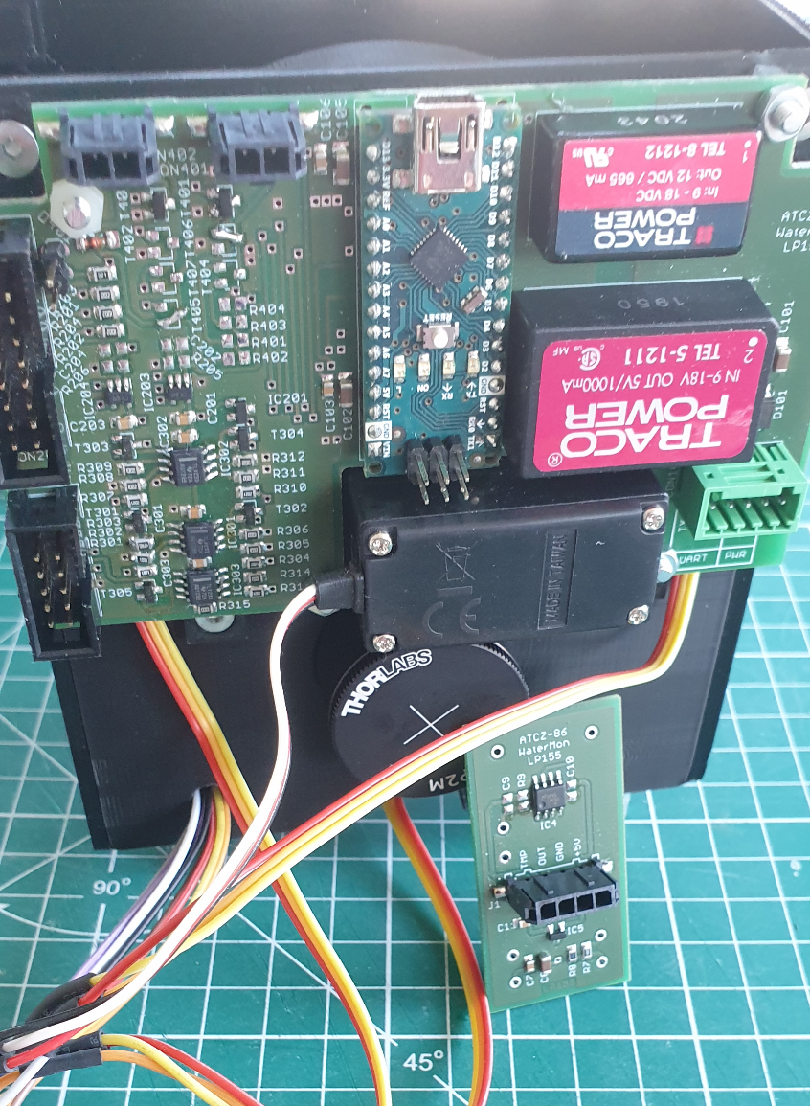
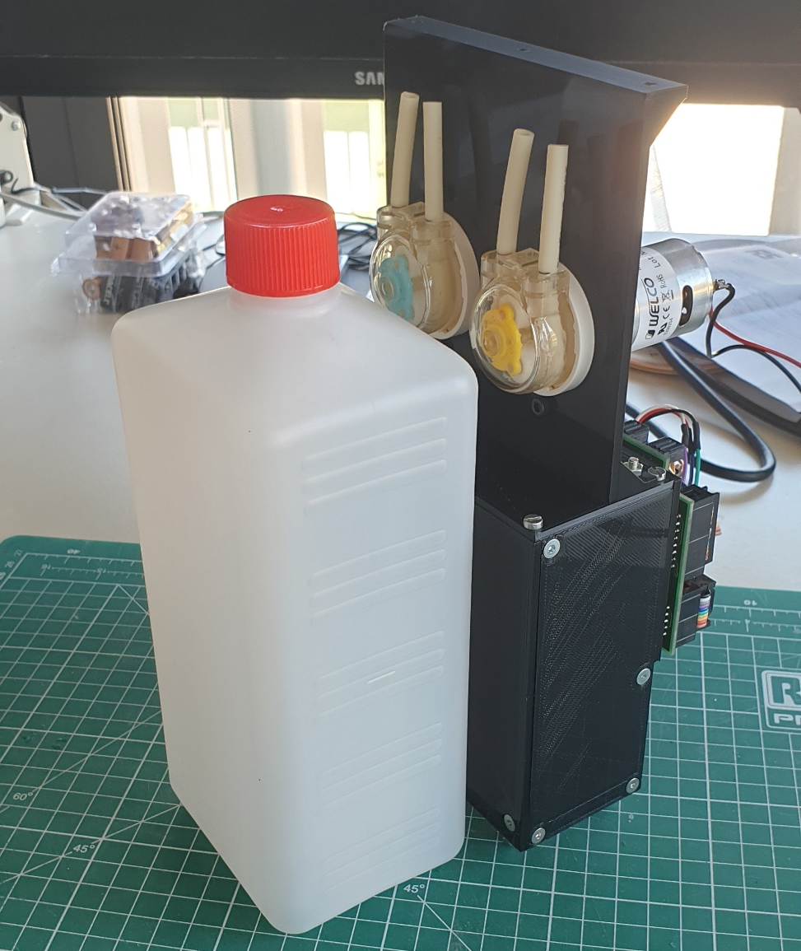
Sensor Modul for DOM & SAC

Slide 8
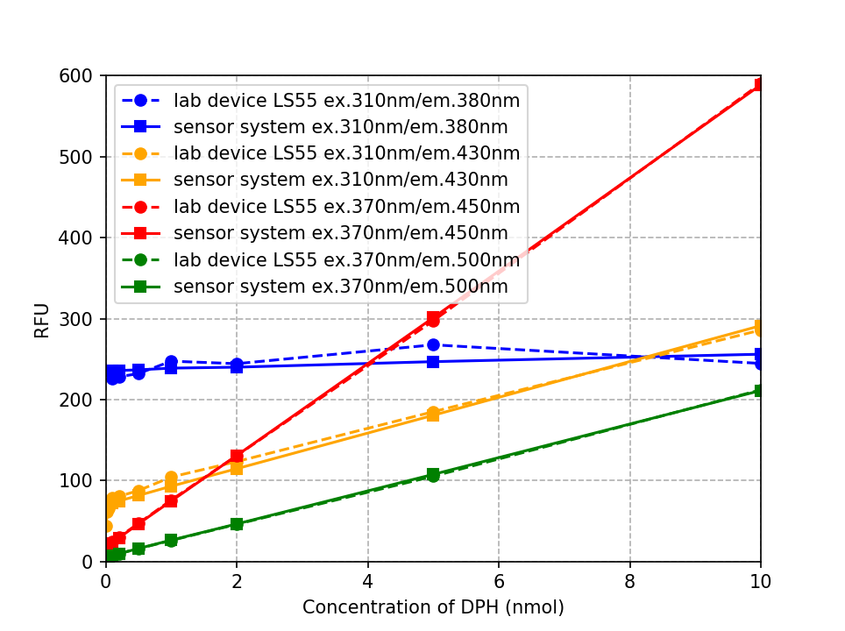
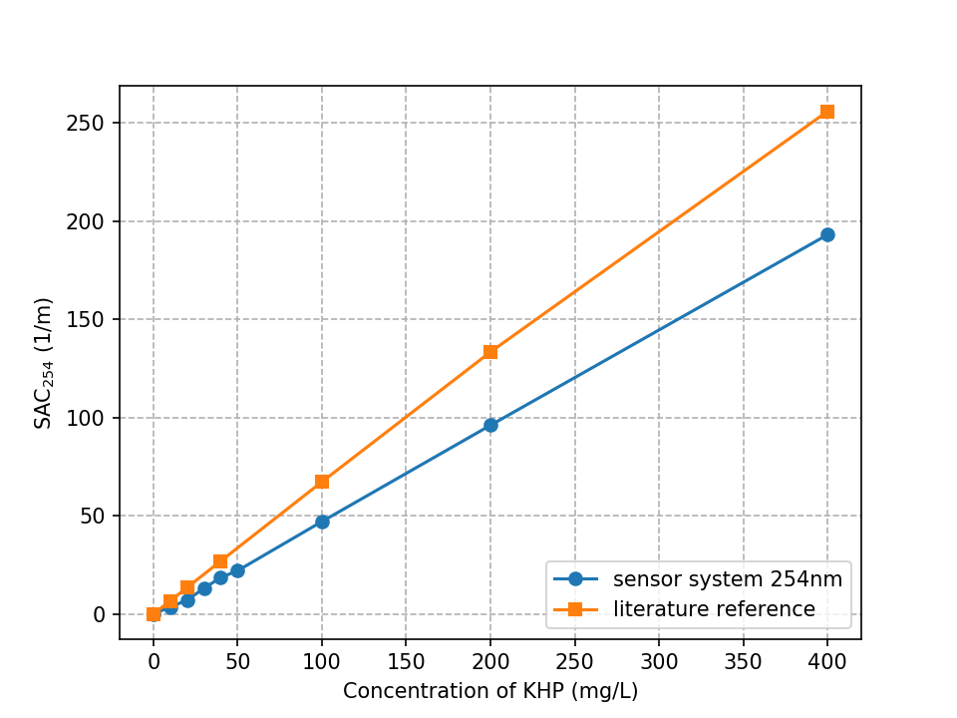
Preliminary results
DOM
SAC
measurements of different DPH (fluorescent hydrocarbon - Diphenylhexatriene, 1,6-Diphenyl-1,3,5-hexatriene) concentrations with our system compared to the fluorescence spectrometer LS55 (PerkinElmer, USA)
comparative measurement of KHP (potassium hydrogen phthalate, C8H5KO4) with literature reference DIN-standard 38404-3 and our system

Slide 9
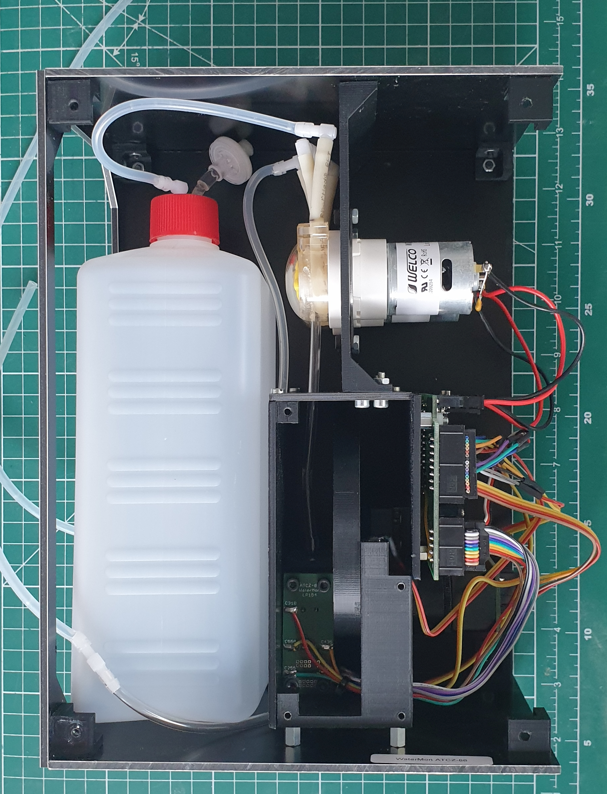
Next Steps
Verification of the module
Construction of a second and third module
Implementation in the overall system

Slide 10
Thank you for the Attention

