Slide 1





INTERREG Meeting
ATCZ-86
WaterMon
04.11.2021

Slide 2

Water is our most important resource!
Ideal of a natural and clean water body
Hintersee, Salzkammergut
Modern sensor technology can support the protection of water as a resource

Slide 3
Initial situation
The discharge of various pollutants, such as organic matter, hazardous chemicals, and nutrients into natural water systems has harmful effects on the water body.
Resulting in:
  Harmful algal blooms, shift in pH, proliferation of microorganisms, excitation of established limits.
Solution:
Therefore, appropriate water quality control technologies are needed to develop an effective water resources management strategy

Slide 4
Monitoring of the water body
Conventional methods for sample analysis
  On-site sampling, sample transport → contamination possible
  Laboratory analysis → time-consuming, personnel-intensive and cost-intensive
Automatic sensors for water quality monitoring (smart sensors)
  Automatic sampling
  On-site analysis → rapid results
  Cost effective
  Analysis possible by “push on button”

Slide 5
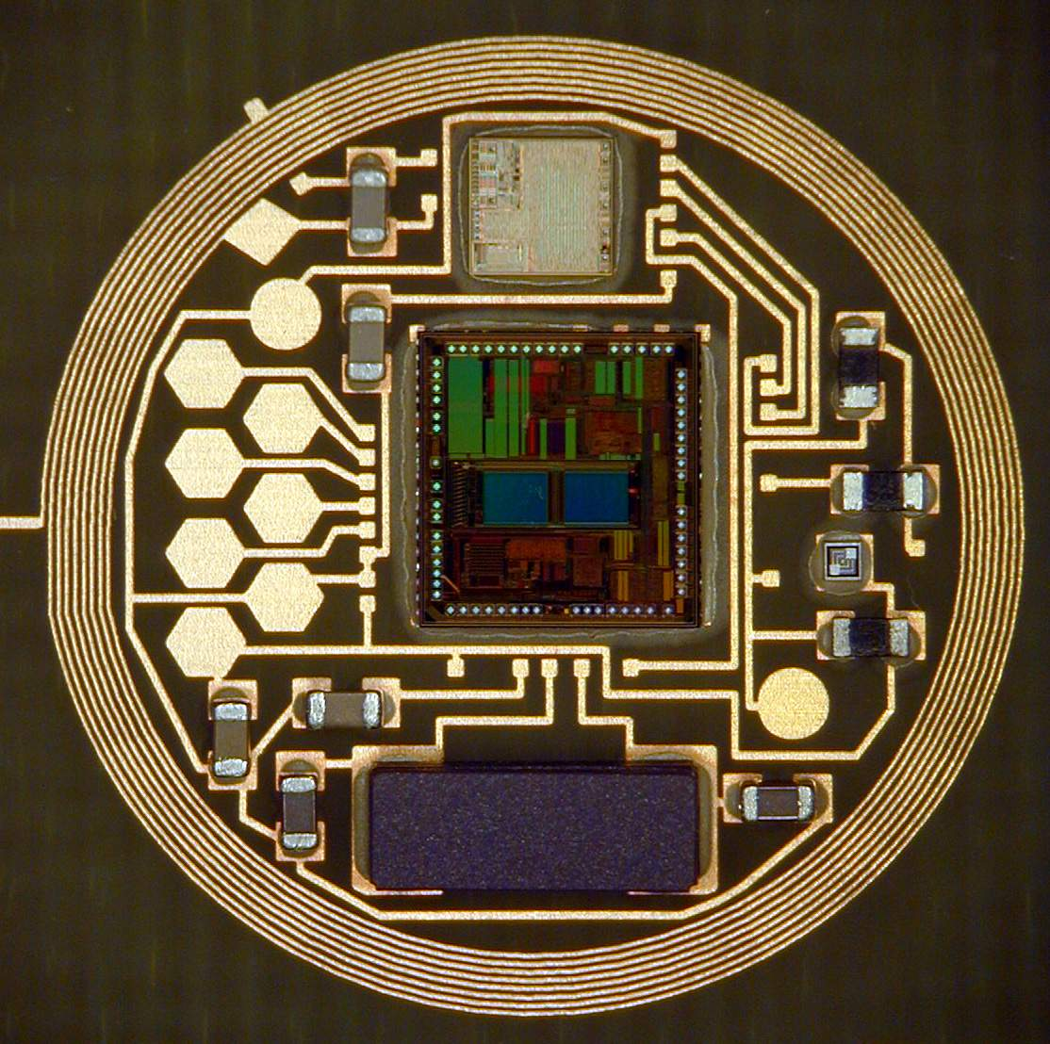
Smart Sensor
Transducer (Sensor)
(Converts a physical or chemical quantity into an electrical signal)
Signal processing
(Sampling, amplification, filtering…)
Data communication
(communication system for connecting the sensors)
Software
(„Intelligence“ for classification of data)
A "smart sensor" contains much more than just a sensor element - it is a complete system.
Sensorinterface
uC for Signalprocessing
Antenna for wireless communication

Slide 6
Project Content & Highlights
Multi-sensor system for automatic measurement of specific water parameters
  Research & development on sensor modules for automatic measurement of water quality parameters
  Evaluation of the functionality and accuracy of the developed sensors
  Development of a webserver for data hosting and a webpage for data display with restricted access
  Presentation and publication of research highlights

Slide 7
Project Organization
Project- management
Advisory Board:
Representatives of the BMLRT, WA2 and the Water Border Commission
Sensor development
Sensor development
Webserver, Webpage
Presentation of results, reporting, publications

Slide 8
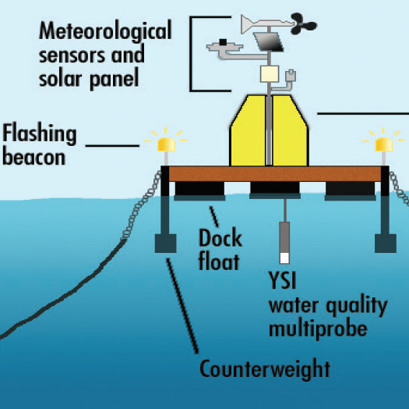
Monitoring-Station Concept
Solar panel, Battery
Wireless interface
Power supply
Sensors DUK
Control unit
Buoy or stationary station
Sensors CEITEC
Discussion Points:
Supply voltage, power consumption - power management
Interfaces - bus protocol
Overall size, module size
Security protection (data protection, stealing of station)
Notes:
Power should supplied by a solar panel

Slide 9
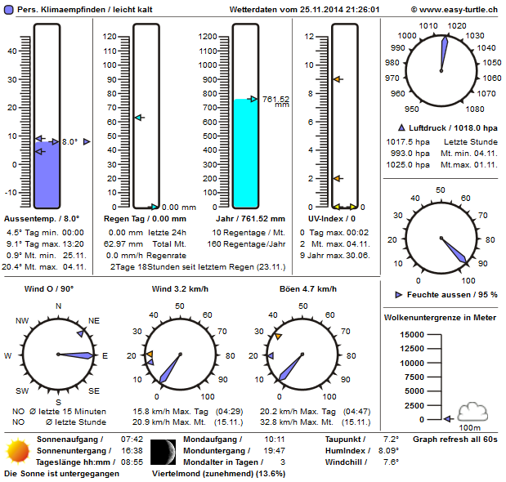



Webserver & Webpage
Antenna
Antenna
Y
Y
GSM Data Transfer
Water Quality
Sensor
Webserver
Webpage with restricted access
Authorization
required
River
User

Slide 10
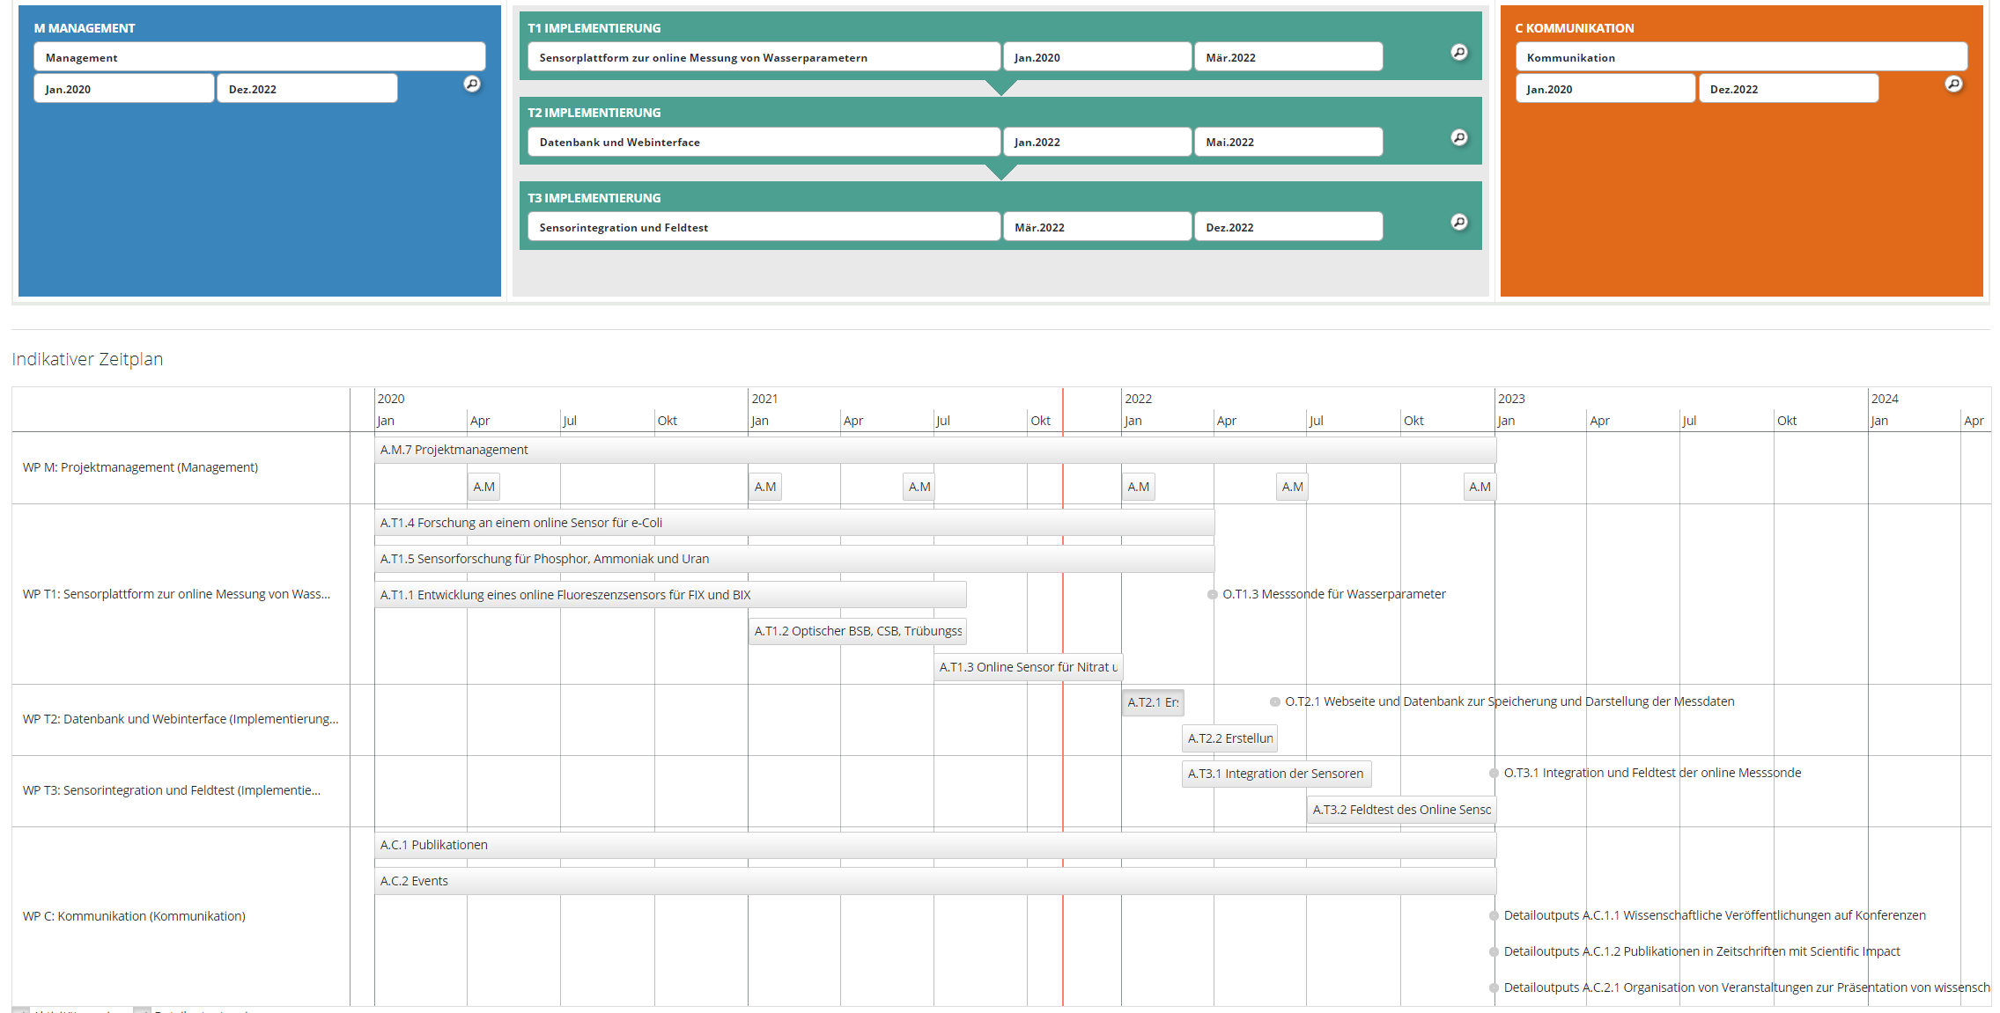
Project Outline
Database
Webpage

Slide 11
Program

