Slide 1
INTERREG Meeting ATCZ-86
WaterMon
02.09.2021

Slide 2
Agenda
Reports from the individual research groups on the progress of the project
Discussion and next steps
Publicity and general remarks

Slide 3
Project Content & Highlights
Multi-sensor system for automatic measurement of specific water parameters
Research & development on sensor modules for automatic measurement of water parameters
Evaluation of the functionality and accuracy of the developed sensors
Development of a webserver for data hosting and a webpage for data display with restricted access
Presentation and publication of research highlights

Slide 4
Project Organization
Project- management
Advisory Board:
Representatives of the BMLRT, WA2 and the Water Border Commission
Sensor development
Sensor development
Webserver, Webpage
Presentation of results, reporting, publications

Slide 5
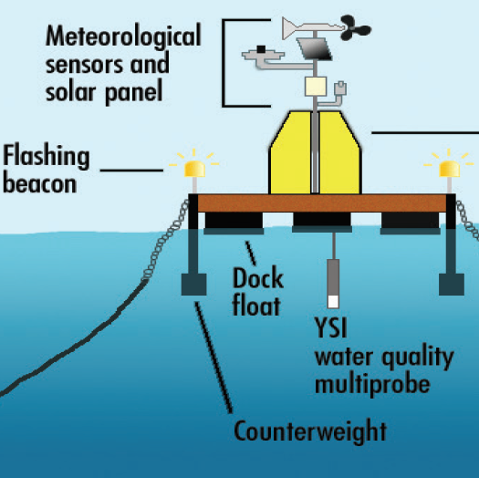
Monitoring-Station Concept
Solar panel, Battery
Wireless interface
Power supply
Sensors DUK
Control unit
Buoy or stationary station
Sensors CEITEC
Discussion Points:
Supply voltage, power consumption - power management
Interfaces - bus protocol
Overall size, module size
Security protection (data protection, stealing of station)
Notes:
Power should supplied by a solar panel

Slide 6
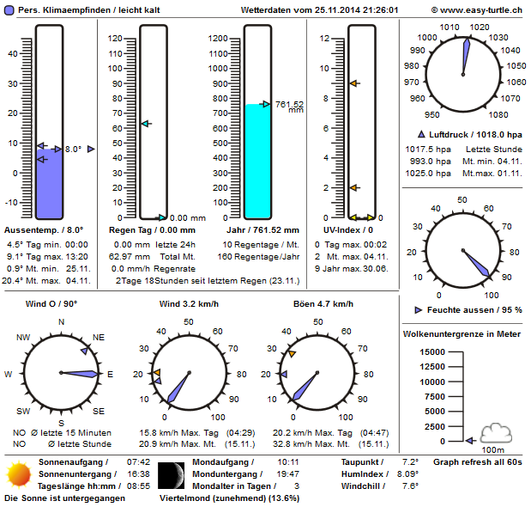
Webserver & Webpage
Antenna
Antenna
Y
Y
GSM Data Transfer
Water Quality
Sensor
Webserver
Webpage with restricted access
Authorization
required
River
User

Slide 7
Report on Activities DUK
Development of Sensor Modules for Water Quality Measurements
Oilfilm Sensor Module
Research on the detection of other problematic microorganisms

Slide 8
Report on Activities CEITEC/VUT

Slide 9
Report on Activities CEITEC-VUT
Electrochemical detection of NH₃
E-coli detection
Colorimetric detection of phosphorus
Development of colorimetric sensing module
Development of electrochemical sensing module
Development of station

Slide 10
Technical Points to Discuss
Power supply and operating voltages
Communication protocol between the subunits
Design of the master unit

Slide 11
Next Steps
Project meeting in Poysdorf in October 2021 or virtual (depends on Corona situation)
Project progress report and presentation of each work group
Discussion on next steps

Slide 12
Summary and Outlook
Task: Sensor development
DUK
CEITEC/VUT
Task: Webserver/Webpage
Task: Reporting, Publicity
in plan
in plan
planned 2022
ongoing

Slide 13
Thank you for the Attention Questions ?

