Slide 1
Inter-Reg WaterMon Project
Half yearly progress report
By
Atripan Mukherjee, Amirmansoor Ashrafi & Lukas Richtera

Slide 2
Objective
Detection of E.coli.
Detection of Ammonia, phosphates.
Detection of Uranium

Slide 3
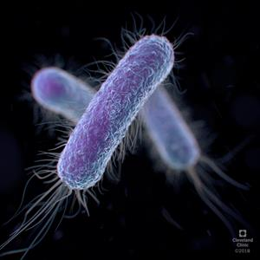
Detection of E.coli
O/100 mL in drinking water as recommended by WHO, EU.
Electrochemical detection techniques were used.
Cyclic voltammetry techniques were applied, and preliminary study were done using both SPGE and SPCE.
Preliminary study were done with both types of electrode as control sample and its looks promising for furthered study based on previous study DOI:
10.1016/j.proeng.2016.11.222

Slide 4
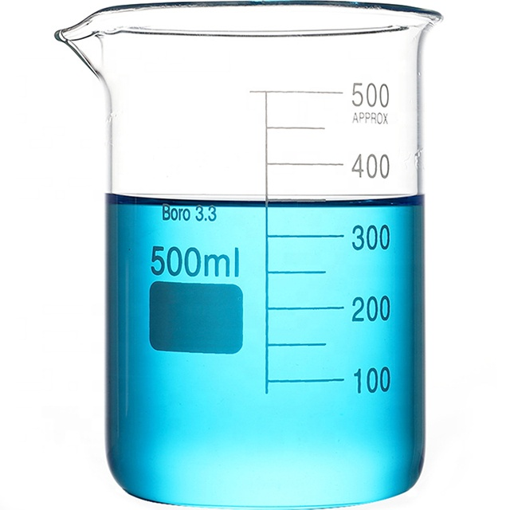
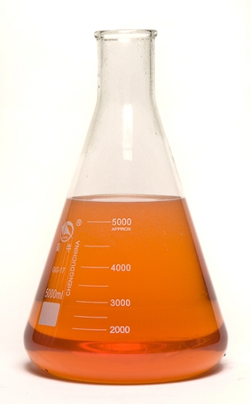
Preliminary confirmation study
LB = Control
LB+8-HQG = Negative control
LB+8-HQG+ENZ= Positive control
Water added
Incubation
LB media+salt for gluconidase enzyme+8-HQG
River water
Cyclic voltammetry
Control study with different electrode in 0.1 M PBS
Control study in LB media with SPCE
10.1016/j.proeng.2016.11.222

Slide 5
Future Plans:
Preliminary study was promising with both the SPGE and SPCE.
Study with the E.coli culture to induce the growth of enzyme by the bacteria itself and obtain the 8-HQ (electroactive species) to be detected electrochemically .
Calibration of the E.coli conc. detection to attain the LOD.

Slide 6
Detection of NH₃
High concentration of NH₃ ion-selective electrodes were prepared for the detection.
Open circuit potential was used for the detection.
Potential matrix Ammonia selective electrode
Reference electrode
(Ag/AgCl/KCl 3M)
Ammonia solution

Slide 7
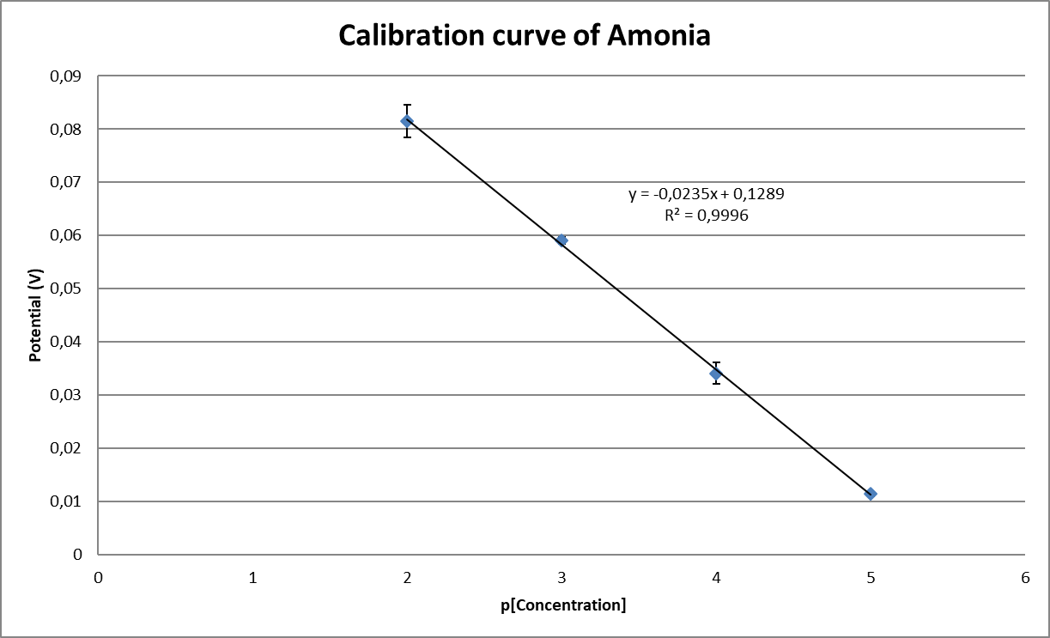
Results
The concentrations used for calibration curves were
10⁻⁵ M, 10⁻⁴ M, 10⁻³ M, 10⁻² M,
Future plans:-
Low concentration of ion-selective electrode for NH₃ can be prepared

Slide 8
Brief experiment procedure for phosphorus detection
Preparation of digestion reagent: - 1.5 g of potassium persulfate was dissolved in 20 mL milli-Q water containing 2.5 mL of digestion acid was added. It was diluted to 25 mL.
Mixed reagent: - 6.25 mL of H₂SO₄-Antimony was added and molybdate soln with 0.2 g ascorbic acid in 25 ml of volumetric flask which was later diluted to 25 mL by using milli-Q water
Phosphorus Standard (ppm) | Phosphate stock soln. (µL) | Dilution by milli-Q (mL) | Digestion reagent (mL) | Mixed reagent (mL)
1 | 30 | 30 | 1 | 0.5
5 | 150 | 30 | 1 | 0.5
10 | 300 | 30 | 1 | 0.5
50 | 1500 | 30 | 1 | 0.5
100 | 3000 | 30 | 1 | 0.5
After mixing incubate for 30 min.
Eisenreich, S.J., Bannerman, R.T. and Armstrong, D.E., 1975. A simplified phosphorus analysis technique. Environmental letters, 9(1), pp.43-53.

Slide 9
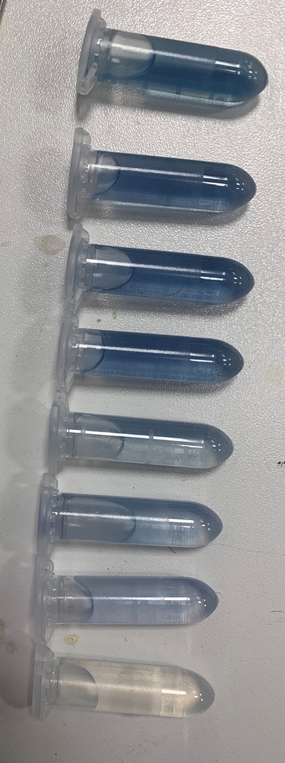
Result
Different concertation of phosphorus after reacting with the colouring agents

Slide 10
Interpretation
Group from Prof. Hubalek recommended some changes regarding the absorbance spectra from 880 nm to around 550-700.
Previous protocol was revised by increasing the amount of colouring reagent and measured at 650 nm.
Absorbance was measured after 2 h of incubation

Slide 11
Future plan
Results are encouraging and need to be modified using different procedures to achieve required limit of detection in collaboration with other colleagues.
We are also working on another procedure for the phosphorus detection to have on standby if other colleagues face problem with the earlier procedure.

Slide 12
Detection of Uranium
Recommended by EU: 2.8-3 Bq/L
Preliminary study.
Carbon paste electrode, GCE modified with MWCNT, Screen Printed Carbon Electrode (SPCE) and SPGE (Screen Printed Gold Electrode) were used. Direct Stripping adsorption voltametric techniques were used. This Preliminary study was not successful
Ligand such as propyl gallate and chloranilic acid will be used for Ur detectionas claimed by previous studies. No promising results is obtained after using the propyl gallate ligand.
Future
Chloranilic acid will be used as ligand for the detection. Literature study will be done to obtain an effective mechanism for the detection.

Slide 13
Thank you for your attention

