Slide 1
Inter-Reg WaterMon Project
Half yearly progress report
By
Atripan Mukherjee, Amirmansoor Ashrafi & Lukas Richtera

Slide 2
Objective
Detection of E.coli.
Detection of Ammonia, phosphates.
Detection of Uranium

Slide 3
Potential matrix Ammonia selective electrode

Slide 4
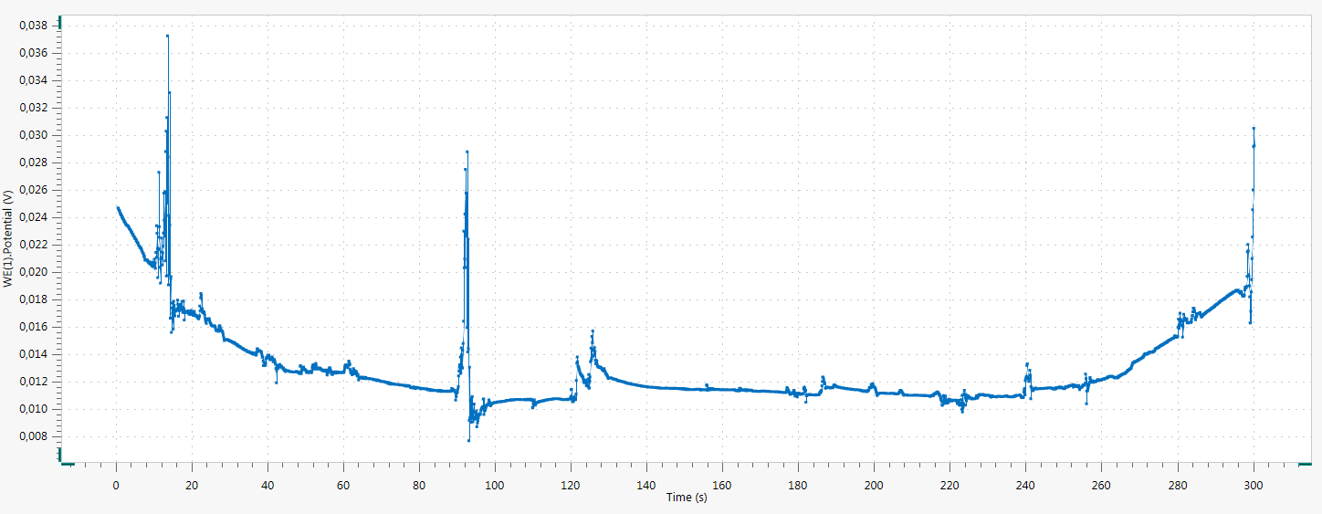
Concentration of Ammonia: 10^⁻⁵ m

Slide 5
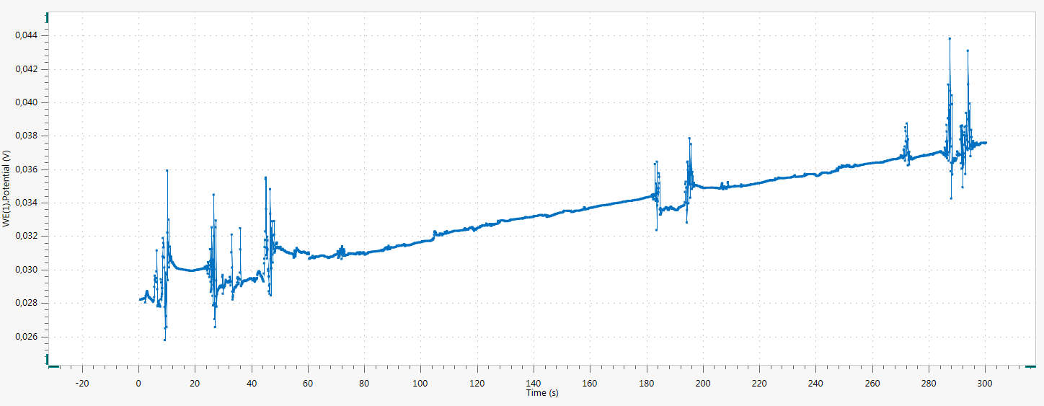
Concentration of Ammonia: 10^⁻⁴ m

Slide 6
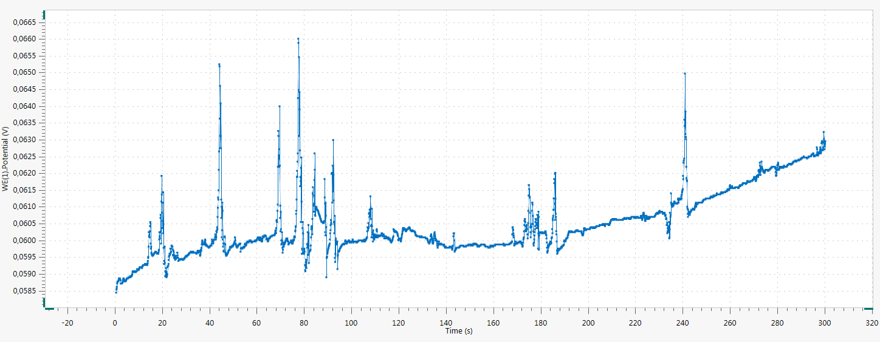
Concentration of Ammonia: 10^⁻³ m

Slide 7
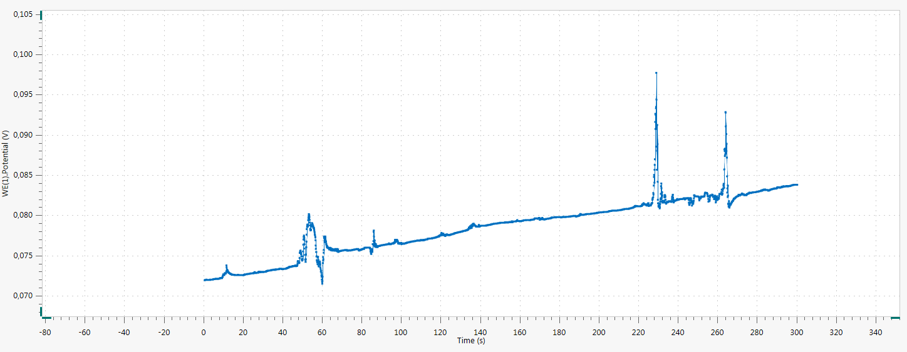
Concentration of Ammonia: 10^⁻² m

Slide 8
Procedure for phosphorus detection:-
Stock solution preparation: -
H₂SO₄-Antinony: - Mix 13.325ml of concentrated H₂SO₄ with 62.5 ml of distilled water and cool; dissolve .187g of Potassium antimony(III) tartrate hydrate and dilute to 250 mL. Remove any precipitate formed by filtration.
Molybdate: Dissolve 5.42 g of sodium molybdate in about 250 mL and dilute to 500 mL.
Digestion acid: - Mix 25.0 mL of Conc. H₂SO₄ with 125 mL of milli-Q water, cooled and diluted to 250 mL.
Standard phosphorous: - To make 1000 ppm P stock solution, dissolve 4.3937 g of dried KH2P04 in deionized H20 then dilute to 1 L. (10 ppm: 1 mL of 1000 ppm stock diluted to 100 mL).
Eisenreich, S.J., Bannerman, R.T. and Armstrong, D.E., 1975. A simplified phosphorus analysis technique. Environmental letters, 9(1), pp.43-53.

Slide 9
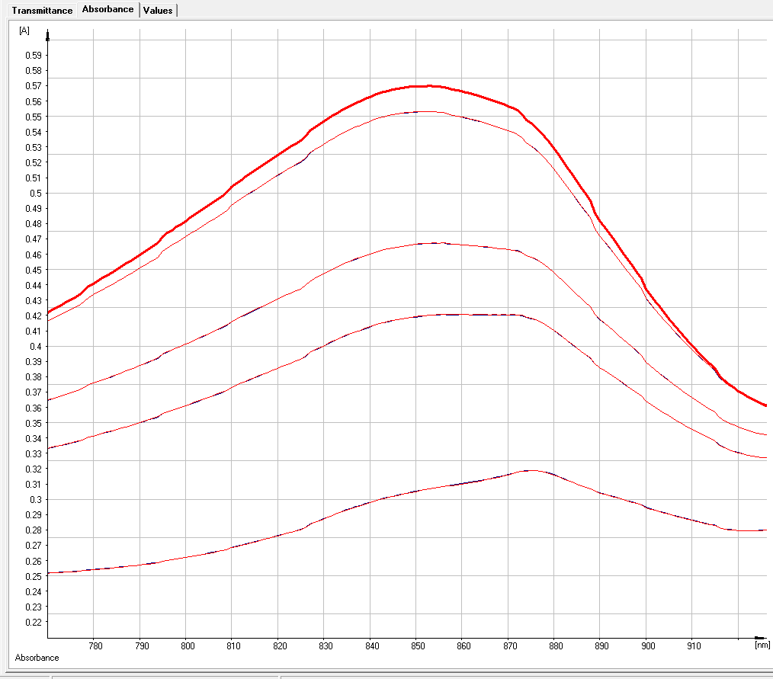
Result
100 ppm
50 ppm
10 ppm
5 ppm
1 ppm

Slide 10
Calibration data

