Slide 1

INTERREG Meeting
ATCZ-86
WaterMon
19.01.2021

Slide 2
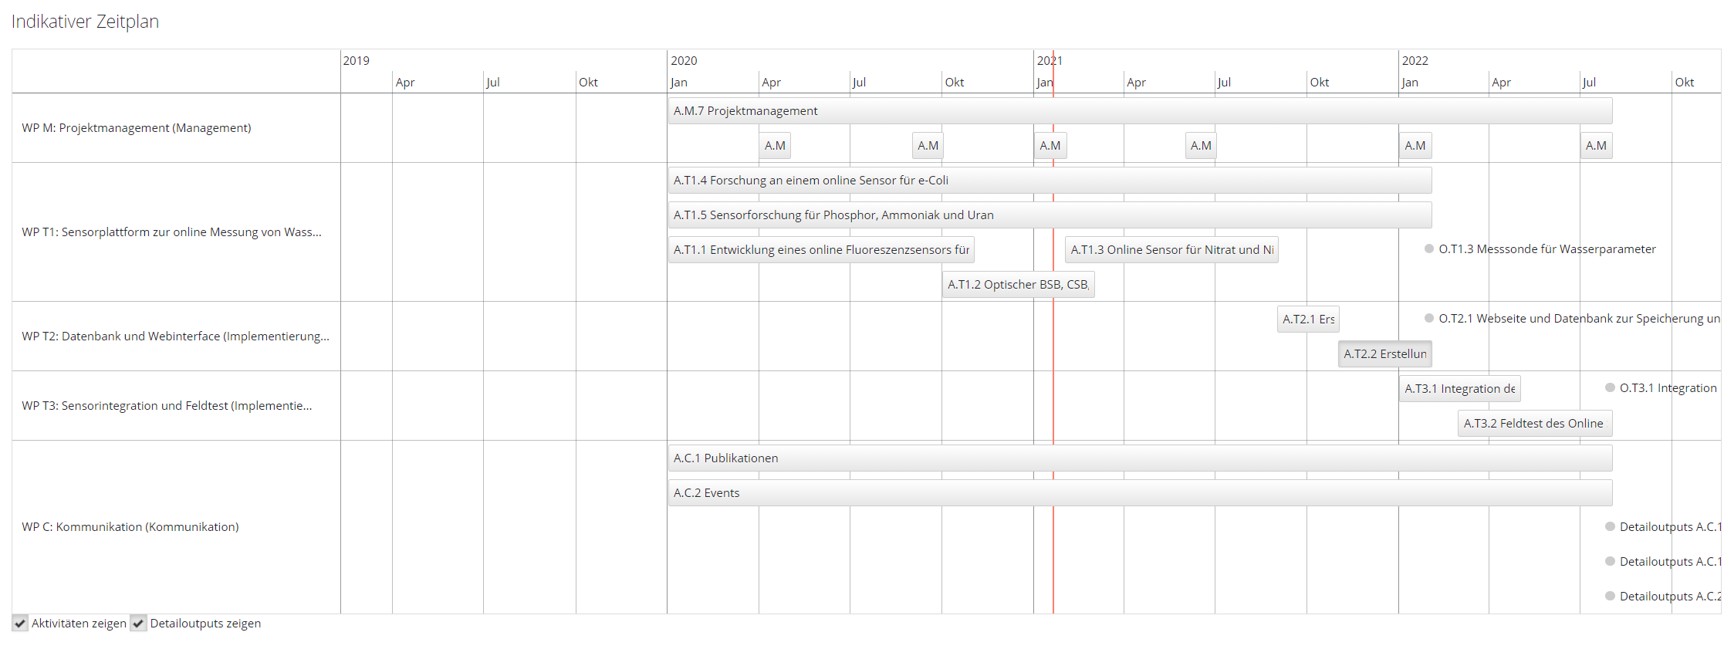
Project Management

Slide 3
Report Periods
Nr. der Berichtsperiode / Pořadové číslo monitorovacího období | Beginn der Berichtsperiode / Začátek monitorovacího období | Ende der Berichtsperiode / Konec monitorovacího období | Art des Projektberichts / Druh Zprávy o projektu
0 | 01.06.2019 | 31.12.2019 | Zwischenbericht_Průběžná
1 | 01.01.2020 | 31.12.2020 | Zwischenbericht_Průběžná
2 | 01.01.2021 | 31.12.2021 | Zwischenbericht_Průběžná
3 | 01.01.2022 | 31.12.2022 | Endbericht_Závěrečná
4
5
6

Slide 4
Parameters
Physical, chemical parameters
  DUK: COD, BOD, DOM, Temperature, Nitrate, Nitrite, BIX, FIX, Oil film
  CEITEC-VUT: Phosphorus, Ammonia, Uranium
Microbiological parameters
  CEITEC-VUT: e-coli
  DUK: e.g. Cyanobacteria (cyanotoxins - microcystin…)

Slide 5
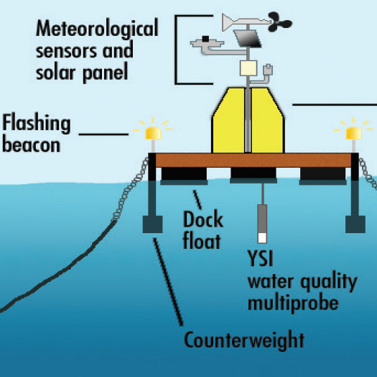
Monitoring-Station Concept
Solar panel, Battery
Wireless interface
Power supply
Sensors DUK
Control unit
Buoy or stationary station
Sensors CEITEC
Open Points:
Supply voltage, power consumption - power management
Interfaces - bus protocol
Overall size, module size
Security protection (data protection, stealing of station)
Notes:
Power should supplied by a solar panel

Slide 6
System architecture
Solar Panel
Water outlet
Waste outlet
Reagent
Buffer
Reagent
Waste reservoir
Optical sensor
(DUK)
Colorimetric sensor
(DUK)
Electrochem. sensor
(MENDELU)
Colorimetric sensor
(BUT)
Reservoir
Data interface
(DUK)
Power Management
(CEITEC)
Battery
Power control
(CEITEC)
Pump
Data server
(DUK)
GSM
(DUK)
CPU
(DUK)
IMU
Memory
Filter
River water inlet

Slide 7
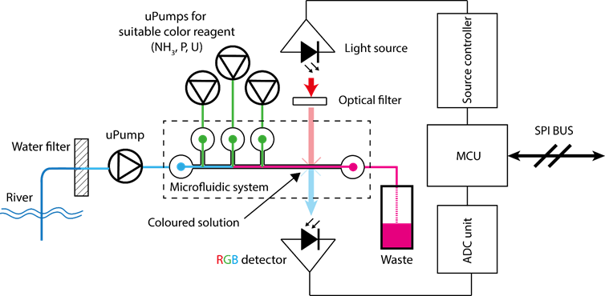
Colorimetric device concept
Power consumption:
defined mainly by pumps
Size:
due to microfluidic could be cartridge size – easily exchangeable

Slide 8
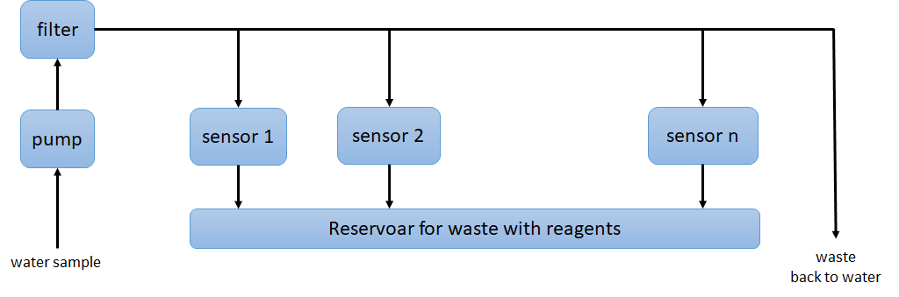
Solution for multi-colorimetric analysis
•We can make join platform for sample distribution
•Microfluidic system assure very low consumption of reagent and low waste

Slide 9
Power Supply
Power supply by solar panel
  Design: Power consumption by modules?
  Main supply voltage: 12V/DC
  Sampling period: 1/week, on request, (max.1/Dy)
  1 common pump for all modules open
  VUT: 5V, 1A max - Wh according to sampling
  Ceitec: 2x per day for 30 minuts, we need 5V 500mA - 2.5Wh for e-Coli
  DUK: Module 30x30x30cm, 30min, 2Amax, 5V
  cooling of the device, ventilation

Slide 10
Communication
Protocol for communication between the modules
  5V RX/TX UART protocol
Communication station <-> database
  GSM
GPS Module
  for safety reasons

Slide 11
Control Board
Stand alone sensor modules (uC & pump on board)
Control board collect data
  main pump
  data transfer to/from data base
  Offline data (raw data) storage (e.g. SD-card)
  e.g. software update via SD-Card
  GPS position, alarm if position is changed
  alarm if parameters out of range (Temp, moisture, voltage…)
Power management
  Solar pannel
  Battery
  Power scheduler
  Fan, air condition
  Status lights

Slide 12
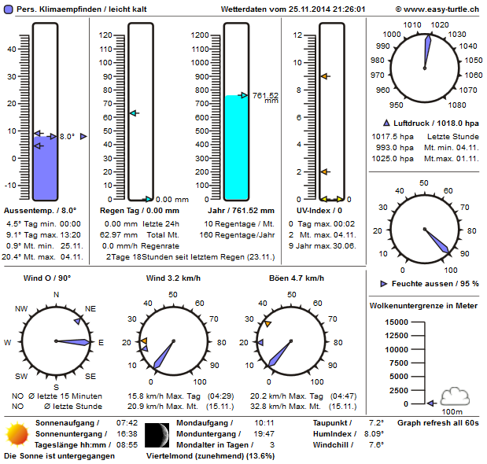



Webserver & Webpage
Antenna
Antenna
Y
Y
GSM Data Transfer
Water Quality
Sensor
Webserver
Webpage
Authorization
required
River
User

Slide 13
Suggestions
Sensor modules 3x
Reservoir for immediate samping based on GMS request

Slide 14


Publicity
There is a database (iBox) on the program website (www.at-cz.eu), which serves as each project's own website. The lead partner is obliged to update the iBox regularly (at least once per reporting period) with evidence of activities undertaken, outputs and results achieved, and information and publicity measures. Access data will be provided to the lead partner only upon conclusion of the ERDF funding contract.
Each project partner is obliged to display a poster (minimum size A3) with the program logo and information about the project, indicating the financial support provided by the program, in a suitable, clearly visible place accessible to the public throughout the project duration.
Roll up pannel
The program logo must be used for all information and communication measures with which a project partner approaches the public (printed materials, audiovisual materials, lists of participants, etc.).
Download on Website

Slide 15
Project Plan (DUK)

Slide 16
ToDo’s
Date | Subject | Who | Until | Done | Comment
19.01.21 | Half-year meeting | MB | W4
 | Reporting in iBox (every reporting period) | MB | W9
 | Project Poster A3 | MB | W4

