Slide 1
Compost Workshop
Estonia - 6 October 2017
COMPOSTING and COMPOST QUALITY –
How to manage – how to achieve – how to evaluate?
Florian Amlinger
Compost – Consulting & Development
100NGO

Slide 2
Draft EU FertReg - Compost /
Digestate Quality Criteria
 | SOLID ORG. FERTILISER [compost] |  | SOIL IMPROVER [compost] | LIQUID ORG. FERTILISER [digestate]
Dry matter % Fresh Matter | > 40% |  |  | < 40%
N total % Fresh Matter | ≥ 2.5 % |  | ---. | ≥ 2 %
P₂O₅ total % Fresh Matter | ≥ 2% |  | --- | ≥ 1%
K₂O total % Fresh Matter | ≥ 2% |  | --- | ≥ 2%
Org. CARBON % Fresh Matter | ≥ 15% |  | ≥ 7.5% | ≥ 5%
Stability
OXIGEN UPTAKE RATE mmol O2/kg organic matter/h | ≤ 25 mmol |  |  | ≤ 50 mmol
SELF HEATING FACTOR | Rottegrad III (40 - 50 °C) |  |  | ---
Residual Biogas Potential Litre biogas / g volatile solids | --- | --- |  | 0,45 l biogas

Slide 3
Draft EU FertReg - Compost /
Digestate Quality Criteria
 | SOLID ORG. FERTILISER [compost] | SOIL IMPROVER [compost] |  | LIQUID ORG. FERTILISER [digestate]
Cd (mg/kg d.m.) | 1.5 | 3 (+ growing medium) |  | 1.5
Cr (mg/kg d.m.) | Cr^{VI}: 2
Hg (mg/kg d.m.) | 1
Ni (mg/kg d.m.) | 50 (growing medium: 100)
Pb (mg/kg d.m.) | 120 (growing medium: 150)
Cu (mg/kg d.m.) | DECLARE ABOVE 200 mg
Zn (mg/kg d.m.) | DECLARE ABOVE 600 mg
PAH₁₆* (mg/kg d.m.) | 6
Biuret (C₂H₅N₃O₂) (g/kg d.m.) | 12 |  | --- | 12
Salmonellae | ABSENT in 25 g
E. coli OR Entercoccaceae | < 1000 CFU/g fresh mass
Impurities (glass, metal, plastics) in > 2 mm (% d.m.) | NOW: < 0,5 % AFTER 8 YEARS: < 0,25 %

Slide 4
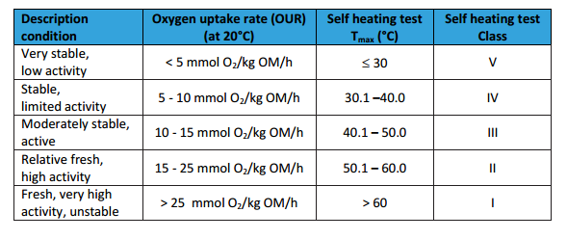
„Maturity“ / „Stability“ Criteria for COMPOST
Example from VLACO/BE – Wim Van den Auweele
Based on historical dataset of Flemish compost samples, the correlation between the SHT (Rottegrad, determined at 22 ± 2 °C) and the OUR (determined at 20 ± 2 °C) is:

Slide 5
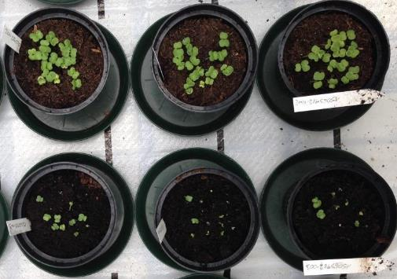
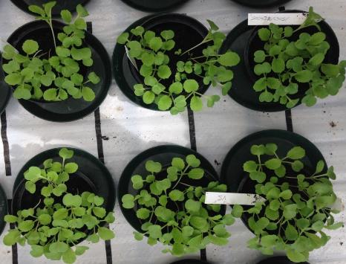
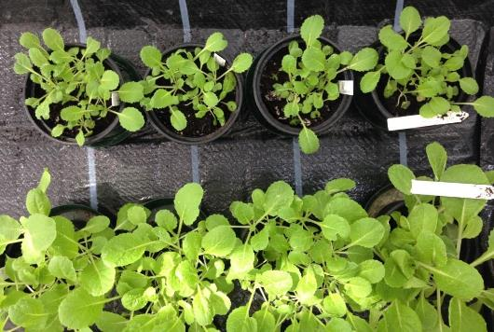
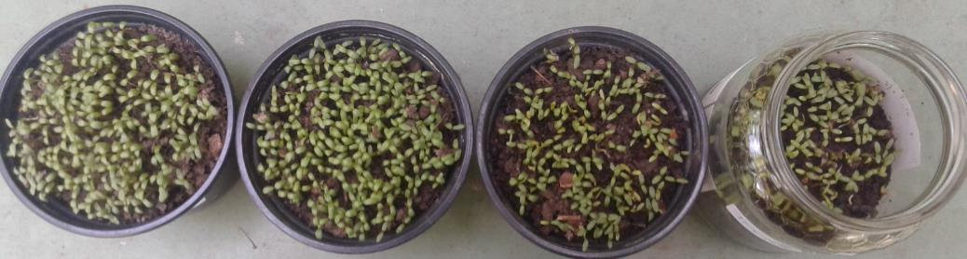
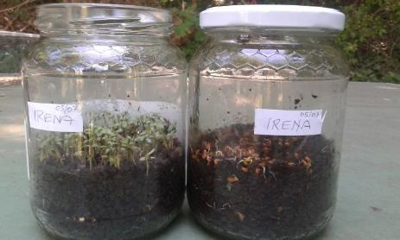
Plant Response
➔ growing media, bagged … 25% compost ➔ > 95% biomass
➔ private gardening 50% compost ➔ > 90% biomass
relative to standard substrate
Cress (Lepidium sativum) & Chinese cabbage (Brassica rapa ssp chinensis)
OPEN & CLOSED CRESS TEST:
  Fully mature Compost ➔ 100% performance in both tests

Slide 6

Minimum STANDARDS for
Open Windrow composting
Minimum bulky/structure material
  BIO-WASTE
    Bulk density Bio-waste URBAN: ~ 0,75 t/m³.
    Bulk density Bio-waste RURAL: ~ 0,5 t/m³
    Volume reduction composting: ca. ~ 40 – 70 %
Origin of Bio-waste | Min % shredded wood per year | By Volume (v/v)
RURAL | 15% + oversize screenings | 1 : 0,5
URBAN | 25% + oversize screenings | 1 : 1
  SEWAGE SLUDGE
    Bulk density shredded wood: 0,25 - 0,35 t/m³.
    Bulk density Sewage sludge: 0,8 – 1,0 t/m³
    Volume reduction composting: ca. ~ 50 %
Type of structure material | Min % structure material By MASS | By VOLUME
STRAW | 20% | 1 : 2,5 – 3
SHREDDED WOOD | 30% | 1 : 1,5 – 2
Notes:
Excogenic means „External“

Slide 7

Minimum STANDARDS for Open Windrow composting
Windrow Size & Turning Frequency
BIO-WASTE & SEWAGE SLUDGE Composting
Height | Cross Section | Width | Turnings/ week | Minimum total rotting time
 |  |  |  | Bio-Waste | Sewage Sludge
< 1,5 m | 3 m³/m | 3 m | 2 -5 | 7 | 8
 |  |  | 1 | 8 | 10
1,5 – 1,8 m | 3 - 4 m³/m | 3,5 m | 2-5 | 8 | 9
 |  |  | 1 | 10 | 12
1,8 – 2,2 m | 4 - 6 m³/m | 4,5 m | 2-5 | 9 | 10
 |  |  | 1 | only with aeration | only with aeration
2,2 – 2,5 m | 6 - 7,5 m³/m | 5 m | 2-5 | 10 | only with aeration
 |  |  | 1 | only with aeration | only with aeration

Slide 8
AT Compost Ordinance / Quality Criteria: LIMIT Values
 | Class A+ ORGANIC FARMING | Class A ALL / GENERAL FARMING | Class B NON FOOD
Compost from SOURCE SEPARATED BIO-WASTE
Cd (mg/kg d.m.) | 0.7 | 1 | 3
Cr (CrVI) (mg/kg d.m.) | 70 (0) | 70 | 250
Hg (mg/kg d.m.) | 0.4 | 0.7 | 3
Ni (mg/kg d.m.) | 25 | 60 | 100
Pb (mg/kg d.m.) | 45 | 120 | 200
Cu (mg/kg d.m.) | 70 | 150 | 500 (400)*
Zn (mg/kg d.m.) | 200 | 500 | 1800 (1200)*
MIXED WASTE Compost additionally:
PAH₁₆* (mg/kg d.m.) | -- | -- | 6
AOX (mg/kg d.m.) | -- | -- | 500
Oil based HC (mg/kg d.m.) | -- | -- | 3000
PCB (mg/kg d.m.) | -- | -- | 1
Dioxin (ng Teq/kg d.m.) | -- | -- | 50
* Declaration threshold Cu = 400 mg // / Zn = 1200 mg

Slide 9
AT Compost Ordinance USE RELATED Quality Criteria | GROWING MEDIA / priv.GARDENING / in BAGS | FARMING | Landscaping | Landfill Reclamatioln
Org. Matter (% d.m.) | > 20 | > 20 | > 20 | > 20
El. Conductivity (mS/cm) | ≤ 3 | -- | -- | --
Max. particle size (mm) | 40 | 40 | 40 | 40
Σ Impurities >2 mm (% d.m.) | 0.5 | 0.5 | 1.0 | 1.0
Plastics >2 mm (% d.m.) | 0.2 | 0.2 | 0.4 | 0.4
Plastics >20 mm (% d.m.) | 0.02 | 0.02 | 0.04 | 0.04
Metals (% d.m.) | 0.2 | 0.2 | -- | --
Glas (% d.m.) | 0.2 | 0.2 | -- | --
Growth Test with “CRESS” [Lipidium sativum] | Biomass [% of standard substrate] | -- | -- | --
25 Vol-% compost:
 | > 95% | -- | -- | --
50 Vol-% compost: | > 90% | -- | -- | --
Viable seeds / weeds | ≤ 3 / litre | -- | -- | --
Salmonellae | none | none | none | none
Pathogenic E.coli | none | none | None in play / sport grounds | --
Campylobacter | none | -- | -- | --
Listeria sp. | none | -- | -- | --

Slide 10
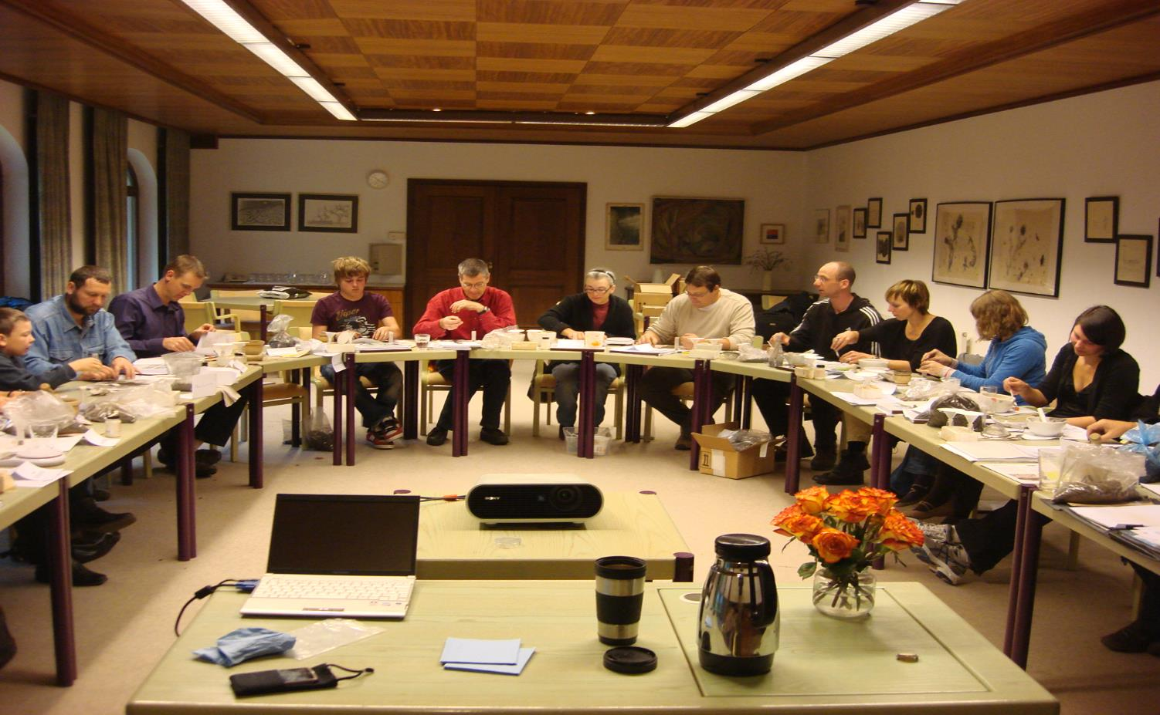
Kompostimise õppepäev:
… kuidas mõista komposti kvaliteeti?
Criteria for the „Komposkar“
Award
Quick tests for practice and learning
NO2 0
NO3 200 – 300 mg/kg
NH4 <2 mg/kg
pH actual (in H2O) 7 – 8
pH potential (in 1 N KCl) 7 – 8
Difference pH act. – pH pot. < 0,3
Sulfid 0
El. Conductivity < 3 mS /cm
Cress Test positive !
Additional Laboratory tests and requirements
Organic matter 20 – 35 % d.m.
Impurities < 0,5% d.m.
Heavy metal limits for agricultural use
Salmonella: 0
Pathogenic E. Coli 0
> 55 °C for 10 days and 2 – 3 turnings

Slide 11
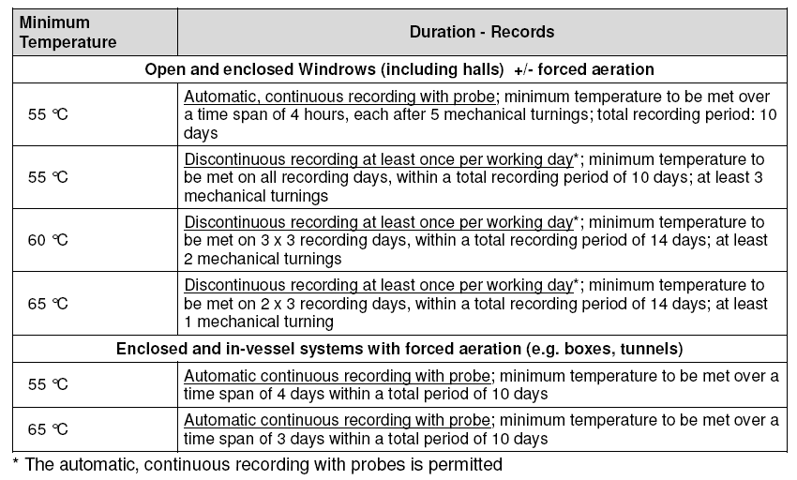
FLEXIBLE Time –Temperature profile for composting – as required e.g. in Austria
https://www.bmlfuw.gv.at/greentec/abfall-ressourcen/behandlung-verwertung/behandlung-biotechnisch/richtlinie_sdt.html

Slide 12
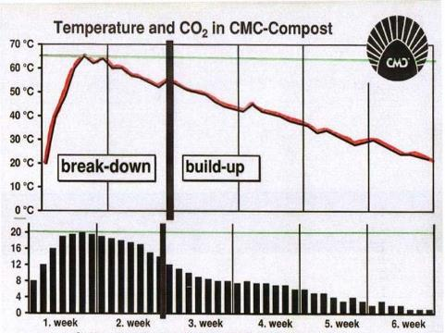

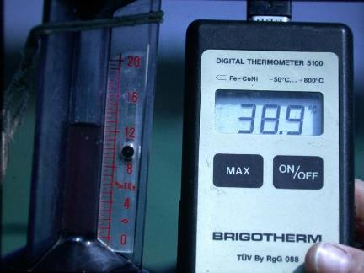
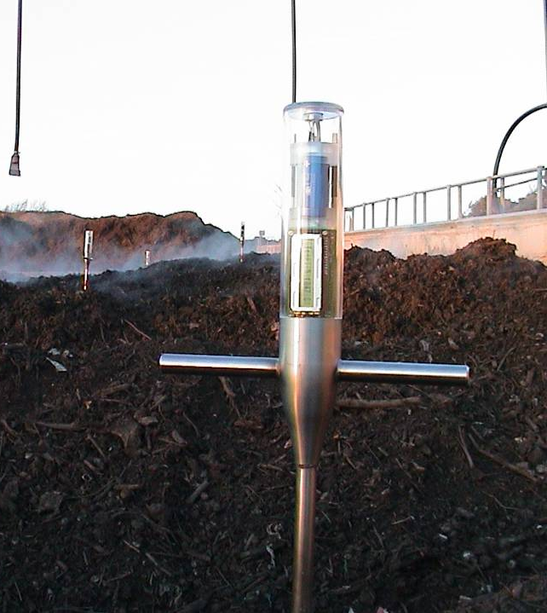
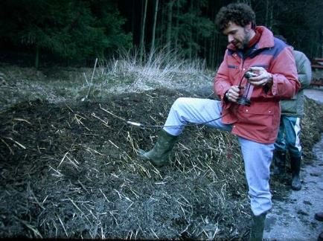
ºC & CO₂ in a controlled process
The controlled
process: °C & CO₂
ºC
CO₂
Temperature max. 60-65 °C
Sufficient OXIGEN min. 5 (1)%
Maximum CO₂ max. 10 – 15 %

Slide 13
Use of ABP in Biogas/Compost
(roughly separated into 4 groups)
Possible input material:
Required treatment:
Manure, DT-Content (Cat.2), milk & milk products; bio-waste without catering waste
No specific pre-treatment required! (Exemption: Suspect of infectious diseases)
Catering waste (Cat.3),
former foodstuff
National rules are applicable;
-> Products may only be placed on the market within MS !
Other Cat.3-Material
i.e. slaughter waste, blood, fat, feathers, bristles, etc.
EU-standard parameters apply
(70°C, 60 min, 12 mm)
or Validated Process
Other Cat.2-Material
i.e. parts of inedible animals
Pressure sterilisation (‚Method 1‘) - beforehand in an approved rendering plant

Slide 14
National Implementation of the ABPR
ABP-Regulation (EC) 1069/2009
  National rules for catering waste (households, restaurants)
  OPEN WINDROW Composting ➔ OK
    … if all the material in the
    system is exposed over
    the required time to a
    defined temperature level
    ➔ TURNING
    ➔ MONITORING
Notes:
Excogenic means „External“

Slide 15
CATERING WASTE …. ➔ National rules
Member States may adopt or maintain national rules for:
  CATERING WASTE
    Food waste from central and household kitchens
  manure;
  digestive tract content separated from the digestive tract;
  milk; milk-based products; milk-derived products; colostrum; colostrum products;
  eggs; egg products;
  Processed former food stuff

Slide 16
CATERING WASTE …. ➔ National rules
Processing requirements COMPOSTING:
  CATERING WASTE from HOUHEHOLDS
    Mixing and treatment within 24 hours after tipping with suitable bulking agents in order to initiate an effective composting
  CATERING WASTE from CENTRAL KITCHENS / processed former foodstuff
    Mixing and treatment immediately after tipping with suitable bulking agents in order to initiate an effective composting
    Covering the windrows with fresh or mature compost, shredded material or geo-textiles (com-post fleece) throughout the thermal sanitisation period (~ 10 to 14 days)

Slide 17
Treatment of Catering Waste in Biogas Plants
Possible options according to Austrian ABP-Ordinance as no BAT for such treatment available for biogas-plant:
  Fermentation as thermophilic process at ≥ 55 °C with
  20 d retention time; particle size ≤ 12 mm or
  Mesophilic fermentation combined with pasteurisation
    Temperature ≥ 70 °C for 1 h, particle size ≤ 12 mm or
    Temperature ≥ 60 °C for 5 h, particle size ≤ 12 mm or
  Composting of fermentation-residues according to national standards (BAT, see above)

Slide 18
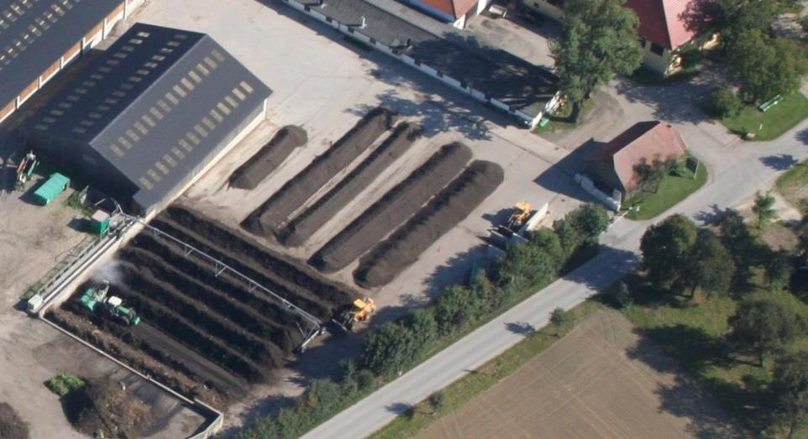
Hygiene Aspects in Process Management
Further Measures & Records (as part of the QM)
  watering, turning, aeration, material additions, screening…
& …… separating / working from DIRTY to CLEAN zone
Ready made
COMPOST
STORAGE
MATURATION
Phase
Intensive Composting
Hygienisation Phase
Delivery/tipping of Bio-waste
Foto: Courtesy of Seiringer
Umwelttechchnik GmbH

Slide 19
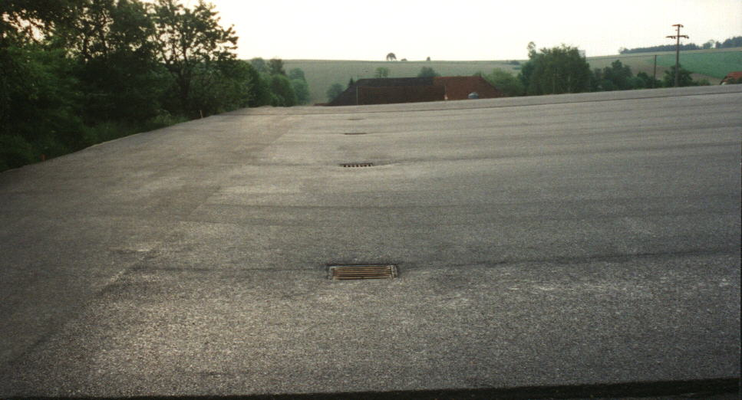
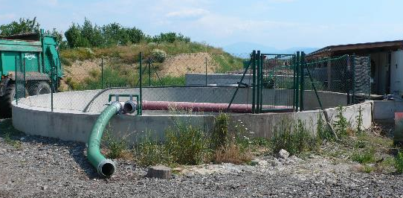
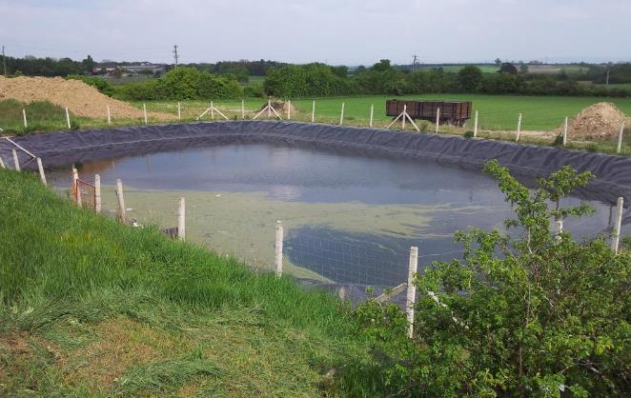
Sealed /paved surface for the main rotting area draining of rain and waste water
2.5 to 5 % slope

Slide 20
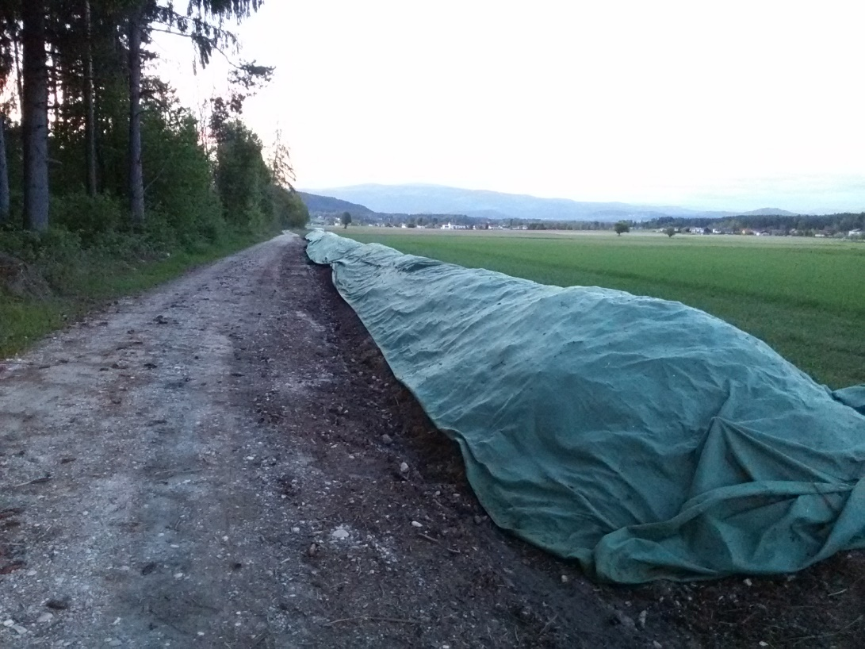
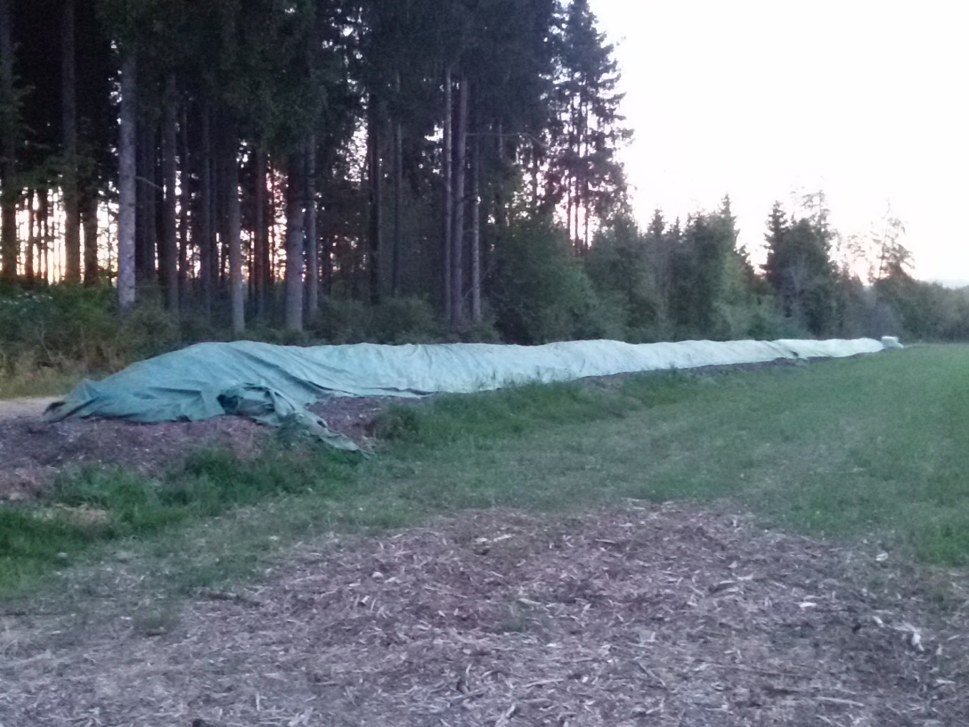
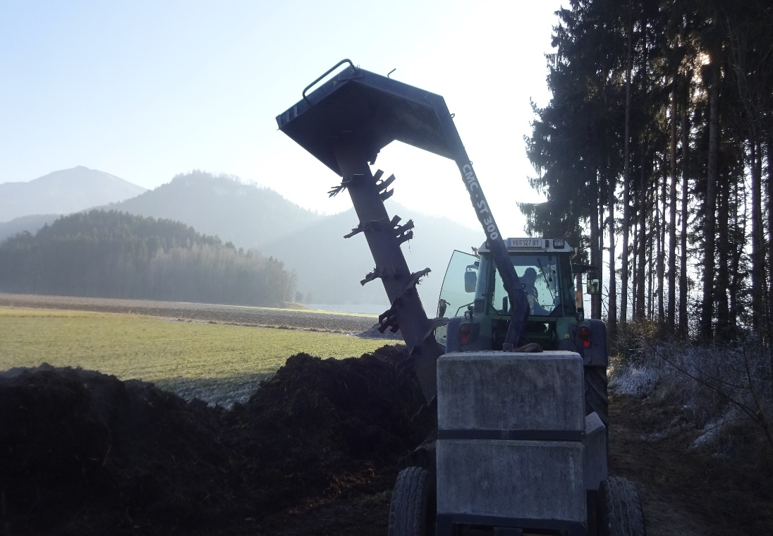
Composition
40 % shredded bush and tree cuttings
30% fine garden waste
10% rotted cattle manure
10% loamy soil
ON-FARM FIELD COMPOSTING
Composting
8 to 12 weeks (summer)
12 to 20 weeks (winter)
Turning : 5 to 3x/week
Screening: 10 to 20 mm

Slide 21
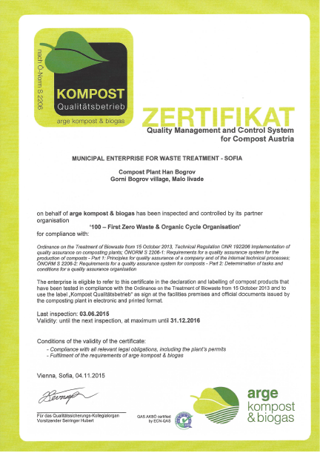





International QAS for compost http://eu100ngo.net/qas/
provided by: “100 NGO” / “Compost & Biogas Association Austria Austria”

Slide 22
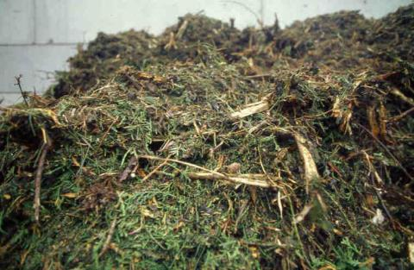
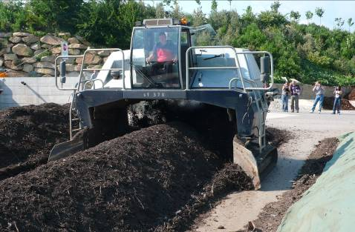
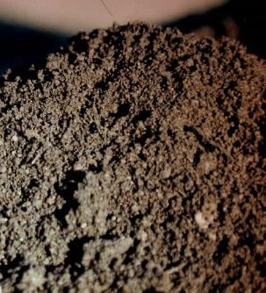
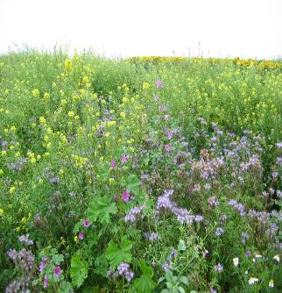
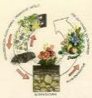

Many Thanks!
Florian Amlinger
eu100ngo@gmail.com
www.eu100ngo.net
Notes:
As the Draft Directive on Biological Treatment mandates source separation to be implemented also in towns, I want to show that purity of sorted waste depends not so much on the size of the population; it is linked to the type of scheme, instead.

